Slide 1

Assets for Independence (AFI) Program Overview
Office of Community Services
Administration for Children and Families
U.S. Department of Health and Human Services
Notes:
1

Slide 2
Administration for Children and Families (ACF)
Part of the US Department of Health & Human Services.
One of the key human services agencies within HHS.
Promotes the economic and social well-being of families, children, individuals and communities.
Responsible for funding many programs and services, including Head Start, child care, child welfare, child support, LIHEAP, family violence prevention, TANF, CSBG, and refugee services.
Notes:
Assets for Independence (AFI) is a discretionary grant program administered by the Office of Community Services (OCS) in the Administration for Children and Families (ACF).
Administration for Children and Families (ACF)
Part of the US Department of Health & Human Services.
One of the key human services agencies within HHS.
Promotes the economic and social well-being of families, children, individuals and communities.
Responsible for funding many programs and services, including Head Start, child care, child welfare, child support, LIHEAP, family violence prevention, TANF, CSBG, and refugee services.

Slide 3
Assets for Independence (AFI) Program
Purpose: Demonstrate and support an assets-based approach for increasing the economic self-sufficiency of low-income individuals and families.
What is asset building?
Supporting the acquisition of assets (both tangible, such as a home, and intangible, such as education) that can increase opportunities, build wealth, and increase economic stability.
  Income-support strategies, such as
  cash assistance and SNAP (food stamps),
  act as a safety net.
  Asset-building strategies act as a ladder.
Notes:
3
AFI was created by Congress in 1998 to demonstrate and support an assets-based approach for increasing the economic self-sufficiency of low-income individuals and families.
What is asset building?
Supporting the acquisition of assets (both tangible, such as a home, and intangible, such as education) that can increase opportunities, build wealth, and increase economic stability.
Income-support strategies, such as
cash assistance and SNAP (food stamps),
act as a safety net.
Asset-building strategies act as a ladder.

Slide 4
AFI Award Information
AFI is a discretionary grant program.
  Competitively awarded; typically more than one competition per fiscal year.
  Program is implemented by grantees.
  Organizations can have more than one AFI grant at a time.
General grant information:
  Maximum award: $1,000,000
  Minimum award: $10,000
  Grants have a 5 year period.
Notes:
4
AFI is a discretionary grant program.
Competitively awarded; typically more than one competition per fiscal year.
Program is implemented by grantees.
Organizations can have more than one AFI grant at a time.
In FY 2014, AFI was appropriated $19.026 million.
Approximately $10 million was awarded as grants.
Total of 44 grant awards were made.
General grant information:
Maximum award: $1,000,000
Minimum award: $10,000
Grants have a 5 year period.
Full funding is available upon award.

Slide 5
Fiscal Year 2014 Information
In FY 2014, AFI was appropriated $19.026 million.
  Approximately $10 million was awarded as grants.
  Total of 44 grant awards were made.

Slide 6
Which entities are eligible for AFI grants?
AFI is authorized to award grants to the following entities:
  Non-profit entities with 501(c)(3) status.
  State or local government agencies or tribal governments applying jointly with a non-profit with 501(c)(3) status.
  Federally certified Low-Income Credit Unions and Community Development Financial Institutions.
Notes:
6
The Assets for Independence (AFI) program is authorized to award AFI grants to the following entities:
Non-profit entities with 501(c)(3) status;
State or local government agencies, or tribal governments, applying jointly with a non-profit with 501(c)(3) status;
Financial institutions that are federally certified as either a Low-Income Credit Union or a Community Development Financial Institution and that demonstrate a collaborative relationship with a local community-based organization whose activities are designed to address poverty;
Entities deemed eligible under Section 405(g) of the AFI Act, specifically the Indiana Housing and Community Development Authority and the Pennsylvania Department of Community and Economic Development.

Slide 7
Assets for Independence (AFI) Program
Grantees provide Individual Development Accounts (IDAs) and related services to low-income people.
  IDAs are special use, matched savings accounts.
  AFI IDAs may be used for:
    To purchase a first home,
    To capitalize a business, or
    To fund post-secondary education or training.
Notes:
7
AFI funds projects that provide Individual Development Accounts (IDAs) and related services to low-income people.
IDAs are matched savings accounts with a specific goal: purchasing an asset.
AFI IDAs may be used for:
To purchase a first home,
To capitalize a business, or
To fund post-secondary education or training.

Slide 8
Key AFI Program Requirements
Grantees are required to provide 100% non-federal cash match for their AFI grant. Application must document committed funds.
Grantees must expend at least 85% of project funds (both the federal AFI grant and non-federal funds) to match participant IDA savings.
Grantees must match participant IDA savings at a rate within the allowable range.
All asset purchases must be made in accordance with the specific requirements for each qualified expense.
Notes:
To summarize the Key AFI Program Requirements:
Grantees are required to provide 100% non-federal cash match for their AFI grant. Application must document committed funds.
Grantees must expend at least 85% of project funds (both the federal AFI grant and non-federal funds) to match participant IDA savings.
Grantees must match participant IDA savings at a rate within the allowable range.
All asset purchases must be made in accordance with the specific requirements for each qualified expense.

Slide 9
Participant Eligibility
Any individual who is a member of a household that is eligible for assistance under their state’s Temporary Assistance for Needy Families (TANF) program.
OR
Notes:
9
Grantees are required to determine whether prospective participants meet the federal eligibility requirements for participation in the AFI projects prior to enrollment in the project. Section 408 of the AFI Act limits eligibility for participation in AFI-funded projects as follows:
Any individual who is a member of a household that is eligible for assistance under their state’s Temporary Assistance for Needy Families (TANF) program.
OR
Any individual who is a member of a household that meets both of the following requirements:
Income Test - Adjusted gross income of the household is equal to or less than 200 percent of the federal poverty guidelines or the earned income tax credit limits.
Net Worth Test - Net worth of the household, as of the end of the calendar year preceding the determination of eligibility, does not exceed $10,000 (excluding value of the primary residence and one vehicle).

Slide 10
Participant Eligibility, cont.
Any individual who is a member of a household that meets both of the following requirements:
  Income Test - Adjusted gross income of the household is equal to or less than 200 percent of the federal poverty guidelines or the earned income tax credit limits.
  Net Worth Test - Net worth of the household, as of the end of the calendar year preceding the determination of eligibility, does not exceed $10,000 (excluding value of the primary residence and one vehicle).
Notes:
10
Any individual who is a member of a household that meets both of the following requirements:
Income Test - Adjusted gross income of the household is equal to or less than 200 percent of the federal poverty guidelines or the earned income tax credit limits.
Net Worth Test - Net worth of the household, as of the end of the calendar year preceding the determination of eligibility, does not exceed $10,000 (excluding value of the primary residence and one vehicle).

Slide 11
How AFI Works: A Participant’s Perspective
Kim would like to purchase her first home.
An AFI grantee in her community determines that she is eligible and Kim opens her IDA.
The AFI grantee matches Kim's savings at a rate of $2 for every $1.
There is a local homeownership program through which Kim can purchase her home with $6,000 for down payment and closing costs.
Notes:
Now let's take a quick look at how an AFI IDA works from the perspective of a participant.
Kim would like to purchase her first home.
An AFI grantee in her community determines that Kim is eligible and Kim opens her IDA.
The AFI grantee matches Kim's savings at a rate of $2 for every $1.
There is a local homeownership program through which Kim can purchase her home with $6,000 for down payment and closing costs.
For 3 years, Kim saves $55 per month of her earned income, working towards a goal of $2000 in her IDA.
During this time, she receives financial education and homeownership training from the AFI grantee or its partners.
Kim saves $2,000 and purchases her home using her savings plus $4000 from the AFI grantee ($2,000 federal/$2,000 non-federal).
11

Slide 12
How AFI Works: A Participant’s Perspective
For 3 years, Kim saves $55 per month of her earned income, working towards a goal of $2000 in her IDA.
During this time, she receives tax assistance, financial education, and homeownership preparation from the AFI grantee and its partners.
Kim saves $2,000 and purchases her home using her savings plus $4000 from the AFI grantee ($2,000 federal/$2,000 non-federal).
Notes:
Now let's take a quick look at how an AFI IDA works from the perspective of a participant.
Kim would like to purchase her first home.
An AFI grantee in her community determines that Kim is eligible and Kim opens her IDA.
The AFI grantee matches Kim's savings at a rate of $2 for every $1.
There is a local homeownership program through which Kim can purchase her home with $6,000 for down payment and closing costs.
For 3 years, Kim saves $55 per month of her earned income, working towards a goal of $2000 in her IDA.
During this time, she receives financial education and homeownership training from the AFI grantee or its partners.
Kim saves $2,000 and purchases her home using her savings plus $4000 from the AFI grantee ($2,000 federal/$2,000 non-federal).
12

Slide 13
How AFI Works: Kim’s IDA
Kim saves $2,000
$2000
Savings
Combined
$6000
for
Home
$4000
Matching
$2,000 Federal
+ $2,000 Non - Federal
Notes:
Here we can see Kim’s scenario more visually. At the end of three years, Kim has saved $2,000 which will be matched with $2000 of federal AFI funds and $2000 of non-federal matching funds. Matched savings expanded Kim’s buying power and she uses the $6000 to purchase her home!

Slide 14
AFI Resource Center
The access point for AFI program technical assistance, including resources for potential applicants.
Website: idaresources.acf.hhs.gov
  Grantee Locator: http://idaresources.acf.hhs.gov/afigrantees
Help Desk:
    Phone: 1-866-778-6037
    Email: info@idaresources.org
Notes:
The AFI Resource Center is the access point for AFI program technical assistance.
Website: idaresources.acf.hhs.gov
Includes information for potential applicants
Grantee Locator: http://idaresources.acf.hhs.gov/afigrantees
Help Desk:
Phone: 1-866-778-6037
Email: info@idaresources.org

Slide 15
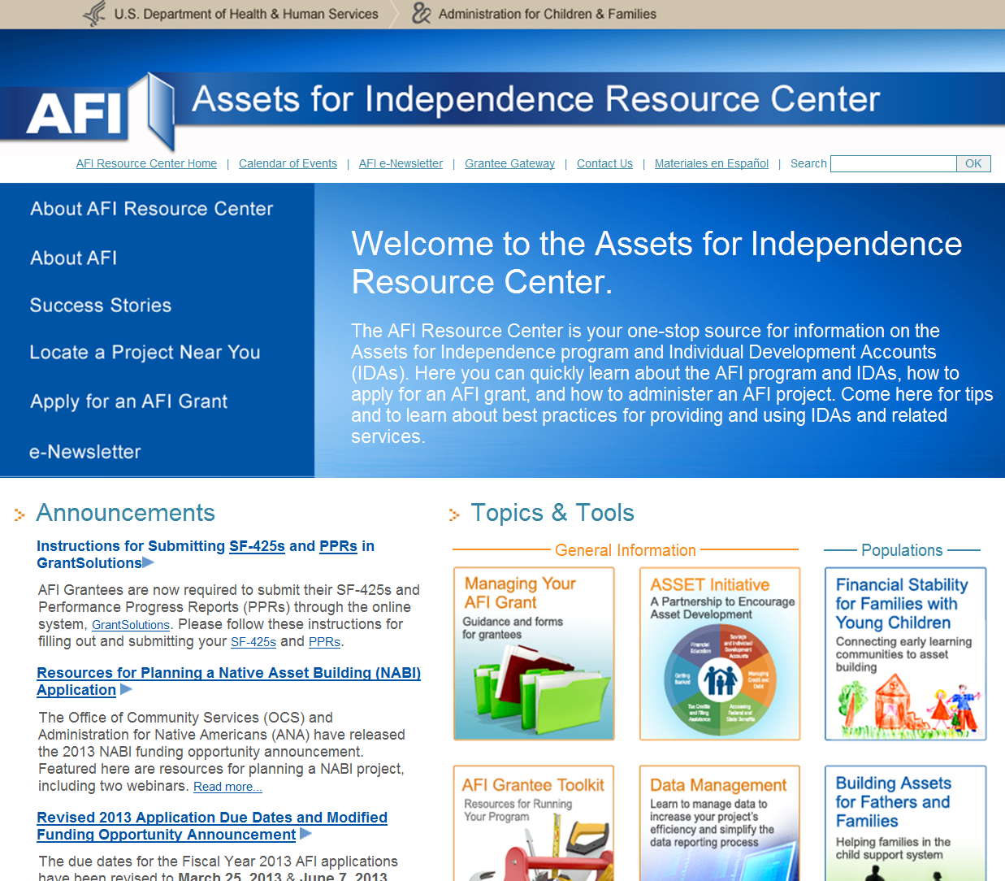
Notes:
Here’s what the AFI Resource Center home page looks like. To keep up with Resource Center events, periodically check out the calendar, which lists dates and registration links for AFI training, conference calls and other activities of interest to grantees.
In addition, by clicking on the buttons, you can find information on;
Managing your grant;
reporting requirements,
contact information,
how to apply for future AFI grants, and much more.
We particularly encourage you to explore ‘Managing your AFI Grant’ and the ‘AFI Grantee Toolkit’ under Topics & Tools. These how-to documents, templates, and checklists are useful resources for our grantees.
You can also find tips and resources for serving special populations, such as:
Native Americans,
Refugees,
Survivors of domestic violence,
Youth, and
People with disabilities.
And on asset building strategies, such as:
Financial education curricula and measurement
Using taxes to develop assets
Banking, and
Coordination with other services
The Resource Center publishes a quarterly newsletter on grantee accomplishments and new information arising from the field, and will send you occasional email blasts when there are special upcoming events or changes in policies or procedures.
AFI Resources is your main go to website for grant related subjects. Make sure that you bookmark it onto your computer.

