Slide 1
Financial Capability at the CFPB
Desmond Brown, Office of Financial Empowerment
Consumer Financial Protection Bureau
November 13, 2014

Slide 2
CFPB Mission
The mission of the Consumer Financial Protection Bureau is to make markets for consumer financial products and services work for consumers by making rules more effective, by consistently and fairly enforcing those rules, and by empowering consumers to take more control over their economic lives.
Notes:
CFPB was created in 2010, through passage of the Dodd Frank Act, in response to the abuses and failures of the financial system that caused the great recession in 2008
The vision of the CFPB is:
To encourage the development of a consumer finance marketplace
where customers can see prices and risks up front and where they can easily make product comparisons;
in which no one can build a business model around unfair, deceptive, or abusive practices;
that works for American consumers, responsible providers, and the economy as a whole.
We fulfill our Mission by:
Educate - An informed consumer is the first line of defense against abusive practices.
Enforce - We supervise banks, credit unions, and other financial companies, and we enforce federal consumer financial laws.
Study - We gather and analyze available information to better understand consumers, financial services providers, and consumer financial markets.
(Cleared Standard CFPB)

Slide 3
CFPB Divisions
Consumer Education & Engagement Consumer Response Research, Markets & Regulations Supervision, Enforcement, & Fair Lending External Affairs
Notes:
There are 6 divisions at the CFPB:
Consumer Education & Engagement – Will talk more about this next
Consumer Response – Charged with listening and responding to consumers’ concerns and provide information as they try to navigate the financial marketplace.
Research, Markets & Regulations – Work to understand conditions in the marketplace and understanding what works for consumers. Make common sense regulations that protect consumers.
Supervision, Enforcement, & Fair Lending – Regulate bank and non-bank financial institutions and take enforcement action when necessary.
External Affairs – Communicate with consumers and the general public about the Bureau.
Legal Division – Represents the legal interests of the Bureau.

Slide 4
Consumer Education and Engagement
Financial Education
Provide educational content and identify and promote effective practices
Consumer Engagement
Create interactive and informative relationships with consumers
Servicemembers
Students
Financial
Empowerment
Improve financial stability for 100 million low-income and economically vulnerable consumers
Improve financial protection
Monitor Service members complaints
Coordinate w/ DoD, etc.
22 million veterans
Older Americans
Protect against financial abuse
Improve financial literacy
50 million aged 62+
Monitor students complaints
Build campus awareness
22-28 million (age 16-26)
68 million unbanked or underbanked
33% of Americans earn 2x the federal poverty level or less
Increase awareness of debt when selecting a college
Planning for life events
2.2 million military personnel
Approximately 50 million have thin or no credit files
Notes:
(SAY ONE SENTENCE FOR EACH OFFICE)
Consumer Education and Engagement has two offices focused on all consumers, Financial Education and Consumer Engagement
Financial Education researches best practices, develops initiatives and disseminates information regarding financial education for all Americans
Consumer Education and Engagement develops tools and resources to engage consumers through our website, social media and other communications
And four population specific offices that were identified in Dodd Frank as having unique challenges in the financial marketplace
Servicemembers – issues related to current and former service-members and their families
Older Americans – financial issues and abuses unique to people as they age, move into retirement and plan for their families
Students – primarily focused on student lending and the cost of paying for college but expanding to address other unique financial challenges experienced by young people
Financial Empowerment - focuses on low-income and economically vulnerable consumers.
Cleared (standard CEE slide)

Slide 5
Office of Financial Empowerment
We work to:
Consumer Protection
Access
Managing
Money
Credit
Savings
Improve the Financial Marketplace
Build Financial Capability
Low-income
and
Economically Vulnerable
Notes:
Access to affordable and appropriate products and services is essential for low-income consumers to successfully navigate the financial marketplace
Money Management skills help people make the most of the money they have today and better plan for tomorrow
Savings is important in the short-term to withstand financial shocks and in the long-term to provide a stable financial situation for consumers and their families
Building and maintaining good credit is important so that consumers can access affordable products and services that will allow them to achieve their life goals.
Consumer protection is essential for consumers to both know their rights and be protected from adverse actions that could affect their financial stability.

Slide 6
Office of Financial Empowerment
Strategies | Goals | Initiatives
Tools | Access to actionable financial information, capability, and counseling tools | Your Money, Your Goals Financial Coaching
Collaboration | Integrate and scale financial empowerment strategies into programs and policies of federal agencies | Dep’t of Labor - People with Disabilities HHS – Summer Youth
Products and Policies | Identify, analyze and report on most promising products, services and policies | Tax-Time Savings Financial Outcome Measures Credit builder loan evaluation
Notes:
We work in three areas: Tools, Collaboration, and Products and Policies
Some of the examples of initiatives that we are engaged in are…(read initiatives)
Previously cleared

Slide 7
Your Money, Your Goals
Topics include:
Goals
Saving
Income and spending
Cash flow budgeting
Debt
Credit
Financial services
Consumer protection
Customizations and adaptations
Legal Aid
Community Volunteers
Workers
Notes:
Don’t read slide.
Rather than focus on equipping case managers to be financial coaches or counselors, we have chosen an approach that will provide training in key financial empowerment concepts and tools case managers can use to with their clients to incorporate key topics into their day-to-day interactions with clients.
Building case manager confidence about money management;
And equipping case managers to understand when and how start the conversation.
It includes assessments that, initially, help the case manager become aware of any gaps in their own knowledge and where they’d like to learn more – and to help clients identify their own financial management needs, goals, and information gaps.
Your Money, Your Goals is available for free download in English and Spanish at the CFPB’s website, consumerfinance.gov. Along with the toolkit, you’ll find training materials and an information guide. In just a moment we’ll share with you all the resources that are available for download and give you a “tour” of Your Money, Your Goals.
Cleared: Minnesota conference June 2014:

Slide 8
CFPB Initiative: Managing Someone Else’s Money
PROBLEM:
Declining capacity to handle finances can make older adults vulnerable
People with diminished capacity often need surrogate to handle their money
“Lay fiduciaries” – critical source of help; often have no training; some even commit fraud
CFPB INITIATIVE:
Released a set of guides called Managing Someone Else’s Money
User-friendly “how-to” guides for agents under powers of attorney, guardians, trustees, Social Security representative payees and VA fiduciaries
National guides available free in bulk http://promotions.usa.gov/cfpbpubs.html
Notes:
2 CFPB INITIATIVE:
Released a set of guides called Managing Someone Else’s Money
User-friendly “how-to” guides for agents under powers of attorney, guardians, trustees, Social Security representative payees and VA fiduciaries
The Office developed an awareness program called Money Smart for Older Adults in collaboration with the FDIC
Content on common issues facing seniors, including how to identify a potential scam or fraud
Materials for trainers to provide presentations on preventing, recognizing, and reporting elder financial exploitation
Participant guides and link to training module at http://www.consumerfinance.gov/older-americans/

Slide 9
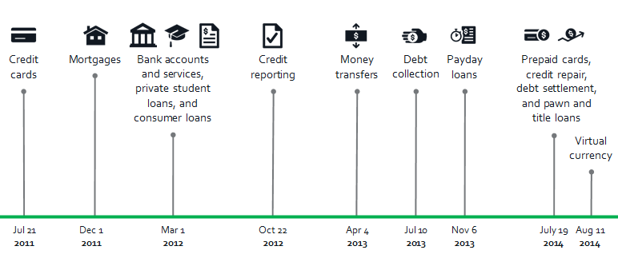
Complaints we accept now
As of September 1, 2014, we’ve handled over 439,800 complaints

Slide 10
CFPB Tools and Resources for Consumers
Tell Your Story: http://help.consumerfinance.gov/app/tellyourstory
Complaints: http://www.consumerfinance.gov/complaint/
Ask CFPB: http://www.consumerfinance.gov/askcfpb/
Your Money, Your Goals: http://www.consumerfinance.gov/your-money-your-goals/
Notes:
Review briefly each of the bullet points.
Short notes on each tool

Slide 11
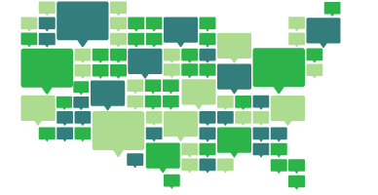
Contact the Office of Financial Empowerment at
empowerment@cfpb.gov
Notes:
One of the ways that we can reach millions of consumers is to partner with other government agencies.
Please visit our booth during the conference for more information and to sign-up to receive our emails.

