Slide 1
Financial Literacy and Education Commission: Coordinating Diverse Federal Efforts
Notes:
Thank you Sandy.
I’m pleased to be here to provide you with an overview of federal financial education activities and resources.
Then you hear from 3 agencies about specific tools and programs they have that you can use.

Slide 2
What is Financial Literacy or Financial Capability?
Financial capability is the capacity, based on knowledge, skills, and access, to manage financial resources effectively.
In order to develop this capacity, individuals must have appropriate access to and understanding of financial products, services, and concepts.
Notes:
We define financial capability as the capacity, based on knowledge, skills, and access, to manage financial resources effectively.
In order to develop this capacity, individuals must have appropriate access to and understanding of financial products, services, and concepts.
Financial capability includes:
Access to information
Ability to use information
Understanding of key concepts
Opportunity to use knowledge and information in appropriate settings

Slide 3
What is Financial Literacy or Financial Capability?
Financial capability empowers individuals to make informed choices, avoid pitfalls, know where to go for help, and take other actions to improve their present and long-term financial well-being.
Notes:
Financial capability empowers individuals to make informed choices, avoid pitfalls, know where to go for help, and take other actions to improve their present and long-term financial well-being.

Slide 4
FINANCIAL LITERACY
AND EDUCATION COMMISSION
FLEC is currently comprised of 22 federal entities and is chaired by the Secretary of the Treasury, with the Director of the Consumer Financial Protection Bureau as Vice Chair.
A full list of the Commission member entities and more information about the work on the Commission can be found in the “About Us” section of www.mymoney.gov.
Notes:
FLEC is currently comprised of 22 federal entities and is chaired by the Secretary of the Treasury, with the Director of the Consumer Financial Protection Bureau as Vice Chair.
HUD is a member, along with the other agencies you will hear from today.

Slide 5
FINANCIAL LITERACY AND EDUCATION COMMISSION: Key Functions
Improve the financial literacy and education of persons in the United States
Coordinate and enhance financial literacy and education programs, grants, and materials of the Federal Government
for all Americans
Maintain MyMoney.gov as a clearinghouse of information about Federal financial literacy and education programs
Notes:
Improve the financial literacy and education of Americans.
We coordinate and enhance financial literacy and education programs and resources of the Federal Government
Maintain MyMoney.gov as a clearinghouse of information about Federal financial literacy and education programs, about which more later.

Slide 6
FINANCIAL LITERACY AND EDUCATION COMMISSION: Key Functions
Promote financial literacy and education efforts among Federal, State, and local governments, nonprofit organizations, and private enterprises
Develop a National Strategy for Financial Literacy
Notes:
We also work to promote financially literacy beyond the federal government.
And develop a National Strategy for Financial Literacy

Slide 7
NATIONAL STRATEGY
FOR FINANCIAL LITERACY 2011
Sets the framework for financial education and literacy activities in policy, education, practice, research, and coordination through its vision and goals
Vision ̶ Sustain the financial well-being of U.S. individuals and families
Mission ̶ Set strategic direction for policy, education, practice, research, and coordination so that U.S. individuals and families make informed financial decisions
Notes:
Sets the framework for financial education and literacy
Toward the Vision: Sustain the financial well-being of U.S. individuals and families

Slide 8
FINANCIAL LITERACY AND EDUCATION COMMISSION: Key Functions
Goals:
Increase awareness of and access to effective financial education
Determine and integrate core competencies
Improve financial education infrastructure
Identify, enhance, and share effective practices
Notes:
Goals identified in the strategy include:
Increase awareness of and access to effective financial education
Determine and integrate core competencies
Improve financial education infrastructure
Identify, enhance, and share effective practices

Slide 9
FIVE FINANCIAL COMPETENCIES
Notes:
Here’s how we summarized the 5 financial competencies – or the mymoney 5
These are the 5 building blocks or main areas of financial knowledge:
Spending
Earning
Saving & Investing
Borrowing and
Protecting
You can find them on mymoney.gov, and use them to organize your financial education activities

Slide 10
MyMoney.gov
MyMoney.gov is the one-stop source for online financial education information from more than 20 federal entities
MyMoney.gov is organized by the five financial competencies and major life events
Notes:
MyMoney.gov is the one-stop source for online financial education information from more than 20 federal entities
MyMoney.gov is organized by the five financial competencies and major life events

Slide 11
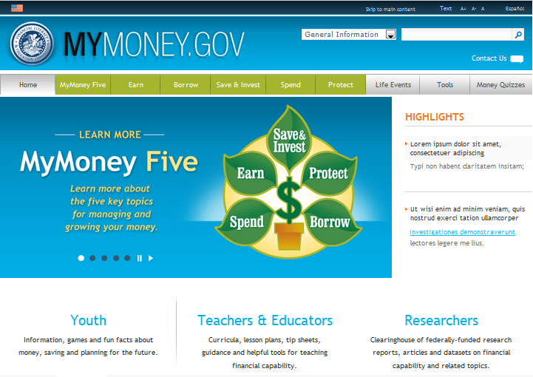
MyMoney.gov
Notes:
Here’s a sample.
You can see the myMoney 5
You can also search by life events, like graduation, new job, or birth of a child
And you can find info for youth, teachers/educators, and researchers

Slide 12
Treasury’s Role in Financial Education and Capability
Office of Consumer Policy
Policy office working to ensure that every American has access to safe and affordable financial products and services, and clear information that enables individuals to make sound financial decisions.
Leadership for the FLEC, and coordinates the President’s Advisory Council on Financial Capability for Young Americans
Notes:
Treasury’s engagement in financial capability is part of its purpose of protecting and promoting the economic health of the nation. We realize that the financial well-being of every household is important to the whole economy.
In addition to our coordination work, our office is supporting a number of projects that will develop, test, and evaluate new ways to empower Americans with their finances and help them access safe and affordable financial products and services. Through the Financial Empowerment Innovation Fund, Treasury will support research and analysis that will develop knowledge and insights, and identify new and effective practices in these areas. Among the items that we are testing:
Is a multi-part research project in San Francisco that seeks to lower the risk of eviction by providing innovative financial products and services to public housing residents. The project will: (i) provide the residents with general purpose reloadable debit cards for receiving wages and benefits, managing their finances, and facilitating the electronic payment of rent; (ii) provide financial coaching and counseling; and (iii) assist residents with building positive credit histories. It will also research the effects of a matched savings program that enables public housing residents to save for unplanned expenses.

Slide 13
myRA A Simple, Safe, Affordable Retirement Savings Account
myRA _{SM} (Retirement Account)
U.S. Department of the Treasury’s new program for people looking for a simple, safe, and affordable way to start saving for their retirement. Accounts are designed for:
Workers without access to OR who are ineligible for an employer-sponsored retirement savings plan.
Notes:
To help more Americans save for retirement, the President announced, in his 2014 State of the Union address, that Treasury would offer a new specially designed savings product to help, largely new savers, begin to save and invest for their futures.
Under the myRA program, workers looking to start saving will be able to invest in a specially-designed Treasury retirement savings bond held in a Roth IRA. To make saving easy, contributions will be made by payroll deposit at the workplace, and there are no contribution requirements or fees.

Slide 14
myRA A Simple, Safe, Affordable Retirement Savings Account
Key features of the myRA program
No fees
No cost to open an account
No minimum contribution OR balance requirements
Contributions automatic from every paycheck
Balances will never go down in value (backed by U.S. Treasury)
Employees keep myRA accounts when changing jobs
Roth IRA rules apply
Initial phase in late 2014, with a full launch in 2015.
Notes:
Key features of the myRA program
No fees
No cost to open an account
No minimum contribution OR balance requirements
Contributions automatic from every paycheck
Balances will never go down in value (backed by U.S. Treasury)
Employees keep myRA accounts when changing jobs
Initial phase in late 2014, with a full launch in 2015.

Slide 15
myRA A Simple, Safe, Affordable Retirement Savings Account
For more information visit
http://www.myRA.treasury.gov or email myRA@treasury.gov
Notes:
For more information, visit the website.

Slide 16
Building Financial Capability
is Collaborative
There are many resources to help you help the families you serve
Notes:
There are many resources to help you help the families you serve
Now I’ll turn to Luke Reynolds, who will talk about some of those resources.

