Slide 1
THE SUPPORTIVE SERVICES DEMONSTRATION FOR ELDERLY HOUSEHOLDS IN HUD-ASSISTED MULTIFAMILY HOUSING

Slide 2
Supportive Services Demonstration
Overview
Approximately $15 million under the FY2014 Consolidated Appropriations Act is being made available
Purpose: test a service model that can demonstrate the potential to delay or avoid the need for institutional long-term care
HUD-assisted multifamily properties that are elderly restricted and have at least 50 assisted units

Slide 3
WHY THIS? WHY NOW?

Slide 4
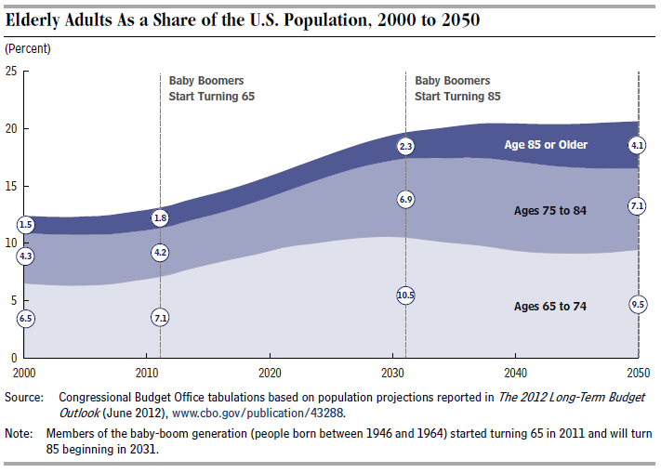
Background: Trends in Aging
Elderly Adults as a Share of the U.S. Population, 2000 to 2050
Source: 2013 CBO Report: Rising Demand for Long-Term Services and Supports for Elderly People

Slide 5
Engage in recreational, learning and social experiences
A Look at Successful Aging in Place
Access to community based services
Health Care Connections
Informal and formal caregiving
Affordable, safe and Accessible

Slide 6
A Look At Our Residents
Residents of HUD-assisted rental housing, especially older adults, tend to be extremely low-income, with higher-than-average healthcare utilization patterns.
Over 12,000 properties nationwide that are restricted to elderly households.
39% - between 62-74 years of age
27% - between the ages of 75-84
13% - between the ages of 85-99
1% are 100 years of age or older
67% of our residents are female
SSI is the primary source of income for 72%

Slide 7
DEMONSTRATION

Slide 8
Demonstration
Goal
Test a housing-with-services model to support Aging in Place
Delay or avoid transitions to nursing homes
Positive impacts on health and well-being

Slide 9
Supportive Services Model
What Gets Funded?
Interdisciplinary Team
Enhanced Service Coordinator
Wellness Nurse
HUD will also provide
Training
Resources
Technical assistance

Slide 10
Supportive Services Model
Core Components
Coordination/support of transitions
Support medication self-management
Falls prevention programs
Mental health programs
Engagement with providers
*Partnerships and regular meetings

Slide 11
Demonstration Design
Research Design
Treatment and control groups
Lottery process
A requirement to implement the model—with training, resources, and technical assistance!

Slide 12
Demonstration Design
Treatment and Control Groups
Treatment Group
Implementation of the Enhanced Service Coordinator and Wellness Nurse model
Control Group
Continues services as usual

Slide 13
Demonstration Design
Applicant Pool
Eligible Properties
Pool 1
Properties WITH Current SC
Pool 2
Properties WITHOUT Current SC

Slide 14
Demonstration Design
Applicant Pool
Pool 1 (SC)
Pool 2 (No SC)
CONTROL
No Intervention
Maintain SC Program
TREATMENT
Intervention
Implement Demo Model
TREATMENT
Intervention
Implement Demo Model
CONTROL
No Intervention

Slide 15
SUBMISSION PROCESS

Slide 16
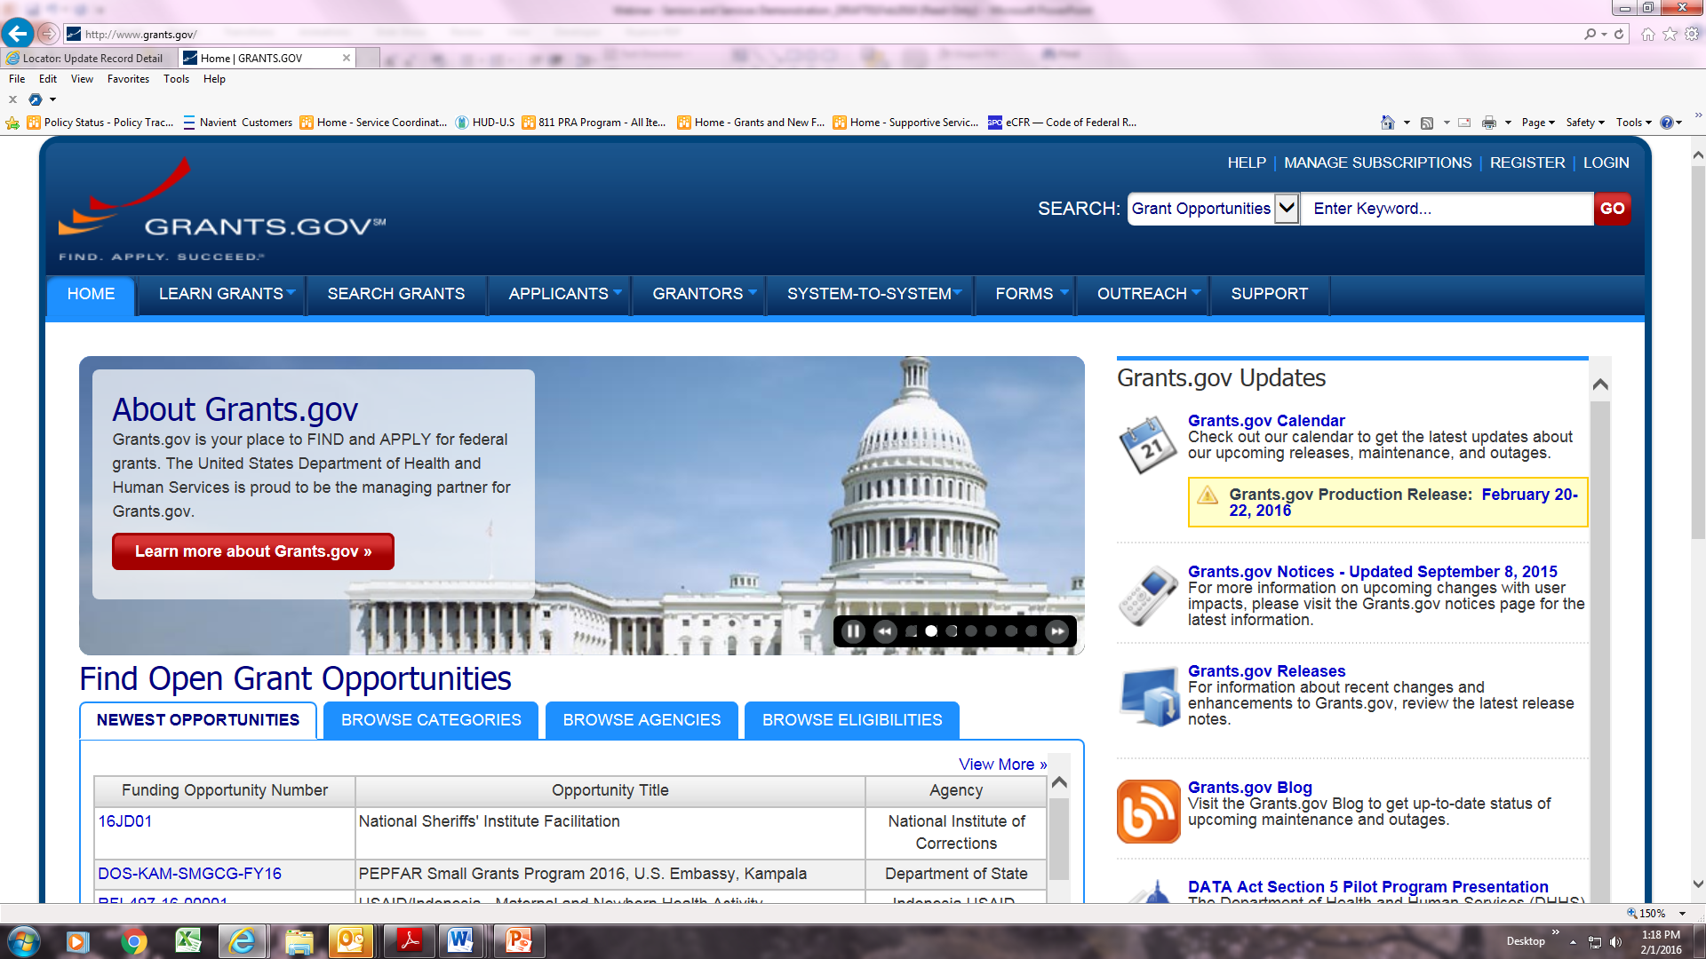
Downloading Package and Instructions FR-5900-N-22
Visit www.Grants.gov
Click the “SEARCH GRANTS” tab to access the page
Enter the criteria to access this grant opportunity
Download Instructions and Package by clicking the appropriate button
Note: The NOFA is stored in the application Instructions file

Slide 17
Application Information
It’s Easy!
Only seven (7) exhibits
Responses to language should be concise
Upcoming regional training

Slide 18
Application Information
Content and Form of Application Submission
READ the Program Section and General Section of the NOFA
Section IV.B for description of exhibits
Section IV.B of the General Section for information

Slide 19
How to Apply
Applicant Training Videos
The step-by-step tutorials are now available on the Grants.gov Applicant Tools & Tips page
The Introduction to Grants.gov Video Series covers the complete Grants.gov application process:
Registering and creating a Grants.gov account
Filling out an application package

Slide 20
How to Apply
Summary of Steps
Obtain a Data Universal Numbering System (DUNS) Number
Register with SAM at http://www.sam.gov/.
Create a Grants.gov Account
EBiz POC Authorizes User Roles
Log in to Grants.gov to check role status

Slide 21
How to Apply
Grants.gov
Questions
Contact the Grants.gov Support Center or access their online resources.
Read Grants.gov Online User Guide—find registration, login, and search instructions
Email. Support@grants.gov
Visit the “Support” page on www.Grants.gov for other resources

Slide 22
SELECTION PROCESS

Slide 23
Selection Process
1. Review Applications
Review threshold requirements
Keep it simple
No points, no rating of applications!
Determine states with enough applications
States with a minimum number of eligible applications
Maximum number of participating states
More information: NOFA Section V.A.

Slide 24
Selection Process
2. Rank States
Rank states using three factors:
1. Availability of health data
2. Availability of care coordination initiatives
3. Availability of a large pool of applications

Slide 25
Selection Process
3. Apply the Lottery
Group applicants within states and within pools (SC and No SC)
Randomly assign applicants to treatment and control groups
Select at least 40 treatment and 40 control applicants
More information: NOFA Section V.B.

Slide 26
IMPORTANT TAKEAWAYS

Slide 27
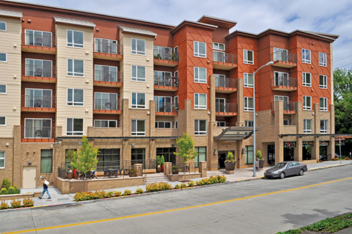
Regional Workshops
Additional Resources Being Made Available
5 Regional Workshops will be schedule for the first week in March
Schedule will be posted on the Funds Available page via HUD.gov
In-depth review of the NOFA requirements
Interactive question and answer period
Discussion through regional lenses
Discussion of reoccurring questions

Slide 28
Participation from Existing Providers
Eligibility Information
Any Owner of a HUD-Assisted Housing types as defined in Section II.A.1.b of the program NOFA
Eligibility is further restricted to those properties:
That have a minimum of 50-units
Restricted to elderly persons
Note: 10% set-aside properties are still eligible

Slide 29
Future Questions
1. Grants. Gov Technical Questions
Call 1-800-518-Grants or
email support@grants.gov
2. Programmatic Questions
email to mfsc @hud .gov
3. General Section Questions
Call (202) 708-0667

Slide 30
Application Deadline
April 18, 2016
Applications must be submitted through www.Grants.gov no later than
11:59:59 p.m. Eastern Time

Slide 31
Q & A

Slide 32
FAQ: http://portal.hud.gov/hudportal/documents/huddoc?id=ssdemonofa-faq.pdf Submit Questions: mfsc@hud.gov

