Slide 1
Underwriting 101 (Basic Overview, Rule Changes, Updates, Forms)
The Office of Residential Care Facilities
U.S. Department of Housing and Urban Development
Rita Dockery, Corley Audorff, & Michael Vaughn (Walker & Dunlop)
Eastern Lenders Conference
Philadelphia, PA
March 13 & 14, 2013

Slide 2
Section 223(a)(7) Updates

Slide 3
Changes in the 223(a)(7) Queue
In January 2011, we created two lanes for enhanced workload management of Section 223(a)(7) Firm Applications – the Green and Regular Lanes. Green Lane deals were defined as refinances with no loan term extensions, no Transfer of Physical Assets (TPA)/change of operator and no new Accounts Receivable Lines requiring Lean compliance approval.
Fast forward to 2013….

Slide 4
Current 223(a)(7) Queue
ORCF allocated additional staffing resources and significantly reduced the previous 223(a)(7) backlogs.
Accordingly, we have decided to merge the two lanes back into one consolidated queue. The consolidated Section 223(a)(7) queue became effective on January 15, 2013, with those applications assigned to underwriters on a first-in, first-out basis.

Slide 5
223(a)(7) Historical Comparison

Slide 6
223(a)(7) Volume (Total applications in the queue not yet assigned as of 03/07/2013)

Slide 7
Changes to 223(a)(7) Lender Narrative

Slide 8
Changes to 223(a)(7) Lender Narrative

Slide 9
Changes to 223(a)(7) Lender Narrative

Slide 10
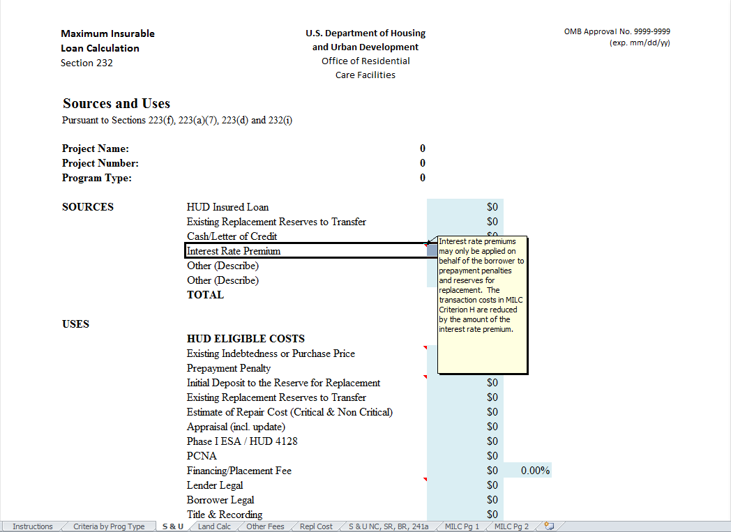
Changes to 223(a)(7) Lender Narrative

Slide 11
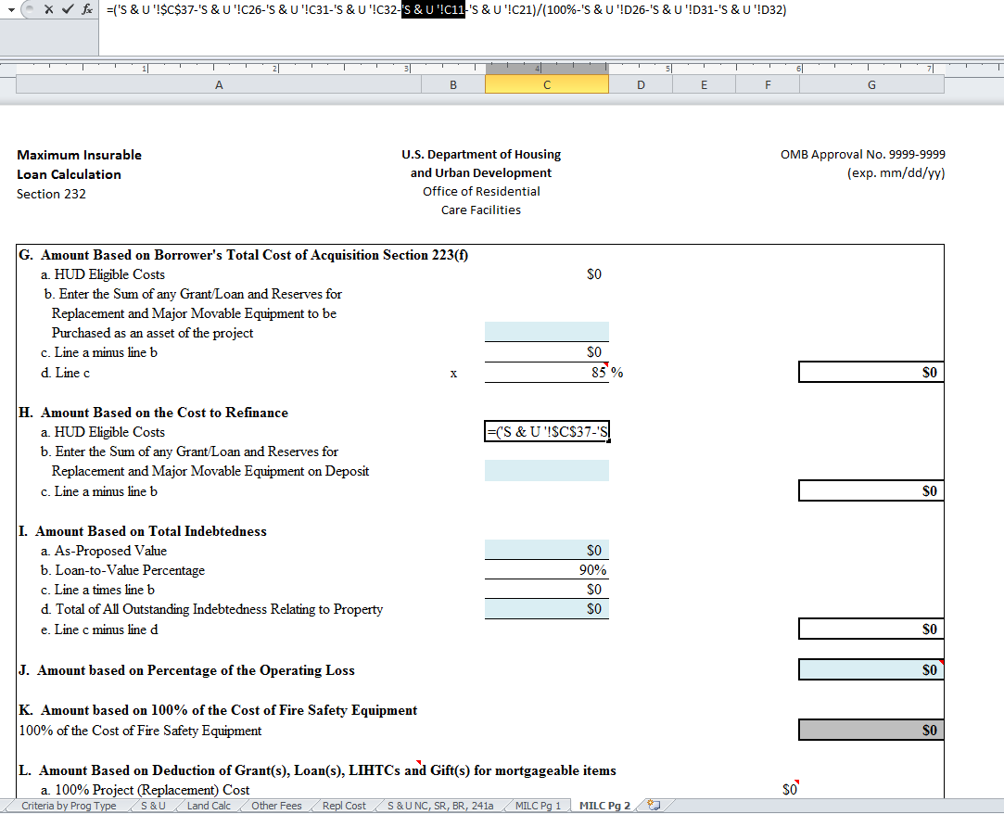
Changes to 223(a)(7) Lender Narrative

Slide 12
Changes to 223(a)(7) Lender Narrative

Slide 13
Changes to 223(a)(7) Lender Narrative

Slide 14
Changes to 223(a)(7) Lender Narrative

Slide 15
Changes to 223(a)(7) Lender Narrative

Slide 16
Changes to 223(a)(7) Lender Narrative

Slide 17
Changes to 223(a)(7) Lender Narrative

Slide 18
Changes to 223(a)(7) Lender Narrative

Slide 19
Changes to 223(a)(7) Lender Narrative

Slide 20
Changes to 223(a)(7) Lender Narrative

Slide 21
Changes to 223(a)(7) Lender Narrative

Slide 22
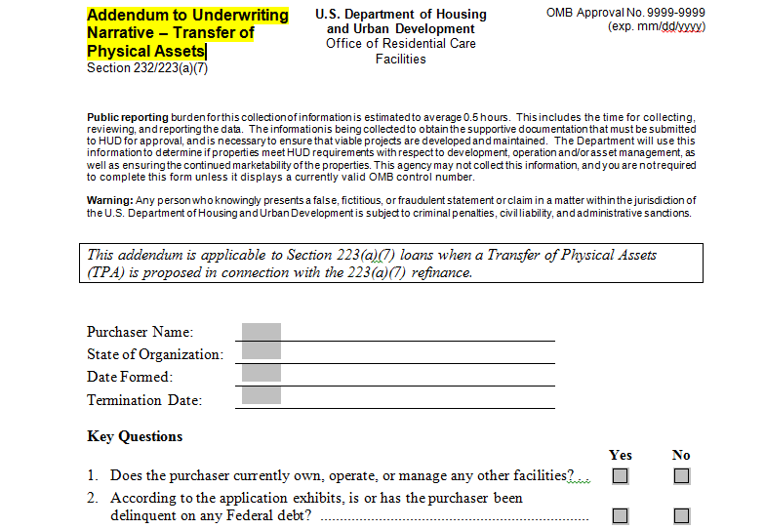
Changes to 223(a)(7) Lender Narrative

Slide 23
Tips on 223(a)(7)s
Submit T12 financials
Make sure the T12 financials are not more than 3 months old
Submit financials at the facility level
Use actual expenses when reporting expenses and NOI; if you make adjustments, describe them in detail and provide both numbers

Slide 24
Tips on 223(a)(7)s
If you use a number in one place, use it again throughout the application.
Principal balance
Prepayment penalty
92264a
If you lump costs together, break them out whenever possible
Transaction fees – call it what it is
PCNA
Survey

Slide 25
223(a)(7) Delays
Assessing compliance with existing business agreements…some of the biggest time delays are related to this
DEC issues
Licensing issues
Obtaining HUD approval of anything that should have had prior HUD approval
Undisclosed TPAs
Significant, unexplained changes in operations
Lack of quality control
Unresponsiveness

Slide 26
Fire Safety Equipment Loan Program

Slide 27
Statutory and Regulatory Authority
Section 232(i) is authorized under the National Housing Act (12 U.S.C. 1715 w) as amended; Section 203(i) Public Law 93-204
24 CFR Part 232 Subpart C – Eligibility Requirements-Supplemental Loans to Finance Purchase and Installation of Fire Safety Equipment

Slide 28
Purpose
Loans for nursing homes, skilled nursing facilities, and intermediate care facilities to purchase and install fire safety equipment—primarily fire sprinkler systems.
Ensure that nursing homes have financing options to meet the CMS regulation that requires all long-term care facilities to be equipped with an automatic sprinkler system by August 13, 2013. Note: CMS is currently imposing exceptions.

Slide 29
Underwriting Guidelines
Mortgage Terms: Vary based on the mortgage amount
For mortgages $100,000 or greater, the maximum mortgage term is…
Coterminous with the maturity of the existing FHA mortgage (if applicable) {OR}
15 years
…whichever is less

Slide 30
Underwriting Guidelines
Mortgage Terms
For mortgages below $100,000, the maximum mortgage term is...
Coterminous with the maturity of the existing FHA mortgage (If applicable) {OR}
10 years
…whichever is less

Slide 31
Underwriting Guidelines
Loan security
1st lien position
In proposals where the property is already encumbered by a 1st mortgage or deed of trust, HUD-FHA will accept a mortgage or deed of trust that is subordinate to the 1st lien
Debt service coverage
Projects must meet the minimum 1.11 coverage ratio.

Slide 32
Underwriting Guidelines
Appraisal
Not required
Physical assessment of the property
For non-FHA-insured projects, the application is to include a PCNA.
The PCNA should include an analysis of the reserve for replacement account, if applicable.

Slide 33
Underwriting Guidelines
Repairs
Any repair unrelated to fire safety equipment installation cannot be funded by mortgage proceeds.
Critical repairs must be performed prior to endorsement of the mortgage.
Non-critical repairs, including Borrower Proposed Repairs approved by HUD, may be completed after endorsement.

Slide 34
Lender Tools
Application Checklists
Distinct checklists for FHA-insured projects and non-FHA-insured projects are on OHP’s website.
Lender Narratives
Distinct narratives for FHA-insured projects and non-FHA-insured projects are on OHP’s website.

Slide 35
Application Processing
Processing times will vary based on ORCF’s capacity
Projects with existing FHA-insured mortgages have priority
Final application procedures will be communicated to lenders by an Email Blast and an update to the OHP website

Slide 36
Questions?

