Slide 1
232 Healthcare Portal Instructions for ORCF Lenders
Processing a Non-Critical Repair Request
Presented by Tiffani Tyer

Slide 2
REVIEWING AND PROCESSING NON-CRITICAL REPAIR ESCROW REQUESTS
There are two types of Non-Critical Repair request submissions:
  Lender Delegated:
    Approved by Lender – the process for Lender Delegated requests will be explained
  Non-Lender Delegated:
    Auto approved - The process for auto-approved requests will be explained
    Forwarded to AE for further review - You will review and process the request according to the instructions below

Slide 3
SUBMITTING A NON-CRITICAL REPAIR ESCROW REQUEST
As the Servicer, you should receive a 92464, 92117 and evidential information from the Owner/Owner Representative. (Please verify the forms received are not expired and are ORCF specific)
  You will use this information to process your request using the 232 Healthcare Portal.

Slide 4
Your first steps in submitting a Non-Critical Repair Escrow (NCRE) request is to:
  Log into the portal.
  Click on the Asset Management tab.
  Select “Non-Critical Repair Request Escrow Form”.

Slide 5
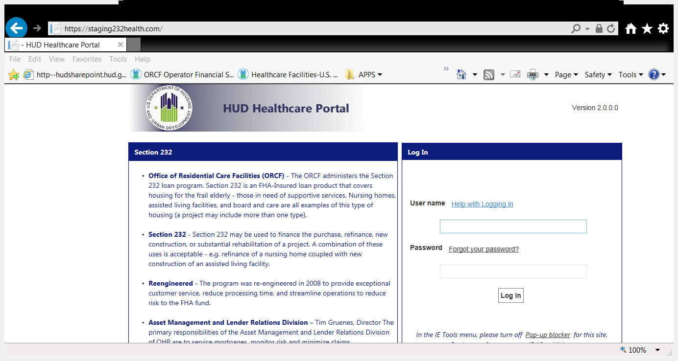

Slide 6
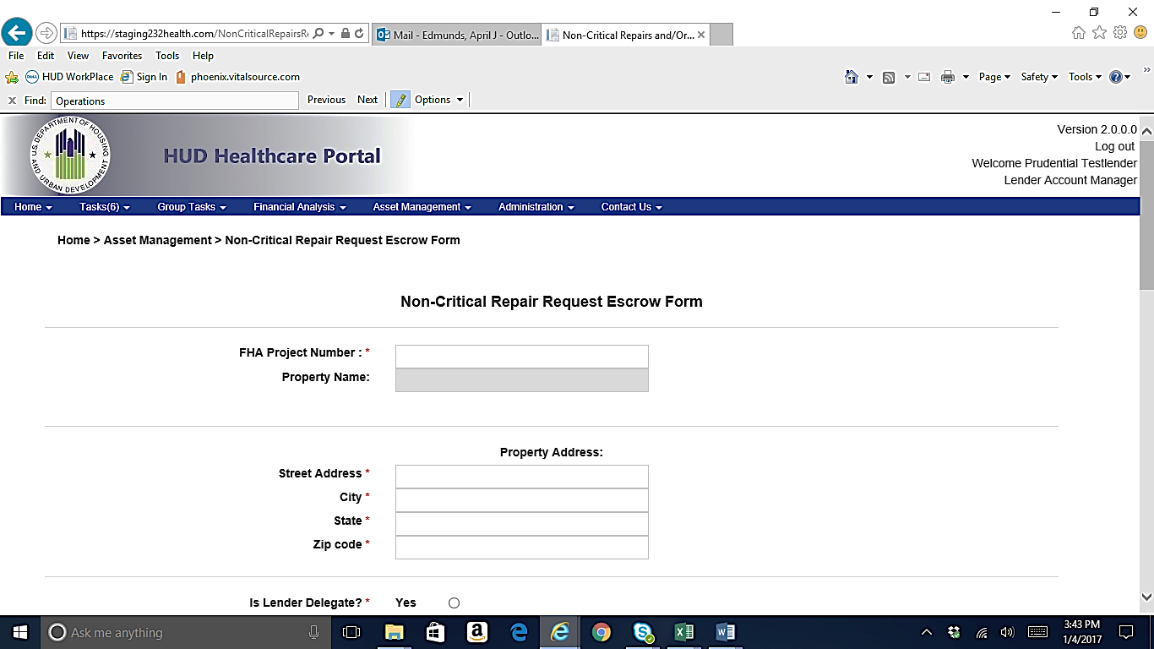

Slide 7
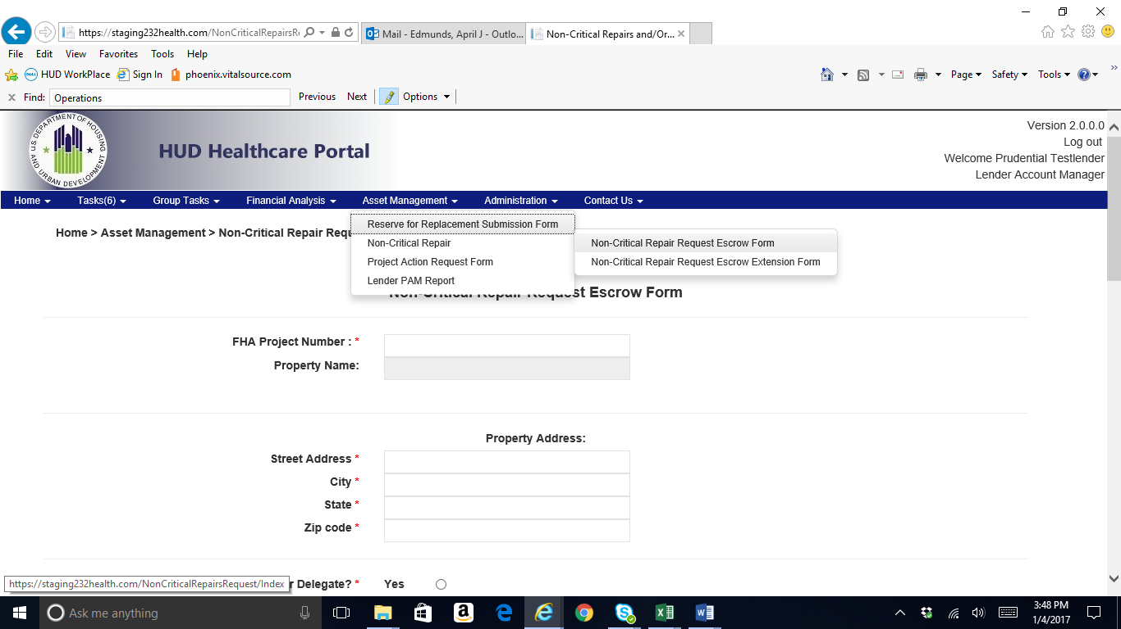

Slide 8
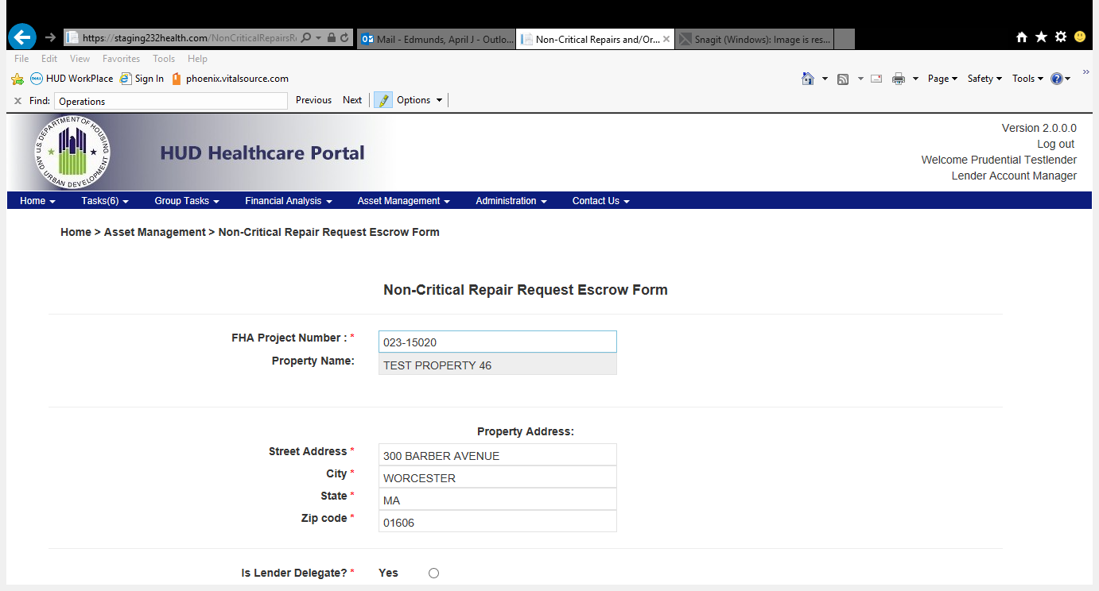
Enter the FHA Project Number – This information comes from the submitted Form 92464 and Form 92117.

Slide 9
Property Name is automatically populated.

Slide 10
If the project has not closed out their Non-Critical Repair Escrow account within 365 days of closing, a messaging stating:
  “Alert: Your loan is greater than 12 months past the Closing Date. Please click on the above link (Request for Extension), to request a Non-Critical Repair extension for this property. You may continue without making the request.”
Select the hyperlink

Slide 11
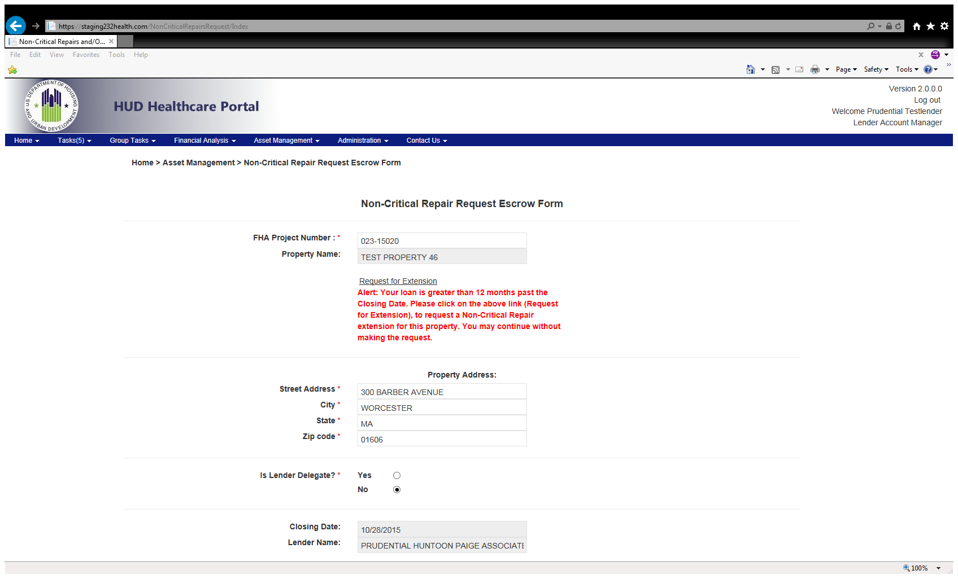

Slide 12
add comments
click the “Submit Request for Six-month Extension” button, to request the extension.

Slide 13
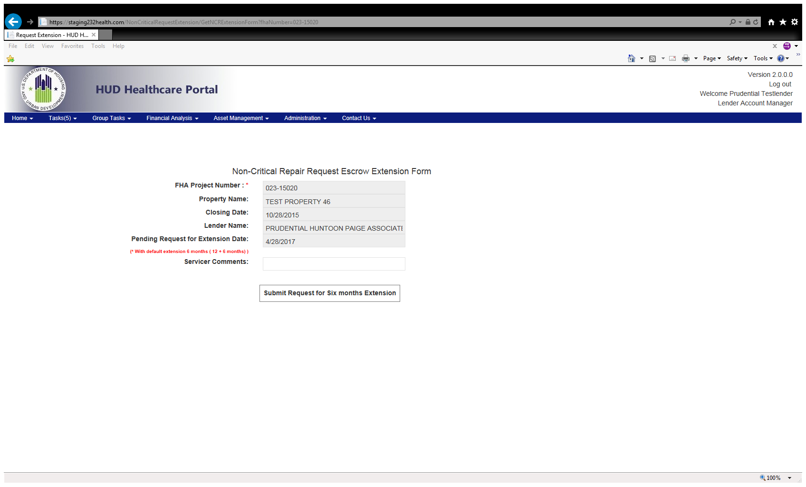

Slide 14
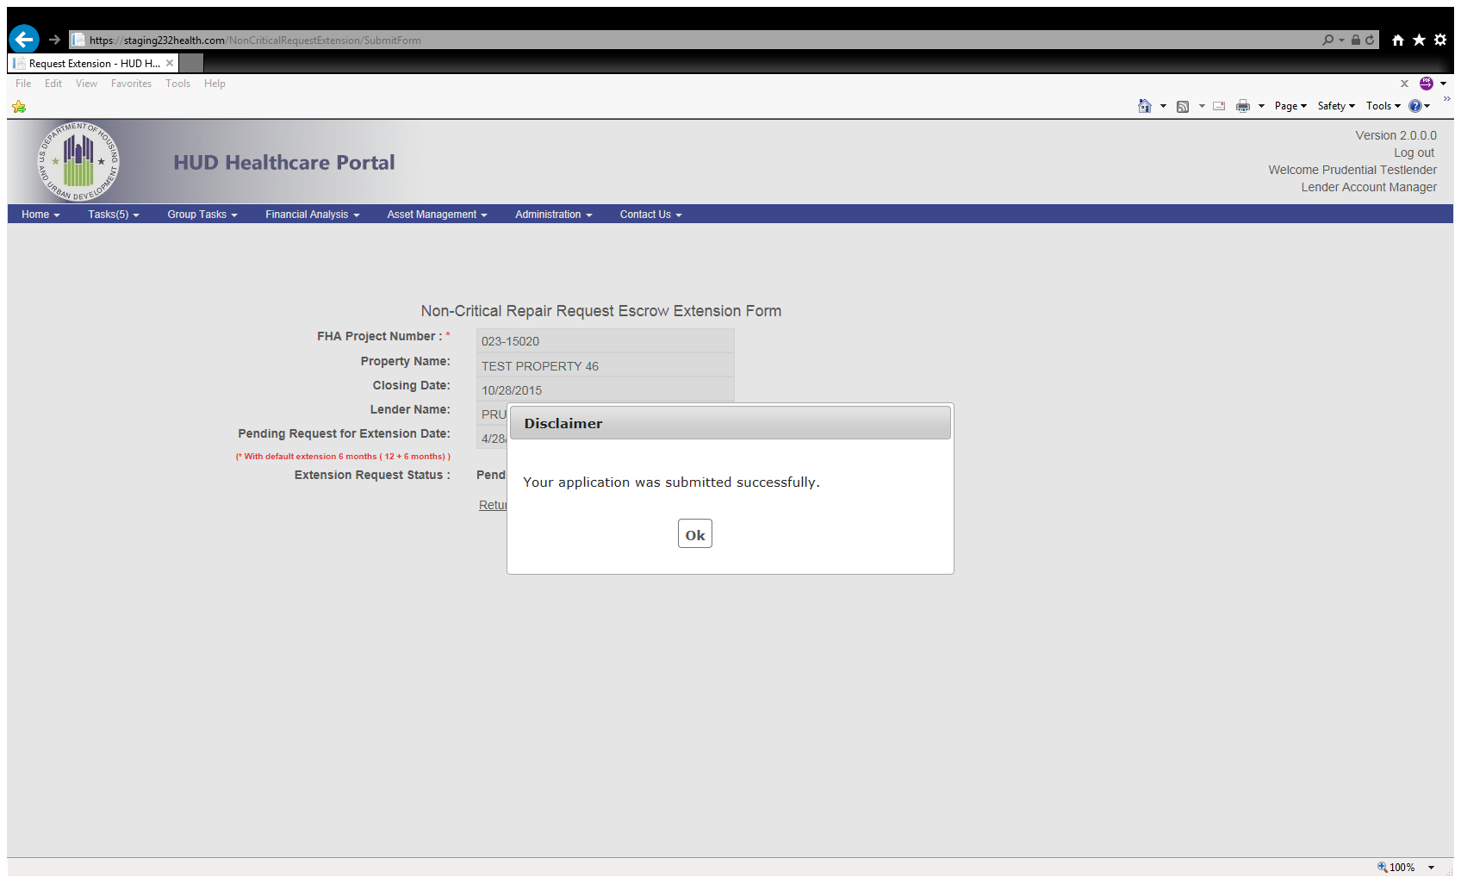
Read the Disclaimer and click “ok”

Slide 15
If you have a pending extension request and you attempt to initiate another Non-Critical Repair request extension, you will receive a message from the portal notifying you of the Pending Extension and will not allow for you to submit another extension until it has been processed.

Slide 16
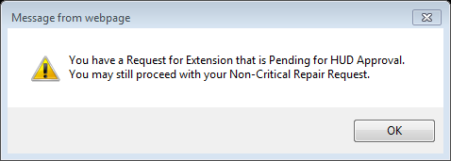

Slide 17
After entering the FHA number, the Property Address will automatically populate.
Verify the address.
  If the address is incorrect, please correct it by deleting the incorrect information and replacing it with the correct information.

Slide 18
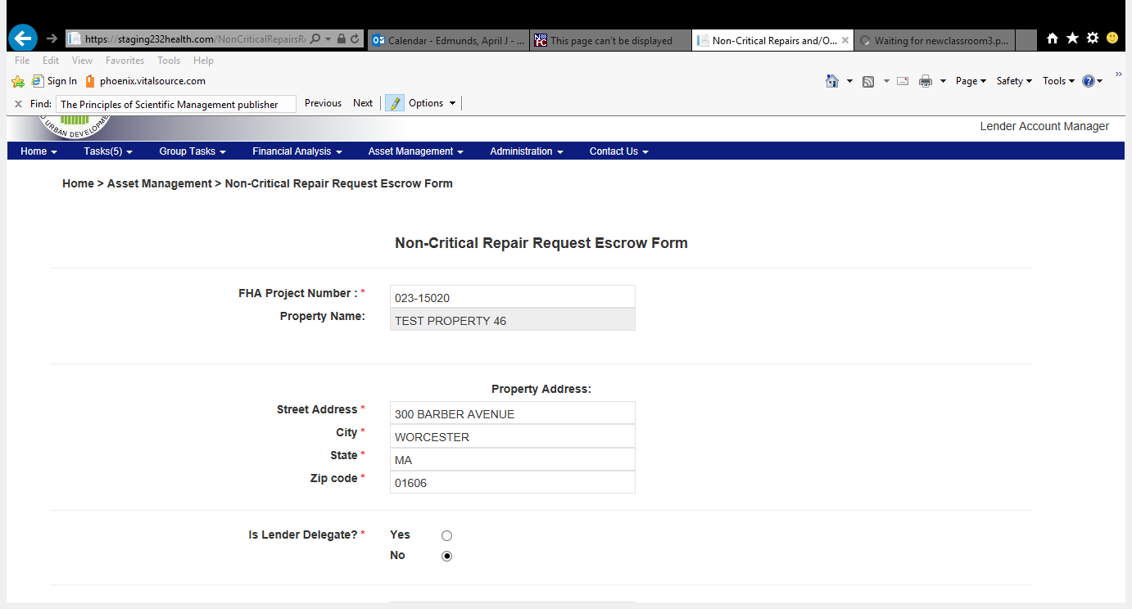

Slide 19
Select whether or not you’re a Lender Delegate.
If you are processing the request as a Lender Delegate, click “Yes”. Enter your approved amount, complete the remainder items, attach required documents and submit.

Slide 20
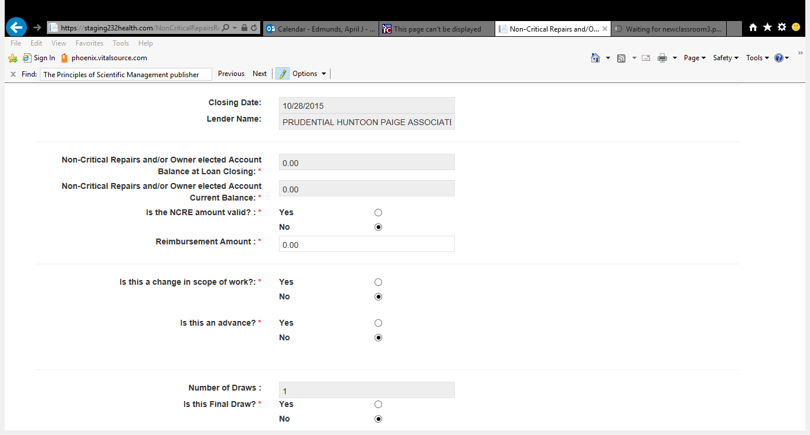
The Closing Date and Lender Name will automatically populate.

Slide 21

Verify the NCRE balance at closing and its current balance is correct. If the amounts shown are incorrect, please select the “No” radio button and your assigned AE will update the information.

Slide 22

Enter the amount requested by the submitter.

Slide 23
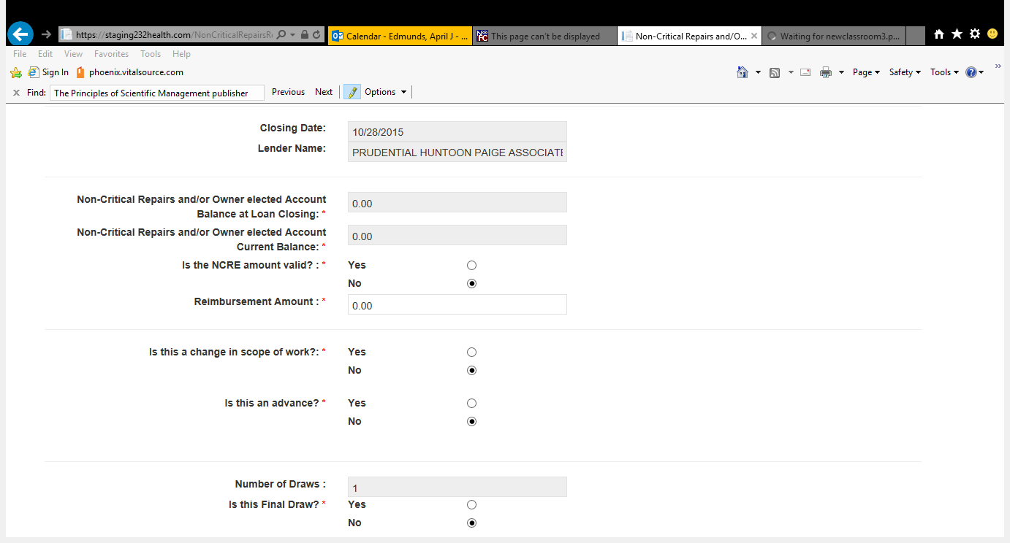
Verify if the requested amount will be used for an item that is a change in scope of work.

Slide 24
Verify if the amount requested is for an advance.

Slide 25

The Number of Draws field will automatically populate.

Slide 26

Verify if this request is for a Final Draw.

Slide 27
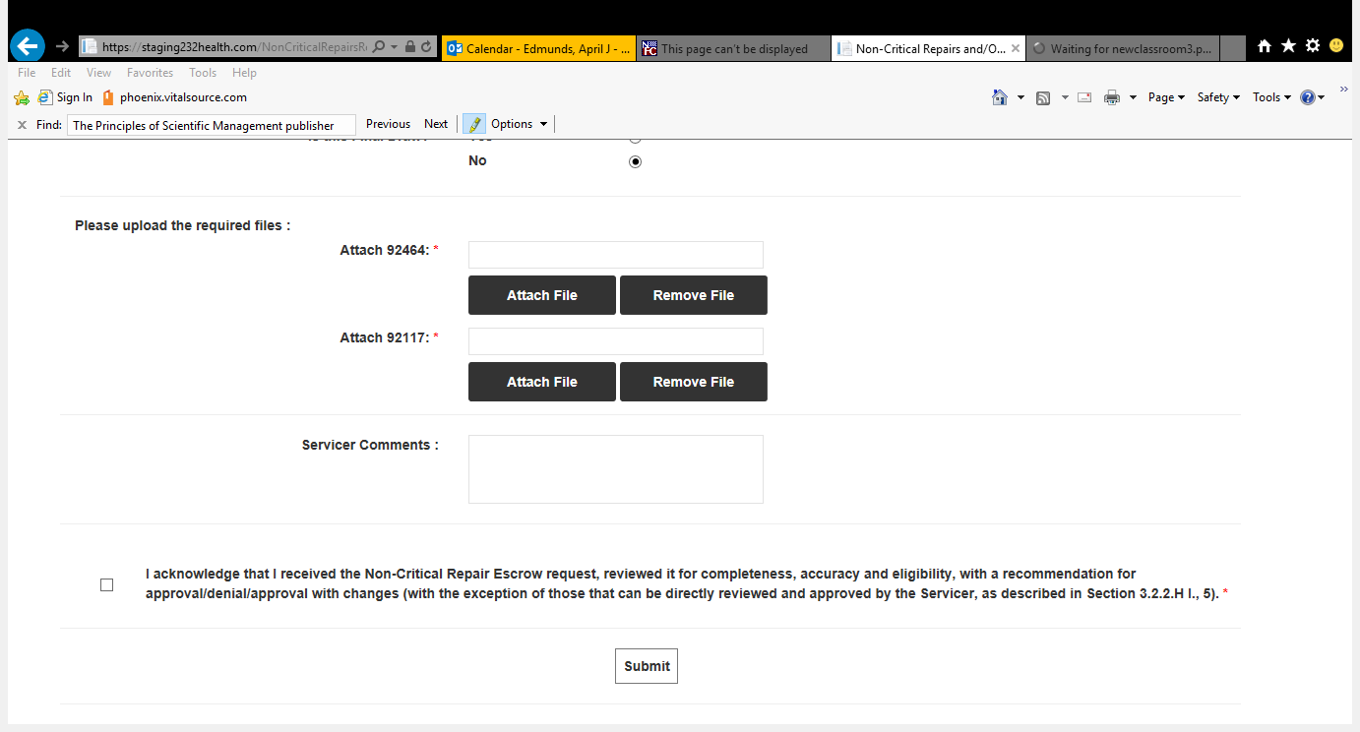
Attach the ORCF Form 92464 and ORCF Form 92117

Slide 28

Enter comments.

Slide 29
Read and accept the Acknowledgement language before submission.

Slide 30
Submit – Click submit when you have entered all required information and attached all required documents.
  If you are a Lender Delegate, your recommendation will immediately be captured, and you will receive an e-mail notifying you of HUD’s receipt of the Reserve for Replacement Decision.
  If the submission is not Lender Delegated, and the request is auto-approved, you will receive an e-mail notifying you of the auto-approval.
  If the submission is not Lender Delegated or auto-approved, you will receive an e-mail, notifying you of the request being reviewed by the HUD Account Executive (AE).
    Following HUD AE review/decision, you will receive an e-mail containing the results of the request.

Slide 31
After submitting the request, the Portal will automatically take you to the “My Task” section of the Portal where you can view the submission and its status.

Slide 32
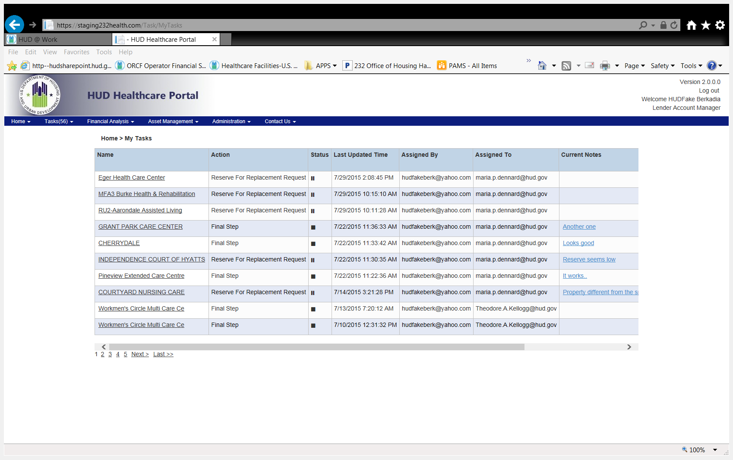
Notes:
Discuss what the symbols mean.

Slide 33
You have now completed the Non-Critical Repair request task for this property.

Slide 34
Who to Contact?
Please e-mail your 232 Healthcare Portal questions or concerns to the
232 Healthcare Portal Help Desk at
HHCP@HUD.GOV

Slide 35

Questions

