Slide 1
HCV Utilization Webinar: HUD-VASH!
June 2023

Slide 2
Welcome!
Today's webinar is being recorded. The recording and PowerPoint will be posted to the "Webinars and Trainings” section of www.hud.gov/hcv.
We are always interested in your feedback. Please enter any suggestions you have for how we can make these webinars or the program resources more useful to you in the chat.
Ask Questions. Please submit any questions via the chat throughout the presentation. If time permits, we will answer additional questions at the end.
Stay connected by visiting www.hud.gov/hcv and subscribing to the HCV Connect Newsletter.

Slide 3
But First: Other Announcements!
Upcoming HCV Set-Aside Deadlines
Housing Mobility-related services NOFO (next slides)

Slide 4
Housing Mobility-related services NOFO
$25 million for Public Housing Agencies (PHAs) to implement a housing mobility program
Expect to make approximately 11 awards
Will help about 6,000 families access a broader range of housing choices over five years
Applications due August 30, 2023
Notes:
Last week HUD announced that there are new funds available to support these housing mobility programs, through a new NOFO. This makes up to $25 million available for PHAs that administer HCV programs. Applications are due August 30, 2023. And we expect to make about 11 total awards and the PHAs will administer their programs for about five full years. We anticipate that over 6,000 families will be able to participate and receive supports accessing a much broader range of neighborhoods.

Slide 5
Upcoming Mobility NOFO Webinars
On June 22nd from 2-3 pm eastern, HUD will be conducting an overview of the NOFO.
Register here
On July 13th from 2-3 pm eastern, HUD will be conducting an overview of the data tools for the NOFO.
Register here
For more information, contact: Alison Bell, housingmobility@hud.gov
Notes:
If you are interested in learning more about the NOFO, we are conducting an hour long webinar on June 22, at 2 pm eastern. And, there are some data tools that have to be used for the application, and we are conducting a separate webinar on that on July 13th at 2 pm.
For additional information , please contact Alison Bell at housingmobility@hud.gov.

Slide 6
A Little Perspective…
Of all regular HCV leasing (non-MS, non-EHV), SPVs account for just under 7%.
Of all HCV leasing (including MS and EHV, i.e. the chart on the left), SPVs account for 10.5% of leased families.
3/1/2023 UMLs

Slide 7
HUD-VASH – By State 3/1/2023 UML/UMA
*Apologies for Bing’s clear anti-small-area-state-data-display bias.

Slide 8
HUD-VASH
National Leasing stands, in March, at just over 70%.
This translates to nearly 34,000 unleased VASH vouchers spread across the country.
Hurdles exist, as you all know, in leasing these vouchers, but let’s see if we can’t learn some of the best ways to clear those hurdles…

Slide 9
Best Practices in Action
HUD
Luigi D’Ancona, Public Housing Director, NYC
New York City Housing Authority
Lakesha Miller, Executive Vice President for Leased Housing, Leased Housing Department, NYCHA
Robert Tesoriero, Central Office Director
Alex Mathew, Brooklyn Client Services Director

Slide 10
New York City Housing Authority
Veterans Affairs Supportive Housing (HUD-VASH) program
Program Operations
Voucher Usage
Relationship Management
Allocation: 3,385
Vouchers under Lease: 3,117
Voucher holders searching: 145
YTD new rentals: 105
Keep your partners engaged beyond eligibility
Explore all housing resources available
Streamline processes
Attrition average: 5%
Lakesha Miller, Executive Vice President
Alex Mathew, Director, Brooklyn Client Services
Robert Tesoriero, Director, Central Office

Slide 11
HUD-VASH Best Practices Background
Since 2010, the number of Veterans experiencing homelessness in the U.S. has been cut almost in half, from 74,087 in 2010 to 37,252 in 2020.
The HUD-VASH program has been a critical piece of this success. To build on that success, HUD, VA, and USICH are prioritizing strategies that work, including:

Slide 12
HUD-VASH Best Practices: Landlord Recruitment and Retention
A primary challenge faced by many HUD-VASH sites is a lack of available decent, safe, affordable housing.
A prolonged housing search puts at risk the Veteran's trust and commitment to sticking with the program.
Finding willing landlords is critical. Successful strategies to aid in landlord engagement and recruitment include:
Consider hiring a staff member whose primary responsibility is to expand housing opportunities for the homeless through the education and recruitment of landlords
Identify, educate, and pre-screen owners
Develop MOUs and/or contractual agreements with local housing location services or the Continuum of Care to assist with housing location services

Slide 13
HUD-VASH Best Practices: Landlord Recruitment and Retention
Expanded use of admin fees and special fees for landlord incentives, security deposit and move-in assistance (PIH Notice 2022-18)
HUD-VASH landlord materials https://www.hudexchange.info/programs/public-housing/hcv-landlord-resources/
HCV Landlord Strategies Guidebook for PHAs https://files.hudexchange.info/resources/documents/PIH-HCV-Landlord-Strategies-Guidebook-for-PHAs.pdf
Inspections/ NSPIRE https://www.hud.gov/program_offices/public_indian_housing/reac/nspire

Slide 14
HUD-VASH Best Practices: Expediting the application and leasing process

Slide 15
HUD-VASH Best Practices: Expediting the application and leasing process

Slide 16
HUD-VASH Best Practices: Project Based Vouchers
There are many benefits of PBV in HUD-VASH. These include -
PBV can preserve or increase the supply of affordable housing within the community
PBVs can help to deconcentrate poverty and encourage affordable housing development in opportunity areas
PBVs can address specific veteran housing needs (collocated services, Enhanced Use Lease sites)
PBVs may improve HCV program efficiency
No additional HUD approval needed for HUD-VASH beyond the standard OFO PBV notification process

Slide 17
HUD-VASH Best Practices: Special Housing Types
Under the HUD-VASH Operating Requirements (Section II.p), PHAs must permit HUD-VASH clients to use special housing types for tenant-based HUD-VASH assistance
single room occupancy (SRO);
congregate housing;
group home;
shared housing;
and cooperative housing
HUD-VASH may be used in some types of assisted living settings

Slide 18
HUD-VASH Best Practices: Intake and Eligibility
Income Eligibility
Note that, under the HUD-VASH Operating Requirements (Section II.b.), HUD-VASH is intended to serve “veterans at a variety of income levels, including low-income”
(up to 80% AMI)
State lifetime sex-offender status
Stay current on state law

Slide 19
HUD-VASH Best Practices: Veteran-Centered Approach
Coordination and regular communication with VA Case Management Team
Collaborative Planning with other partners
Physical Coordination- providing space for VA case manager(s) in PHA’s office
Ensuring veteran success is an ongoing commitment between the PHA, VAMC and veteran family

Slide 20
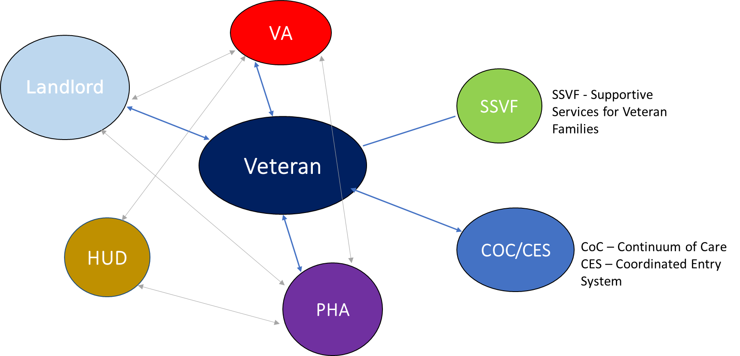
HUD-VASH Best Practices: Veteran-Centered Approach

Slide 21
HUD-VASH Best Practices: Veteran-Centered Approach
The establishment and maintenance of regular communication is essential for long-term program effectiveness.
Providing information to all partners about the status of each applicant, as well as Veterans already leased up, ensures that issues of concern are addressed timely.
Strategies to ensure Veteran families are progressing include:
Regular meetings with VAMC staff to identify barriers and address issues of concern,
Communication systems that allow all partners to exchange information on the status of Veterans‟ housing applications and the identification and availability of units,
Developing, maintaining and sharing a by-name-list with VA partners to track voucher issuance and expiration date, sources of income, inspection date and whether or not the inspection passed or failed, reinspection date, recertifications, etc

Slide 22
HUD-VASH Best Practices: Collaboration and Reallocation
MOUs to administer across jurisdictions
Consistent Payment Standards across PHAs within a VAMC
Voluntary Reallocation or Recapture of HUD-VASH Vouchers: Notice PIH 2022-25
PHAs should consider reallocation if:
There is still need at the VAMC, but not within the jurisdiction of a specific PHA
There are significant disparities in HUD-VASH utilization between PHAs within a VAMC catchment area
There are a large number of veteran families moving under portability between PHAs and moving vouchers could substantially ease administrative burden
There is an opportunity to move vouchers between PHAs in order to apply additional vouchers to a PBV development

Slide 23
Questions? Comments? Concerns?
Contact us at VASH@hud.gov

Slide 24
Reminders
The first deadline for additional HCV ("set-aside") funding is June 16th (TOMORROW!). To learn more, check out the 2023 Funding Opportunities Section of www.hud.gov/hcv.
We have another HCV Utilization Webinar planned for Thursday, July 20th. Go to www.hud.gov/hcv to register and see upcoming topics.
Finally, this webinar was recorded. The recording and PowerPoint will be posted to www.hud.gov/hcv in about a week.
To stay up to date on all HCV program guidance and resources, sign up for HCV Connect at www.hud.gov/hcv.

