Slide 1
Simplified Environmental Reviews: Use of Programmatic Part 50 and Limited Scope Reviews
Danielle Schopp
July 24, 2025

Slide 2
Agenda
Programmatic Part 50
Limited Scope Environmental Review for Project-Based Rental Assistance with no Rehabilitation or Construction
CodeTalk Environment Website: Streamlining Resources
Q&A
Notes:
Today we will be going over what these simplified reviews are – why you might consider using them – when to use them and finally, how to use them
I will also go over where to find these simplified reviews and other sample reviews on CodeTalk Environment’s website.

Slide 3
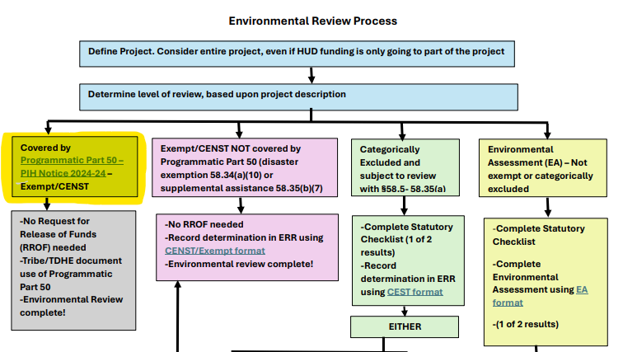
Flow chart at: https://www.hud.gov/sites/dfiles/PIH/documents/Environmental_Review_Flow_Chart.pdf
Notes:
I wanted to start out with the beginning of the overall flow chart we have developed for environmental review to help put into context where/how to use the Programmatic Part 50 ER.
Process is the same – first step is to define the project, including all activities regardless of funding sources. Next step is to determine the level of review.
If the level of review is Exempt/Categorically Excluded Not Subject to CENST), then you can use Programmatic Part 50. We will be going over this Exempt/CENST activities – it is everything in our regulations, except for disaster exemption and supplemental assistance. And if the activities go beyond those exempt/CENST – then it is either Categorically Excluded Subject to (CEST) or require an Environmental Assessment.
I will show you where to find the full flow chart that includes links to formats at the end of the webinar
Today our focus is on the highlighted box – Programmatic Part 50

Slide 4
Programmatic Part 50
What is the Programmatic Part 50?
Environmental review conducted by HUD
Programmatic Review: soft costs (including administration, operations, maintenance, and planning), tenant based rental assistance, public and support services, and certain activities to assist homebuyers do not require a Part 58 Review from Tribe
PIH Notice 2024-24
Notes:
Environmental review conducted by HUD – when HUD does the review, we use 24 CFR Part 50. (when Tribe does HUD envt’l review – Tribe does the review under Part 58).
Programmatic Review covers the following activities: soft costs (including administration, operations, maintenance, and planning), tenant based rental assistance, public and support services, and certain activities to assist homebuyers do not require a Part 58 Review from Tribe.
For those familiar with HUD’s environmental and regulations – it covers all listed exempt/CENST activities EXCEPT for disaster exemption and supplemental assistance.

Slide 5
Programmatic Part 50
How does the Programmatic Part 50 streamline the process?
Allows TDHE or Tribe to not conduct environmental review under Part 58 for covered activities
  Enables TDHEs to undertake activities immediately after documenting they are covered by the Programmatic Part 50
Notes:
No more Exempt/CENST format that is signed by TDHE and Tribe and analyzes whether 3 laws/authorities apply - airports, coastal barrier resources, and flood insurance.
Pt 50 does that work for you!

Slide 6
Programmatic Part 50
What activities are covered in the Programmatic Part 50?
  Soft costs: administration, operations, planning
  Tenant based rental assistance: where participant selects the unit
  Public and supportive services
  Homebuyer assistance: closing costs, downpayment assistance
  Maintenance
Notes:
These are the broad categories – we will go over the specifics in the next couple of slides
With the exception of maintenance, these are non-physical actions – actions that by their scope, will not have an impact on the environment
Soft costs: administration, operations, planning
Tenant based rental assistance: where participant selects the unit
Public and supportive services: Services with no physical impact – employment, crime prevention, child care, drug abuse, health, education, short term payments, rent/mortgage assistance
Homebuyer assistance: closing costs, downpayment assistance
Maintenance

Slide 7
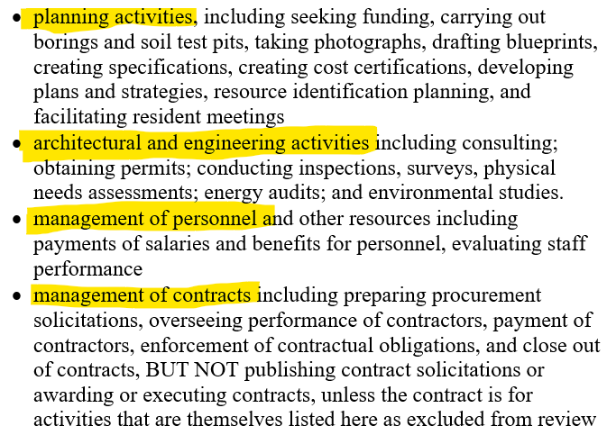
Programmatic Part 50
PIH Notice 24-24 lists soft cost activities
Notes:
Planning, engineering, management of personnel and contracts
Everything listed as Exempt/CENST in our regulations

Slide 8
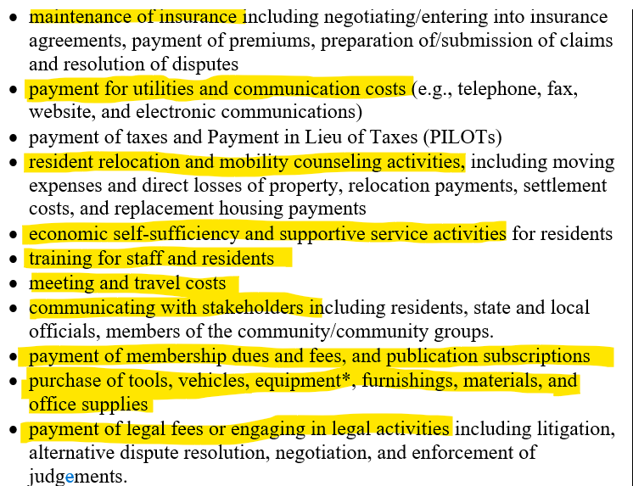
Programmatic Part 50
PIH Notice lists soft cost activities
Notes:
We added some examples to the list in our regulations to cover common activities
Anytime you see an * - like here for equipment then you may need to provide flood insurance if it is insurable.

Slide 9
Programmatic Part 50
PIH Notice also covers Maintenance
Maintenance activities slow or halt deterioration of a building and do not materially add to its value or adapt it to a new use
See Appendix A for specific activities
See also CPD Notice 16-02
Notes:
The one category of actions covered by the Programmatic that is a physical activity is maintenance
We will be doing a deeper dive into what maintenance means for envt’l review purposes
It has a very specific definition because we are defining it in a way that ensures there will be no adverse envt’l impacts
Want to distinguish maintenance (cleaning, repairs that slow or halt the deterioration of the building from rehabilitation (where more impactful repairs that go beyond cleaning and operations)
Rehabilitation is a higher level of review then maintenance – it is at least Categorically Excluded and Subject to Laws at 58.5. A rehabilitation envt’l review will require analysis of impact to historic property and resources, among other laws and authorities.
The Notice provides specific example of what is maintenance vs rehab. CPD Notice 16-02 also provides examples.
We will spend the next couple of slides going over some examples.

Slide 10
Feature or System | Maintenance Activities | Rehabilitation Activities
Site | Lawn care (litter pickup, mowing, raking), trimming trees and shrubs Snow/ice removal Application of pavement sealants, parking lot restriping, directional signage or marking for handicapped accessibility Repair of cracked or broken sidewalks | New landscaping throughout an area Construction of new walkways, driveways, or parking areas, or replacement thereof
Building Exterior | Cleaning and fixing downspouts Repainting previously painted surfaces Replacing deteriorated section of siding Removal of graffiti | Cleaning masonry or stripping painted surfaces by sandblasting, acid wash, or high pressure washing Applying new exterior siding
Notes:
CPD Notice 16-02 provides some examples to help you consider if the activity is maintenance or rehabilitation
Things like cleaning and taking care of site like law care, snow removal or fixing part of a sidewalk – maintenance
Constructing new walkways or paths are rehabilitation (ground disturbance might impact cultural resources)
Repainting previously painted surfaces – maintenance. However, when you use abrasive means to clean or strip paint it is rehabilitation (again, think of the impact of an abrasive removal would have on historic building)
Replacing some siding – maintenance. Applying all new siding to entire building – rehab.

Slide 11
Feature or System | Maintenance Activities | Rehabilitation Activities
Roof | Fixing leaks In-kind replacement of loose or missing shingles or tiles Replacement of deteriorated flashing Application of waterproof coating to flat roof | Complete replacement of roof with new shingles, tiles, roll roofing, membrane, or new metal roof Installation of solar panels
Windows and Doors | Caulking, weather stripping, re-glazing windows and doors Fixing broken windowpane(s), storm window(s), or damaged entry door Replacing broken door lock Replacing a vandalized entry door to restore security of building or unit Replacing a single severely damaged window to match | Replacement of windows Replacement of exterior doors Adding storm windows or storm doors
Notes:
See theme – fixing broken part of system (like roof shingles or damaged windowpane) maintenance. Complete replacement is rehab.

Slide 12
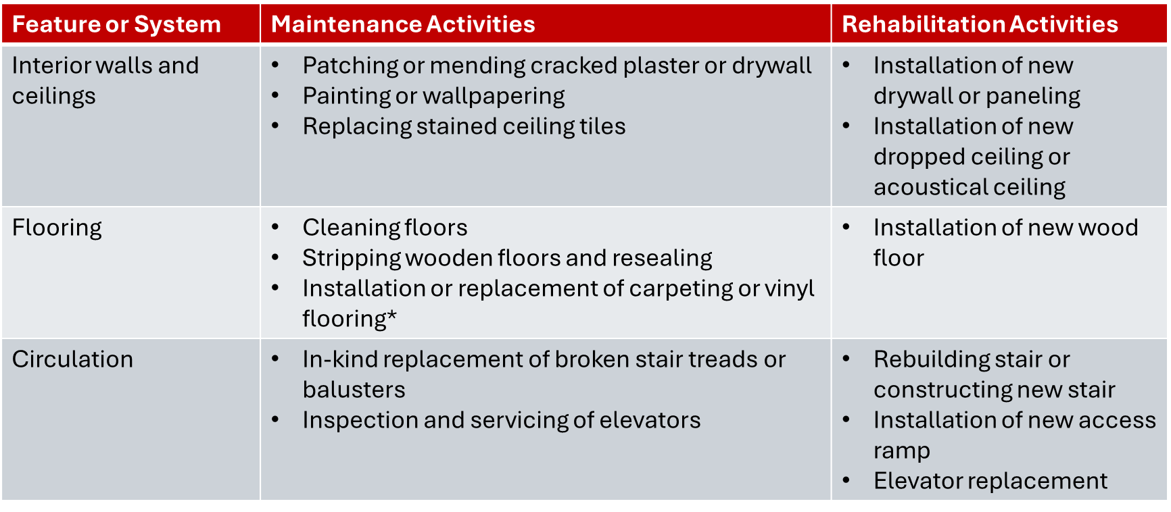
Notes:
Providing these examples because we get a lot of questions on details of work – especially for work to turn a unit over to a new resident
These are just examples that get at the focus of what it means to slow halt deterioration vs rehabilitate or fix up unit
We can’t address or cover all activities – want to give you a guide

Slide 13
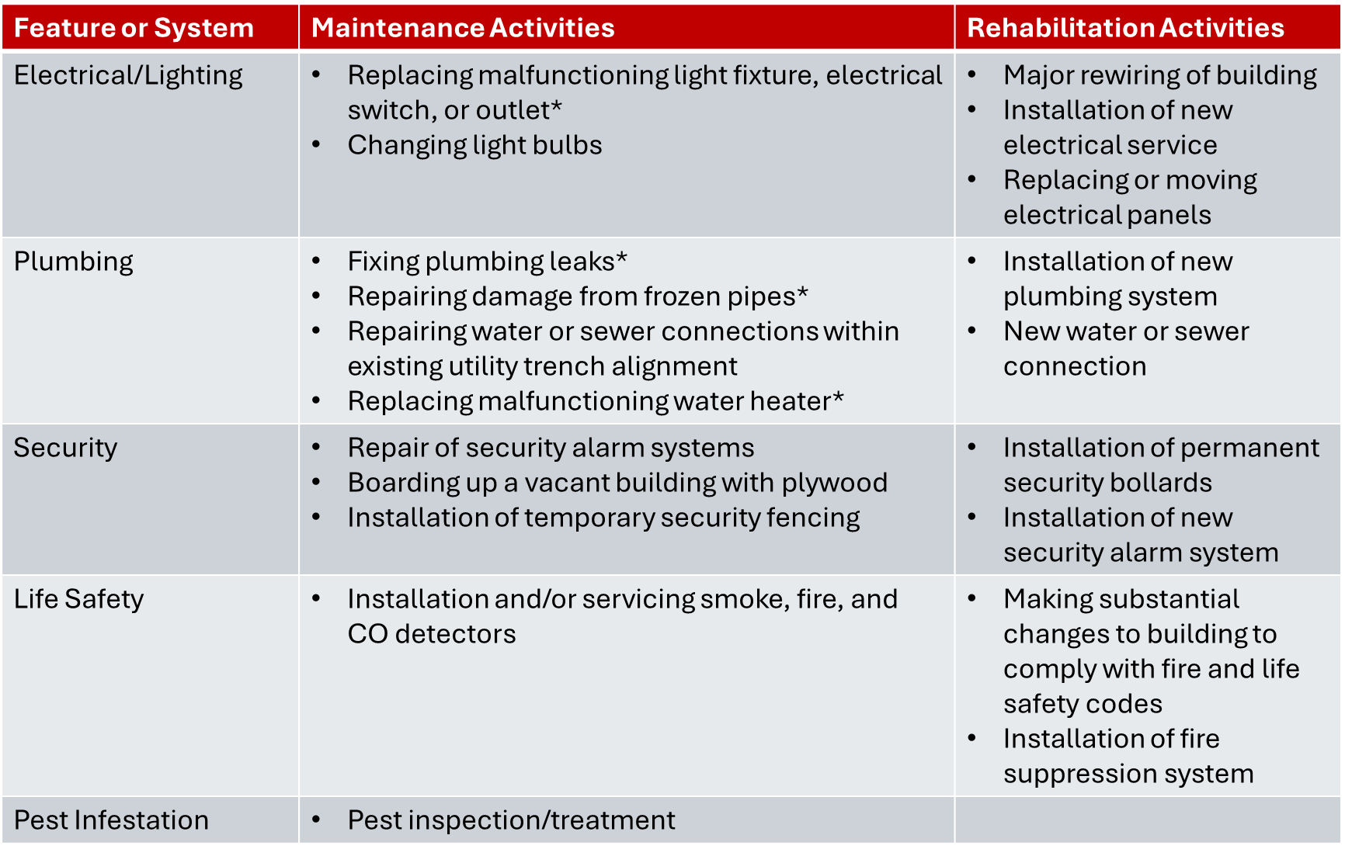
Notes:
Fixing small component generally maintenance, new systems are generally rehab

Slide 14
Feature or System | Maintenance Activities | Rehabilitation Activities
Kitchen | Replacement of stoves, refrigerators, and microwaves* Replacing cabinet hardware* | Complete or substantial kitchen remodel
Bathroom/Laundry | Replacing broken medicine cabinet, toilet* Replacing washing machines and dryers* Installation of grab bars | Complete or substantial bathroom remodel
HVAC | Servicing and maintenance of mechanical systems Installing or replacing humidifiers and dehumidifiers Installing or replacing a window air conditioner Replacing a malfunctioning part of a HVAC system like a thermostat or heating unit with no new ducting or piping except to connect into existing system* | Installation of new heat distribution system
Notes:
Changing out appliances is maintenance
Chaing out HVAC – furnace – where take old unit out and put in a different unit without doing a lot of duct work – maintenance.

Slide 15
What activities are not covered by the Programmatic Part 50?
Rehabilitation
Acquisition/leasing
New Construction
Emergency repairs –
assistance or permanent improvements that do not alter environmental conditions and are limited to protection, repair, or restoration activities necessary only to control or arrest the effects from disaster or imminent threats to the public safety
Notes:
Activities not covered in the Programmatic besides rehabilitation
Acquisition/leasing
New Construction
Emergency repairs –
assistance or permanent improvements that do not alter environmental conditions and are limited to protection, repair, or restoration activities necessary only to control or arrest the effects from disaster or imminent threats to the public safety

Slide 16
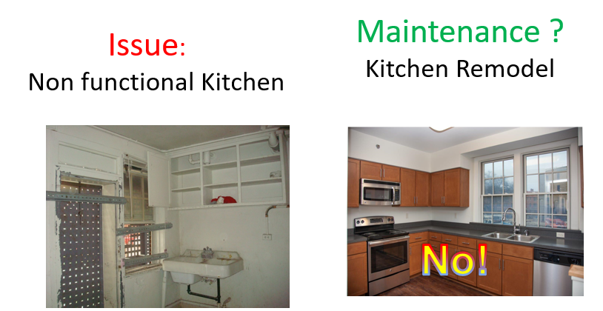

Slide 17
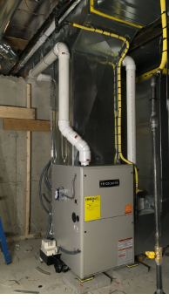
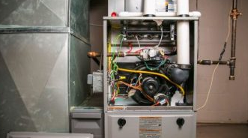
Issue Maintenance
Furnace breaks Replace broken furnace
Yes!

Slide 18
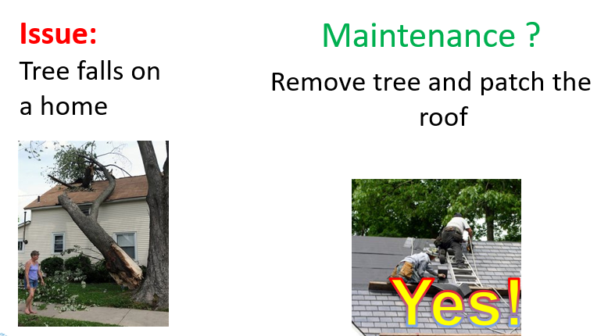

Slide 19
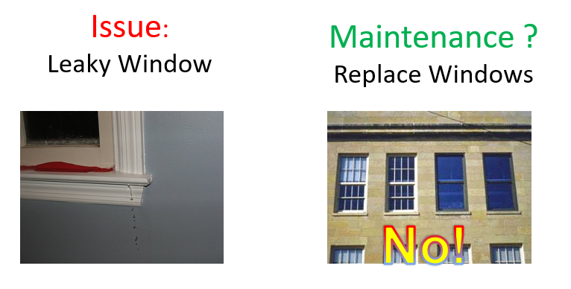

Slide 20

Programmatic Part 50
When should I use it?
When ONAP funded activities are non-physical activities
When ONAP funds are limited to maintenance
How do I use it?
Program file, cite ONAP funded activity to Programmatic Part 50 to show compliance
Notes:
When should I use it?
When ONAP funded activities are non-physical activities
When ONAP funds are limited to maintenance
How do I use it?
Program file, cite ONAP funded activity to Programmatic Part 50 to show compliance

Slide 21
Will Tribes need other Environmental Reviews?
Yes, because the Programmatic Part 50 does not cover rehabilitation, new construction, acquisition
Notes:
Programmatic Review is not likely to cover all of the activities a Tribe conducts to build and maintain quality housing
It is one tool to use to help improve efficiency
Now, we are going to turn to another tool to use

Slide 22
Limited Scope Review
What is the Limited Scope Review?
Simplified environmental review when project is project based rental assistance with no associated repairs, rehabilitation, new construction
Notes:
Simplified environmental review when project is project based rental assistance with no associated repairs, rehabilitation, new construction
Based upon the nature of the activity, the review is simple and HUD wants to make it as easy as possible by eliminating from review the laws/resources that don’t apply
Limited Review is done by Tribe under Part 58 – but we wanted to provide documentation on as many envt’l resources as we could so you could focus on a very limited number of laws that apply

Slide 23
Limited Scope Review
Why should I use it?
Simplifies the environmental review process
Reduces laws/authorities you need to analyze – only need to consider 4 (out of 15 laws/authorities)
When should I use it?
When you have program/activities that are project based assistance with no rehab/repair/new construction
Notes:
Simplifies the environmental review process by reducing laws/authorities you need to analyze – only need to consider 4 (out of 15 laws/authorities)

Slide 24
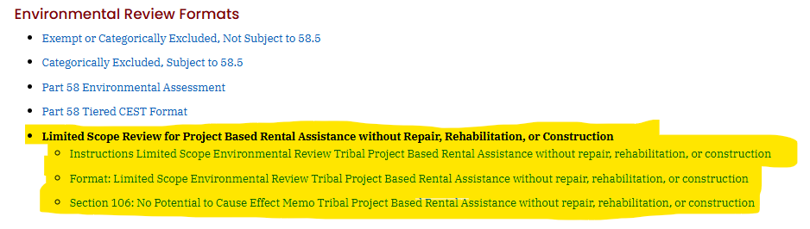
Limited Scope Environmental Review
Available at CodeTalk
https://www.hud.gov/helping-americans/public-indian-housing-resources#hh7
Notes:
On CodeTalk Environment we have links to instructions for limited review and a format to document environmental compliance

Slide 25
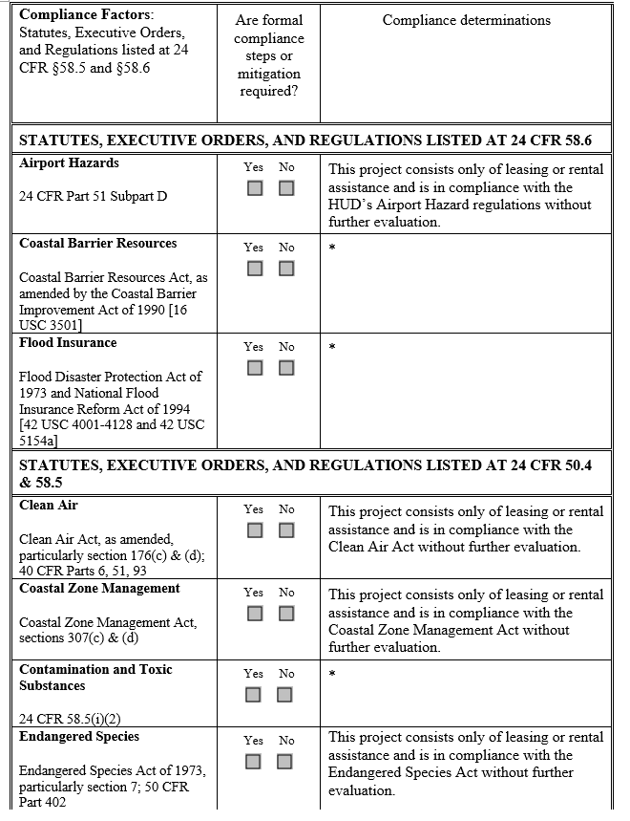
Limited Scope Review: CEST 24 CFR 58.35(a)(5)
You will need to complete using Limited Review Instructions
Notes:
The Limited Scope review includes a word template that has already filled out answers for compliance for many of the resources
The ones with the astrics are dependent upon project and location. The instructions have detailed guidance on how to fill out compliance for Coastal Barrier Resources, Flood Insurance, Toxics,
Next we will go over the analysis for these 3 laws/authorities

Slide 26
Limited Scope Review: CEST 24 CFR 58.35(a)(5)
Coastal Barrier Resources Act: prohibition on using HUD funds
Document by including one of the following:
Statement that project is not within a state with Coastal Barrier Resources
If project is in one of the states listed in the Coastal Barrier Resources Act (AL, CT, DE, FL, GA, LA, ME, MD, MA, MI, MS, MN, NJ, NY, NC, OH, RI, SC, TX, VA, WI), then attach the CBRA Map from US Fish and Wildlife Services that document project is not in Coastal Barrier Resources Unit
Notes:
Coastal Barrier Resources Act: prohibition on using HUD funds
Document by including one of the following:
Statement that project is not within a state with Coastal Barrier Resources
If project is in one of the states listed in the Coastal Barrier Resources Act (AL, CT, DE, FL, GA, LA, ME, MD, MA, MI, MS, MN, NJ, NY, NC, OH, RI, SC, TX, VA, WI), then attach the CBRA Map from US Fish and Wildlife Services that document project is not in Coastal Barrier Resources Unit

Slide 27
Limited Scope Review: CEST 24 CFR 58.35(a)(5)
Flood Insurance: Flood insurance is not required for leasing
Flood insurance may be advisable for leasing for projects
If flood insurance was purchased, include a receipt or policy statement
Notes:
Flood Insurance: Flood insurance is not required for leasing
However, the Tribe/TDHE may want to advise/require flood insurance for contents.

Slide 28

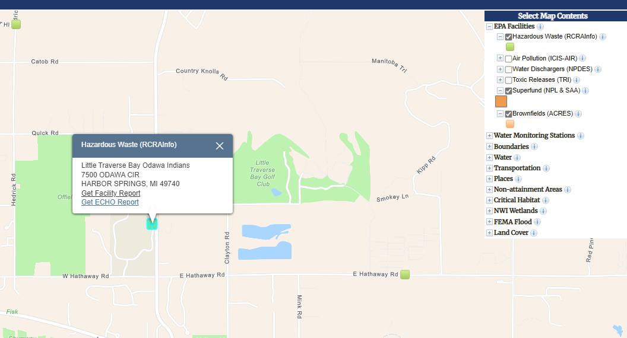
Limited Scope Review: CEST 24 CFR 58.35(a)(5)
Contamination: Must be free of hazardous materials, contamination, toxic chemicals and gases and radioactive substances, where a hazard could affect the health and safety of the occupants
Notes:
Our regulations require the projects are free of hazardous materials, contamination, toxic chemicals and gases and radioactive substances, where a hazard could affect the health and safety of the occupants
Radon testing and mitigation is not required at this time
Want contamination analysis to be appropriate to the project – here, leasing with no rehab, want a simple analysis to find the sources that could impact the project and the resident
Instructions include how to use EPA’s NEPAssist to locate hazards on or near your project site. I am looking at RCRA, Superfund and Brownfields. If the map shows something, need to give it a further look – here RCRA report popped up and I can see it is permit for a very small quantity generator – it is a small testing lab and there are no reported violations. Not a problem

Slide 29
Limited Scope Review: CEST 24 CFR 58.35(a)(5)
Document compliance by including:
A report of nearby toxic sites and releases using EPA’s Envirofacts or NEPAssist
If you are providing assistance to multifamily housing with 5 or more dwelling units (even if leasing fewer than 5 units), provide documentation showing past uses of the site. Assistance provided to housing with 4 or fewer units does not require analysis of past uses. Examples of types of documentation could be any of the following:
  Historical aerial photographs of the site showing the status of the site through time. You do not need to go back further than 1940.
  A letter from someone who has specific information on the history of the site, for example the current or previous owner, the local historian, an elder in the community, the local planning department
  A Phase I Environmental Assessment Report. If a Phase I report is provided, none of the above toxics information is needed (the Envirofacts map, historic aerial photographs, and the letter from someone with specific information on the site.) These items will be included in the Phase I.
A discussion of potential adverse impacts, if any
Notes:
Note that for now, you do not need to consider radon in the contamination review.
When use NEPAssist – click on EPA facilities – focus hazardous waste (RCRA info), Superfund (NPL) and Brownfield. If your search brings something up, this means you need to look further to determine if it will impact your project. Recommend reaching out to Tribal Envt’l Department for help documenting whether any known hazardous uses that could impact residents. For single family houses, a NEPAssist search to find EPA facilities and/or letter from Tribal Natural Resources Dept is enough research and analysis
For Multifamily housing (5 or more units), then our regulations require you to also look at the past uses of the property. Aerial photos if you have them – or letter from Natural Resources/planner/elder – someone with knowledge of the site – or can always use or get an ASTM Phase I ESA. These cost money and are not required for limited scope review – but there might be one available from when the project was constructed and an older Phase I will have info on past uses that you can use

Slide 30
What is not covered by Limited Review for Project Based Assistance with no rehab?
Any project-based assistance project with repair, rehabilitation, or new construction
Tenant based rental assistance
  You can use PIH Notice 2024-24 Programmatic Part 50
Notes:
Limited review is limited to projects without physical actions – that is how we eliminated the need to consider 11 of the 15 federal laws/authorities

Slide 31
Limited Scope Review
Resources @ CodeTalk Environment:
Instructions for Limited Scope
Format for Limited Scope
Section 106 Compliance: No Potential to Cause Effect Memo
Notes:
Find resources for limited review on CodeTalk

Slide 32


Recommendations
Use Programmatic Part 50 for covered activities
5 Year Environmental Review for Tribally owned units
Aggregation Webinar
Environmental Reviews based upon programs/activities
  Tiered reviews for homeowner rehab or scattered site new construction
  Tiered Webinar and Sample Envt’l Review
  Limited scope for project based rental with no rehab, new construction
Notes:
We have covered two tools to streamline and simplify envt’l reviews; however, we want to remind you that we have developed other resources and tools
Encourage Tribes to develop a 5 year envt’l review for Tribally owned units – this can cover the rehabilitation. Here, want to cover everything that you might do to all of the known properties. And do your analysis one time every 5 years. Aggregation webinar can help you.
We have been also been developing sample environmental reviews based upon programs/activities: for homeowner rehab program a tiered review will help avoid delays and simplify the process. We have a webinar and sample tiered documents.
We have Limited Review for project based with no rehab

Slide 33
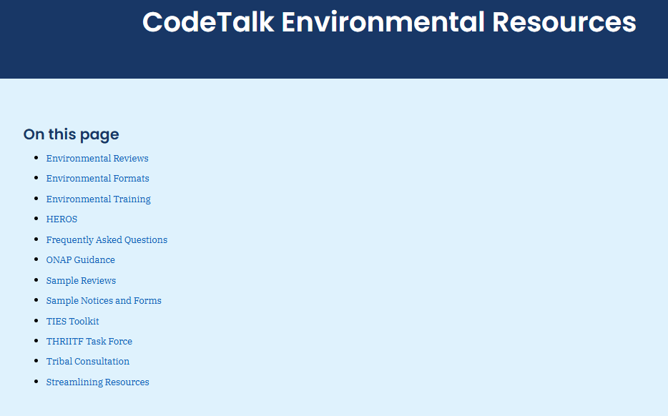
Codetalk Environment
https:// www.hud.gov/helping-americans/public-indian-housing-resources#hh7
Notes:
Here go to live link and show where to find Resources: Programmatic Part 50, Limited Review Instructions, Other Example Environmental Reviews.

Slide 34
Q&A
For questions:
Danielle Schopp
(202) 402-4442 Danielle.L.Schopp@hud.gov

