Slide 1

Rate Reduction Incentive (RRI)
Office of Public and Indian Housing
Office Public Housing Voucher Programs
Office of Public Housing Programs
Financial Mangement Division
PHFMDEnergyBranch@hud.gov

Slide 2
Rate Reduction Incentive (RRI)
RRI is a financial incentive for PHAs that pursue special efforts beyond what is required by statue or regulation to reduce their utility rate. The RRI program is an opportunity for PHAs to share in savings by reducing their utility rates. There are term limits for claiming the RRI.
RRI Opportunities
Special Negotiated Rate (RRI Claimed up to 5 years)
Wellhead Purchase of Gas (RRI Claimed up to 5 Years)
Power Purchase Agreement (PPA) (RRI Claimed up to 20 Years)
Investments for fuel switching in an interruptible utility Rate (RRI Claimed up to 3 Years)
Commodity Purchase of regulated utilities (RRI Claimed up to 5 Years)
Active Commodity Trading (RRI Claimed up to 5 Years)
Onsite Renewable Energy (RRI Claimed up to 20 years)

Slide 3
Rate Reduction Incentive (RRI)
RRI Eligible Actions
      Special rate negotiated by and for the PHA- PHA negotiates with the local Utility for a special rate
      Wellhead purchase of natural - The PHA negotiates a natural gas rate at the wellhead
      Power Purchase Agreement (PPA) using a third-party energy supplier- PHA participates in a power purchase agreement (PPA), including a PPA for on-site or off-site solar energy, where a third-party finances, owns, maintains, and operates an energy generating system and the PHA purchases the output (allocation of benefits to PHAs must be clear and traceable)
      Energy efficiency investments that lead to lower utility rates
      Investments to allow for fuel switching capability to participate in an interruptible utility rate - Participation in the program requires a PHA to temporarily (cannot be permanent) switch between fuels
      Commodity purchases of regulated Utilities in a deregulated market that result in a lower utility rate

Slide 4
Rate Reduction Incentive (RRI)
RRI Eligible Action
      Active commodity trading - the PHA purchases a utility commodity on the spot market at regular intervals throughout the year.
      On-Site renewable energy - a PHA installs a renewable energy system, the PHA may include the electricity generated on-site for the purposes of calculating the blended rate
      Community Solar - Community solar is any solar project or purchasing program, within a geographic area, in the benefits from the solar photovoltaic production flow to multiple customers such as individuals, businesses, nonprofits, and other groups
      Other Actions not listed. PHA must submit descriptions and sufficient documentation for HUD to determine if this action is eligible.

Slide 5
Rate Reduction Incentive (RRI)
Ineligible Actions for RRI
      Energy investments that lower utility consumption but not the rate (unit cost)
      Selecting the best available utility rate
      Combining or removing utility meters in a manner that prohibits the PHA from individually metering tenant level consumption- PHA may install a master utility meter upstream from individual meters and convert the unit level meters from individual utility accounts to PHA operated CheckMeters
      Fuel Switching to obtain a better rate when new equipment is not required

Slide 6
FY2025 Rate Reduction Incentive Process
1. RRI Application Data
2. Savings Calculations
3. Attach Documentation
4. Submit RRI Application
5. Review by Energy Branch
6. Notification of Approval or Denial
7. Claim RRI on 52722 Form if Approved

Slide 7
RRI APPLICATION PROCESS
Step 1: RRI Application Data
An RRI Application must be submitted for each RRI Action each year the PHA wants to include an RRI Incentive in its Operating Subsidy form HUD 52722.
RRI Withdrawal any time before 9/30/2024
PHA will enter all Required information for each RRI Application per Project per utility per RRI action
  PHA Name
  PHA Code
  Project Number(s) for each project included in the proposed RRI Action

Slide 8
RRI APPLICATION PROCESS
Step 1: RRI Application Data Continued
  Required for ALL RRI Applications
    Utility Type
    RRI Action Description – A brief description of the action the PHA undertook to reduce the utility rate. If the RRI is being undertaken with an EPC, the RRI description must identify that is RRI completed in conjunction with an EPC?
    Utility Contract Start Date
    Utility Contract End Date
    Is the RRI Application for Renewable Energy?
    Multi-Year or Single Year Approval

Slide 9
RRI APPLICATION PROCESS
Step 1: RRI Application Data Continued
  Total Utility Consumption;
  Unit of Measure for the Consumption
  RRI Percentage - Identification of the incentive the PHA is requesting approval of, whether it is 50 percent or, if the PHA is undertaking the RRI in conjunction with and EPC, 100 percent of the actual savings. EPC Start Date and EPC End Date depending on RRI Application Type
  RRI Savings Calculation for the RRI Action
      Provide clear description of their RRI Savings Calculations in a traceable excel workbook are required with every RRI Application.
      The excel workbook must identify and calculate, where applicable, the Project, Actual Utility Rate, Actual Utility Cost, Default Utility Rate, Default Utility Cost, Utility usage with unit of measure (e.g. kWh, gallons, CCF,), Rate Savings, RRI percentage, and RRI

Slide 10
RRI APPLICATION PROCESS
Step 2: RRI Savings Calculations
Formula 1. RRI Savings = ((Default Utility Rate) - (Actual Utility Rate)) x (Actual Utility Consumption), where
  Actual Utility Rate = Actual Utility Cost/Actual Utility Consumption
Formula 2. RRI Savings = ((Default Utility Cost) - (Actual Utility Cost)), where
Default Utility Cost = Default Utility Rate x Actual Utility Consumption
Actual Utility Cost= Actual Utility Rate x Actual Utility Consumption
Important Note: The RRI Savings for any project may not be greater than the Default Utility Costs for the Utility

Slide 11
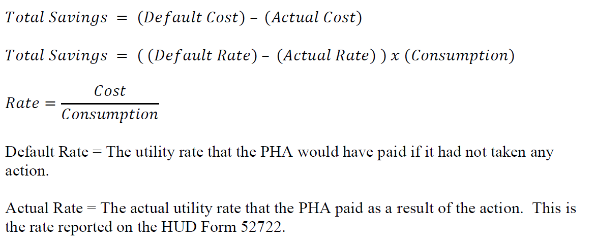
Sample RRI Savings Calculations
RRI Incentive = $77,168

Slide 12
RRI Calculations Template

Slide 13
RRI Calculations Template- RRI with EPC Calculations

Slide 14
RRI APPLICATION PROCESS
  Step 3: RRI Documentation
      Default Utility Rate Documentation- (Required) Documentation may be a published utility rate schedule or tariff published by the utility company or the state public service commission, or other official source (e.g. government posting). Some utility companies provide the Default Utility Rate on their invoices. It should show the Default Utility Rate that is being used in Rate Savings Calculations. Default Utility Rates may also be listed on utility company price to compare(Tariffs)
      Actual Utility Rate Documentation- (Required)
        Sample invoices- Two to three invoices within reporting period that include consumption, Actual Utility Cost, and Actual Utility Rates that are stated in the submitted RRI Savings Calculations and rate documentation (e.g. Utility Rate Contract)
        Utility Rate Contract- must indicate the negotiated Actual Utility Rate and the term of the contract and match rates used in the RRI Savings Calculation

Slide 15
RRI APPLICATION PROCESS
RRI – Contracts
  Step 3: RRI Documentation Continued
  PHAs must submit a copy of executed contract in the RRI module in the Public Housing Portal. It should include the contract start date, contract end date, actual rate and signature.
  For contracts with terms over 5 years, PHAs must submit a contract approval letter from the Field Office in the RRI module in the Public Housing Portal
  When a PHA enters into a new contractual agreement (including the RRI renewal of an existing contract) for an eligible RRI Action, even if the action impacts the same utility and project(s) as a previously approved RRI action, this is considered a new RRI action and requires a new RRI Application submission.
  Apple Housing authority has contract for the commodity purchase of electricity for a project AP0000001 that ended in December 31,2024. Apple Housing Authority signs a new contract the commodity purchase of electricity for APP0000001. This is considered a new RRI action and Apple PHA must submit a new RRI application.

Slide 16
RRI APPLICATION PROCESS
RRI – Contracts- PPAs
  Step 3: RRI Documentation Continued
  For approved Power Purchase Agreements (PPAs)
    Submit RRI Application by Project and by utility
    Attach PPA contract
    Attach Field Office PPA Contract Approval Letter
    Attach RRI savings calculations
    IF PPA is included in an EPC, attach EPC Approval Letter
    An RRI PPA may be claim up to 20 years
  Proposed Power Purchase Agreements
    IF a PPA has term greater than 5 years, PHAs submit a Market Study to the Field Office. The Field Office will submit to the Energy Branch to review
    The PHA will submit a Proposed Power Purchase Agreement to the Field Office. The Field Office will submit to the Energy Branch to review

Slide 17
RRI APPLICATION PROCESS
RRI – Community Solar
  Step 3: RRI Documentation Continued
  Community Solar - Community solar is any solar project or purchasing program, within a geographic area, in the benefits from the solar photovoltaic production flow to multiple customers such as individuals, businesses, nonprofits, and other groups
  PHAs, general pay some subscription or fee to participate in the Community Solar Program
  Guidance for utilizing Solar Credits for Tenant Utility Bills is located on the Energy Branch Website. https://www.hud.gov/program_offices/public_indian_housing/programs/ph/pheb
  Guidance for Community Solar Credits in Master Metered Public Housing is located on the Energy Branch Website. https://www.hud.gov/program_offices/public_indian_housing/programs/ph/pheb
  The PHA may submit an RRI Application for utilities paid by the PHA.
  PHA should submit a copy of the executed Community Solar Agreement in the RRI Module of the Public Housing Portal

Slide 18
RRI APPLICATION PROCESS
RRI – Contracts- Evergreen
  Step 3: RRI Documentation Continued
  Evergreen Contracts- Evergreen are contracts automatically renew after its initial term expires
    The parties agree that the contract rolls over automatically and indefinitely until either party gives the other notice to terminate it.
    PHAs may enter into special rate actions that have evergreen contracts with their utility provider that fall into this category
    Initial term of an evergreen contract is not more than five years
    Evergreen Contracts may be cancelled by either party after the initial term or at any time
    Evergreen contracts do not require Field Office approval

Slide 19
RRI APPLICATION PROCESS
RRI – EPC
  Step 3: RRI Documentation Continued
  RRI Undertaken in Conjunction with an EPC:
    RRIs completed at the same time as an EPC are eligible to retain up to 100 percent of the savings (rather than 50 percent of the savings with the RRI) during the EPC repayment period.
    PHA must be eligible for both EPC incentives and RRI incentives (1) at the same project, (2) for the same utility, and (3) in the same funding period.
    Both the RRI and EPC approval letters from HUD must indicate that the PHA is pursuing the EPC and RRI in conjunction with each other.

Slide 20
RRI APPLICATION PROCESS
RRI – EPC
  Step 3: RRI Documentation Continued
  RRI Undertaken with in Conjunction with an EPC with Renewables
    PHAs may execute an EPC that includes RRI for some renewable energy like Solar PPA.
    A renewable energy RRI Application for energy production eligibility may be approved for the same term as the EPC (up to 20 years)
    PHAs must submit EPC Approval letter in the RRI Module in the Public Housing Portal. Information need from the EPC is the EPC start date and end date.
    If the EPC Approval Letter does not show where EPC and RRI were performed at the same time, the PHA must include sufficient description and justification with acceptable documentation showing that the RRI and EPC were undertaken in conjunction with each other.

Slide 21
RRI Application Process
RRI – EPC
Step 3: RRI Documentation Continued
EXAMPLES of RRI with an EPC
  If a PHA executes a Departmental approved EPC at two (2) of its three (3) projects and simultaneously executes a Departmental approved RRI at all 3 projects, only the 2 projects included in the EPC may be eligible to retain 100 percent of the savings. The third project that is not included in the EPC may be eligible to retain 50 percent of the savings.
    Project 1 – 100% of savings with EPC ; Project 2 - 50% of Savings (no EPC); Project 3 – 100% of Savings with EPC.
  If a PHA has a Departmental approved EPC that includes both electricity and water savings and simultaneously executes a Departmental approved RRI for natural gas, the PHA may be eligible to retain 50 percent of the savings because the EPC and RRI impact different utilities.
    Project 1 - 100% gas savings with EPC; Project 1 - 50% Water Savings; Project 1 – 50% Electricity Savings

Slide 22
FY2025 Rate Reduction Incentive Process
1. 4. Submit RRI Application
5. Review by Energy Branch
6. Notification of Approval or Denial
7. Claim RRI on 52722 Form if Approved

Slide 23
RRI APPLICATION PROCESS
Step 5: Energy Branch Review:
  Review PHA submitted RRI application in the portal after the deadline (9/30/2024)
  Review RRI application and supporting documentation
  Applications that are incomplete or have errors or miscalculations will be denied. We have created a module in the portal to make it easier for PHAs to make submissions. PHAs should review their packages in detail before submitting to best ensure that submissions are approvable.
Step 6: Notification of Approval or Denial
  Energy Branch will Issue Signed RRI Approval Letters in the RRI Module in the Public Housing Portal to PHA

Slide 24
RRI APPLICATION PROCESS
Step 7: Claim RRI on 52722 Form if Approved
  Total Approved RRI. With HUD RRI Approval, the PHA must include the Total Approved RRI on the 52722 Operating Subsidy forms. PHAs must submit RRI Applications and receive HUD approval each year of the term in order to be able to claim an RRI incentive in its HUD Form 52722 each year.
    The information used to calculate RRI Savings must be consistent with the rate and costs used to calculate the Utility Expense Level (UEL).
    The Total Approved RRI = Sum of the Total of Each Approved RRI Action
    (e.g. Total Approved RRI = Approve Electricity RRI for Commodity Purchase + Total Approved Gas Electricity for Commodity Purchase) ​
    Negative Savings
    If any of the projects realized negative savings in a given year, the total savings (both positive and negative) of all projects derive the RRI for that RRI action. After HUD approves the RRI Application (e.g. multiyear RRI term), if the PHA includes approved RRI in any HUD Form 52722, the PHA must include the RRI on the HUD Form 52722 for all projects that are part of the RRI Action, even projects with negative savings

Slide 25
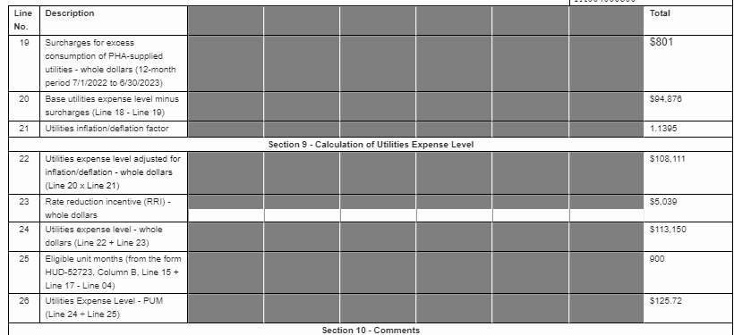
RRI APPLICATION PROCESS
PHA RRI Incentive for 52722 Form (Step 7)
RRI

Slide 26


Questions
PHFMDEnergyBranch@hud.gov

