Slide 1
Housing Counselor Certification Rule: For Select PIH Programs Audio is only available by conference call
Please call: 1-844-291-5491 Participant Access Code: 3674169 to join the conference call portion of the webinar
January 21, 2020
Notes:
Timing:
The introductory slides will take approximately 5 minutes.
Make sure that the phone number is the correct one for your webinar
Have this slide as the opening slide that participants see when they login to GoTo Webinar
Key points:
Leave this slide up on the screen as participants enter the virtual training room.
Once attendees are in the virtual room, make the welcoming remarks.
Common questions/concerns:
NA
Training delivery tip:
NA

Slide 2
Webinar Logistics
Audio is being recorded. The playback number along with the PowerPoint and a transcript will be available on the HUD Exchange at www.hudexchange.info/programs/housing-counseling/webinars/
The webinar will be posted in 7-10 days.
The Training Digest on HUD Exchange will be updated when the webinar is posted.
Handouts were sent out prior to webinar. They are also available in the Control Panel. Just click on document name to download.

Slide 3
Questions & Comments
There will be Polling Questions. Please respond to them.
There will be Q&A periods.
With questions taken over the phone.
If so, the operator will give you instructions on how to ask questions or make your comments.

Slide 4
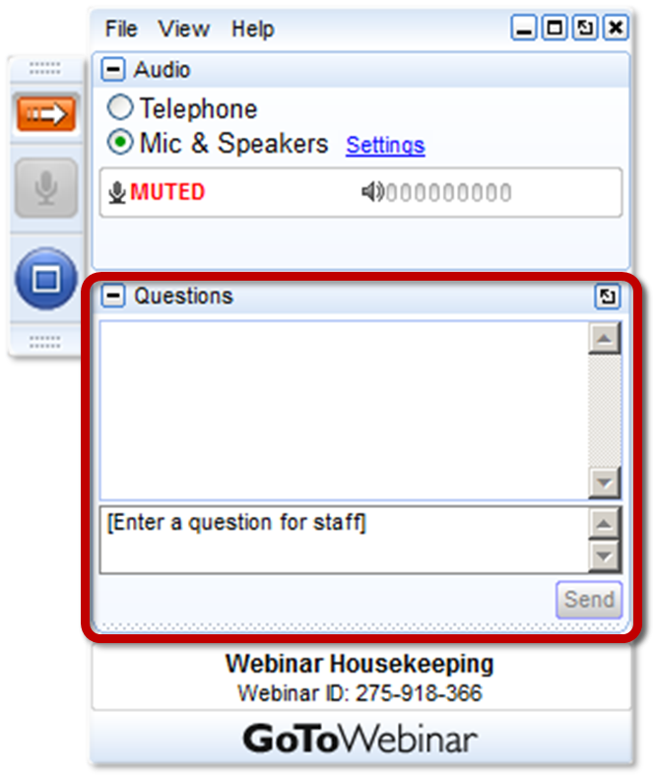
Other Ways to Ask Questions
Please submit your text questions and comments using the Questions Panel. We will answer some of them during the webinar.
You can also send questions and comments to housing.counseling@hud.gov with the webinar topic in the subject line.

Slide 5
Welcome
Lorraine Griscavage-Frisbee
Deputy Director
The Office of Outreach and Capacity Building
Office of Housing Counseling (OHC)
U.S. Department of Housing and Urban Development
Notes:
Key points:
Lorraine’s talking points:
Thanks for joining us today. We are very pleased to have you join us today in this joint presentation with HUD’s Office of Housing Counseling and Community Planning and Development programs, specifically HOME, CDBG, and CDBG-DR. The HUD Housing Counselor Certification Rule impacts your programs in a variety of ways; however, there are partners in the field who are professionals who can assist your agency in ensuring compliance.

Slide 6
Webinar Objectives
Inform PHAs about HUD’s Housing Counselor Certification Rule
Review how each program is covered by the HUD Housing Counselor Certification Rule
Plan for options for PHAs
Determine implementation and next steps, based upon options
Notes:
Key points:
Jerry will cover the webinar objectives and then turn it over to Lorraine and the other speakers.
Common questions/concerns:
NA
Training delivery tip:
NA

Slide 7
Presenters and Q and A
Presenters
Lorraine Griscavage-Frisbee and Robin Penick, HUD OHC, Office of Outreach and Capacity Building
Shawna LaRue Moraille, ICF, TA Provider and Jessica Porter, Quadel, a subcontractor to ICF
Q and A
Tammy Dunn, HUD Public and Indian Housing (PIH), and Jane Charida, HUD OHC, Office of Outreach and Capacity Building and Anice Schervish Chenault and Chad Trepinski PIH
Notes:
Key points:
Presenters – All will introduce themselves.
Questions – Questions will be taken at the end of the webinar and fielded by HUD and ICF staff in the questions box.
Common questions/concerns:
NA
Training delivery tip:
NA

Slide 8
Feedback
There will be Feedback Provided in Mentimeter throughout this presentation. When prompted by the icon to the right, please respond to questions at www.menti.com using your computer or smart phone.
Time for Mentimeter!
Notes:
Shawna will cover this slide

Slide 9
Agenda
Housing Counseling Office and Program
Housing Counselor Certification
Next Steps to Consider
Notes:
Shawna will cover this slide

Slide 10
Housing Counseling Office and Program
Notes:
Key points:
Lorraine will cover this slide.
Common questions/concerns:
NA
Training delivery tip:
NA

Slide 11
Who are HUD-Approved Housing Counseling Agencies?
Public or nonprofit organizations
Almost 1,750 agencies participate in HUD’s program
Some apply for funding via NOFA
Not all are funded by HUD’s NOFA
Types:
Network agencies (with Affiliates/Subgrantees)
National or regional intermediary organizations
State Housing Finance Agencies (e.g., MSHDA)
Multi-State Organizations
Local Housing Counseling Agencies (HCAs) (e.g., community action agencies)
Notes:
Key points:
This slide shows that there are many public and nonprofit agencies working in the program, some could be existing PHAs.
Common questions/concerns:
NA
Training delivery tip:
NA

Slide 12
National Housing Counseling Activity FY 19 Q4
Total Counseling Activity – 1,015,911 Clients

Slide 13
Definition of Housing Counseling
What is housing counseling (CFR § 5.100)? Housing Counseling is independent, expert advice customized to the needs of the consumer to address the consumer’s housing barriers and to help achieve their housing goals.
It must include the following elements:
Intake,
Client budget,
Financial and housing affordability analysis,
A client action plan, and
A reasonable effort to follow-up with client.
Notes:
Key points:
Focus on the individualized attention and the elements.
Common questions/concerns:
NA
Training delivery tip:
NA

Slide 14
Group Education ≠ Housing Counseling
Housing counseling is individualized assistance that is customized to the consumer.
Group education, including Homebuyer Education, is not housing counseling.
On-line education classes by themselves do not meet HUD programmatic requirements for housing counseling.
Notes:
Key points:
Focus on the fact that online education is not housing counseling. It can be a piece of housing counseling services, but the client must receive individualized assistance.
Common questions/concerns:
NA
Training delivery tip:
NA

Slide 15
Housing Counselor Certification - Final Rule
Time for Mentimeter!
Notes:
Key points:
Shawna will cover this slide/section
Common questions/concerns:
NA
Training delivery tip:
NA

Slide 16
Benefits of Certification
Broader knowledge
=
Better counseling
Create professional recognition for housing counselors
Elevate the value of the program for consumers
Consumers avoid scammers and con artists
A credential for counselors
Consumers benefit from HUD approved agencies
Housing counseling offered in connection with HUD programs meets OHC standards
Programs and counselors eligible for grants and scholarships
Increased visibility and awareness of housing counseling
Notes:
Key points:
Shawna will cover this slide.
Common questions/concerns:
NA
Training delivery tip:
NA

Slide 17
Housing Counselor Certification
KEY PROVISIONS
Housing counseling required under or provided in connection with any program administered by HUD shall be provided only by organizations and counselors certified by the Secretary.
A HUD Certified Housing Counselor is a housing counselor who has passed the HUD certification examination and works for a HUD-approved housing counseling agency.
Effective date: August 1, 2020
Notes:
Rule published December 2016
Exam available August 1 2017

Slide 18
Covered Programs
Required under or provided in connection with any program administered by HUD means:
Housing Counseling is required by HUD
Housing Counseling that is funded under a HUD program
Housing Counseling that is required by a grantee or sub-grantee of a HUD program as a condition of receiving assistance
Client served by a HUD program is referred to housing counseling
Notes:
Eighteen (18) specific programs are listed in the final rule

Slide 19
Family Self Sufficiency (FSS)
The FSS NOFA allows Coordinators to provide homeownership counseling to FSS participants only.
If homeownership counseling is performed with FSS funds the Coordinator must be a HUD certified housing counselor. The PHA must be a HUD approved housing counseling agency effective August 1, 2020.
Any referrals by ANY FSS Coordinator must be made to agencies approved to participate in HUD’s Housing Counseling Program.

Slide 20
Section 8 Housing Choice Voucher Homeownership Option
Public Housing Authorities (PHA’s) are not required to become approved to participate in HUD’s Housing Counseling program (nor is the PHA’s staff required to become HUD certified counselors), unless the homeownership counseling is being provided directly by the PHA.
Housing counseling provided to families participating in the HCV Program Homeownership Option must be conducted by a HUD certified housing counselor working for an agency approved to participate in HUD’s Housing Counseling Program effective August 1, 2020.

Slide 21
Other Programs Under Public and Indian Housing
Conversion (Voluntary or Mandatory) of Distressed Public Housing to Tenant-Based Assistance program
Displacement Due to Demolition and Disposition of Public Housing program
Public Housing Resident Homeownership Option (Section 18)
Resident Opportunity Self-Sufficiency (ROSS)
Notes:
Rule may affect, depending upon if rental housing counseling is funded or the program involves homeownership housing counseling (e.g., funded/required, provided, or is referred):
Rental housing
Conversion of Distressed Public Housing to Tenant-Based Assistance program
Displacement Due to Demolition and Disposition of Public Housing program
Homeownership
Public Housing Resident Homeownership Option
Resident Opportunity Self-Sufficiency (ROSS)
Public Housing Operating Fund (not on the slide; however, if brought up as the source of funds for the housing counseling):
Completely depends on if the PHA uses part of its operating fund for either: rental or homeownership housing counseling purposes:

Slide 22
Housing Services ≠ Housing Counseling
The housing services that do not meet the definition of housing counseling per CFR part 5.100, such as:
Housing information, or placement or referral services
Routine administrative activities (such as program eligibility determinations and intake)
Case management that is incidental to a larger case management and does not fund housing counseling
Fair housing advice and advocacy, such as processing complaints and filing claims
Group education without individualized housing counseling services

Slide 23
Impact on Pass-Through Organizations and Management
Staff who fund, oversee or administer a housing counseling program and do not directly provide housing counseling are not required to become HUD-certified
Only use designation “HUD Certified Housing Counselor” if you have passed the exam and are activated by your agency in FHA Connection
Notes:
Key points:
Shawna will cover this slide.
Common questions/concerns:
NA
Training delivery tip:
NA

Slide 24
Next Steps to Consider
Time for Mentimeter!
Notes:
Key points:
Shawna will do question then hand to Robin
Robin will cover
Common questions/concerns:
NA
Training delivery tip:
NA

Slide 25
Identify Your Options
Become a HUD-Approved Housing Counseling agency
Public agencies or nonprofits are eligible
Partner
Identify housing counseling agencies working in your state or look for a national, regional HUD intermediary or state housing finance agency
Conduct an RFQ to gather partners, or search for qualified partners
Issue procurement or enter into a subrecipient agreement
Stop delivering housing counseling by August 1, 2020
Notes:
Key points:
Robin will cover
Common questions/concerns:
NA
Training delivery tip:
NA

Slide 26
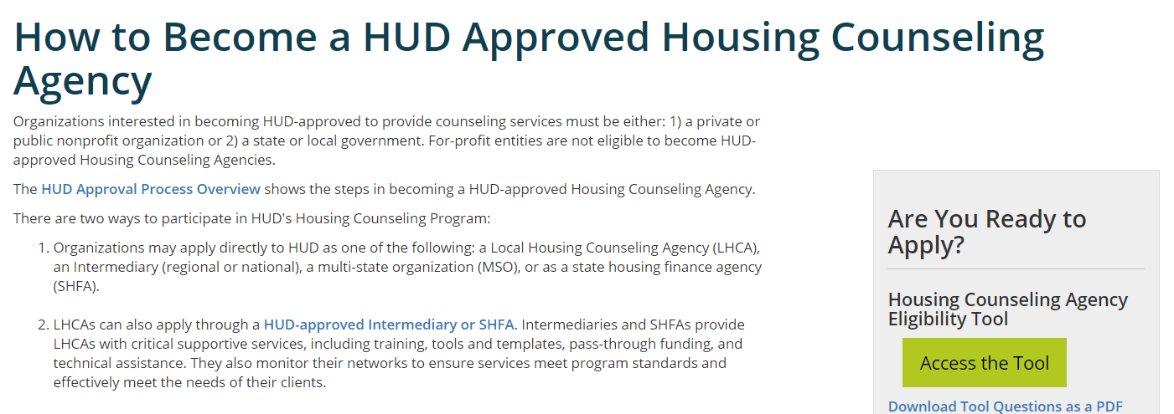
HUD Approval
https://www.hudexchange.info/programs/housing-counseling/agency-application/
Notes:
Benefits of HUD Approval - HUD’s Housing Counseling Program offers a number of benefits to participating state HFAs and/or other partners who become HUD-Approved.
HUD-Approval adds a lot of credibility for the organization. Foundations, lenders, and other financiers often provide additional support when an agency has the approval paperwork.
OHC has a number of training partners such as NeighborWorks America, Rural Community Assistance Corporation (RCAC), Unidos US (previously National Council for LaRaza), and National Community Reinvestment Coalition (NCRC) who offer training, technical assistance and resources for housing counselors. Some also offer scholarships!
OHC maintains a national network where agencies are listed on the HUD Exchange and on HUD.gov – through the Find a Housing Counselor as shown previously in the presentation.
Here’s a screenshot of the page we developed on HUD-Approved. It provides details on the criteria and a link to resources. Finally, the box on the right-hand side provides a link to an online tool which I will cover on the next slide.
Qualifying Criteria
Private or public nonprofit organization 501(c), or state or local government
One year experience providing housing counseling
One year of operation in proposed geographic service area(s)
Sufficient counseling resources

Slide 27
Housing Counseling Agency Eligibility Tool (HCAET)
Anyone with a HUD Exchange account can use the tool
Provides in-depth explanation of eligibility criteria
Evaluates agency readiness to apply based on information provided to the tool
Provides an agency with a user report to follow up on next steps
Does not replace a formal application review by HUD
Notes:
This tool is one of a kind on the HUD Exchange. This tool can be used with a HUD Exchange account and good for an organization to take to determine if they are ready to apply to HUD. This is a comprehensive teaching tool as well with links to resources available as an organization answers a series of simple yes/no question. Once the organization receives a “ready to apply” result, they can provide that to HUD’s Office of Housing Counseling and the formal application.

Slide 28
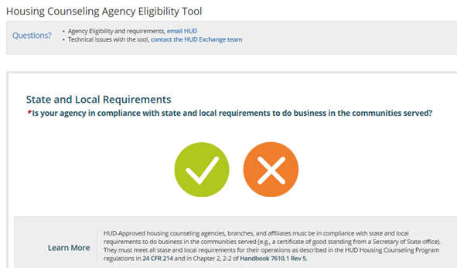
HCAET (cont)
https://www.hudexchange.info/programs/housing-counseling/housing-counseling-agency-eligibility-tool/
Notes:
Here’s an example of a question within the tool and the teaching part, “Learn More” which accompanies each question within the tool.

Slide 29
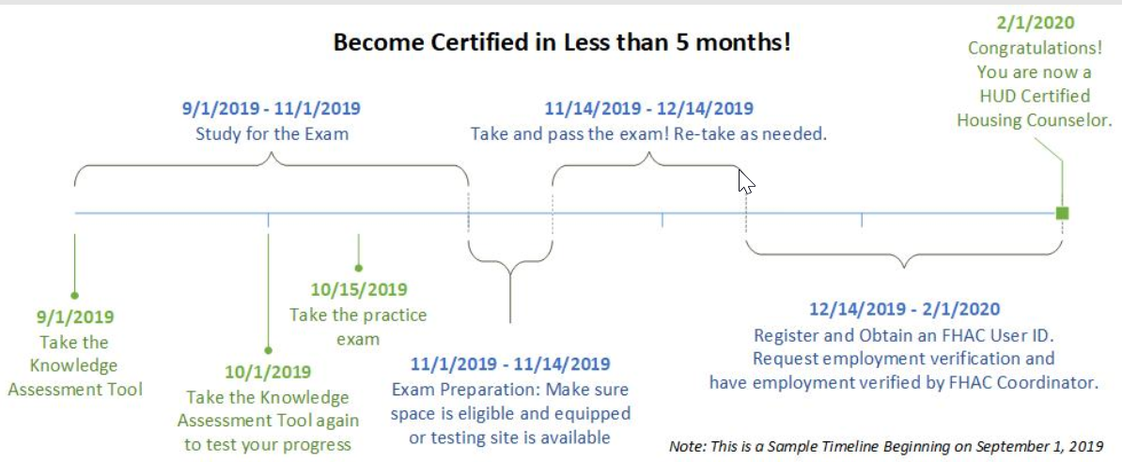
Sample Timeline for Certification

Slide 30
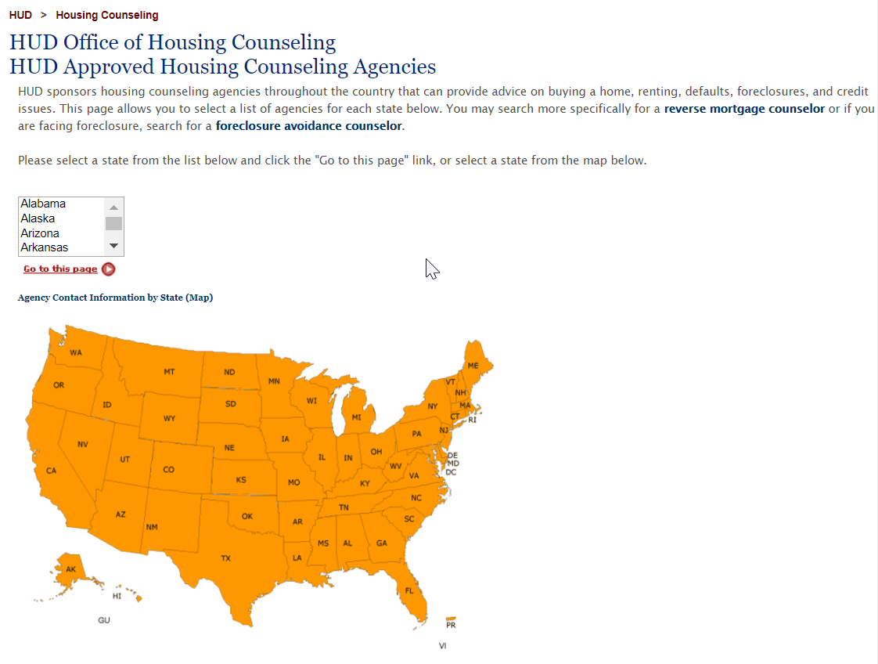
HUD Approved Agencies
https://apps.hud.gov/offices/hsg/sfh/hcc/hcs.cfm
Notes:
Key points:
TBD
Common questions/concerns:
NA
Training delivery tip:
NA

Slide 31
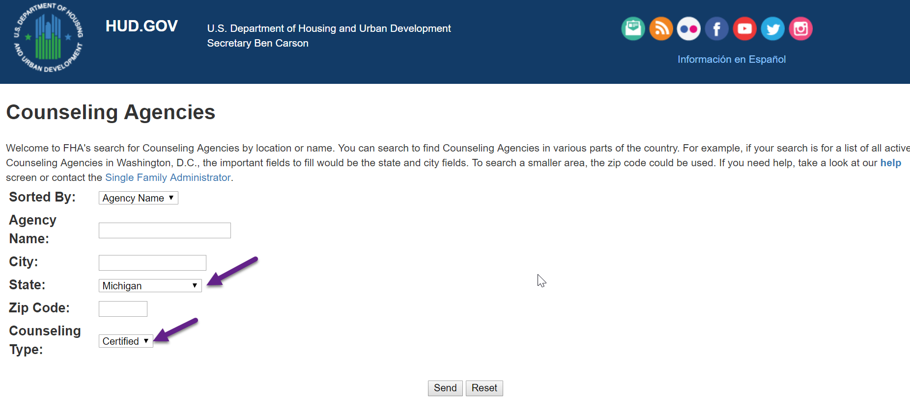
Find an Agency with HUD-Certified Housing Counselors
https://entp.hud.gov/idapp/html/hecm_agency_look.cfm
Notes:
Key points:
TBD
Common questions/concerns:
NA
Training delivery tip:
NA

Slide 32
Upcoming Webinar on HUD Approval
Please join us March 3, 2020
Purpose of the webinar:
Designed for prospective housing counseling agencies and will offer tips and best practices on how to meet HUD’s requirements for approval
Cover the process of how to become a HUD-approved housing counseling agency
Review resources available on the HUD Exchange will also be explained and featured throughout the webinar
Registration link: https://register.gotowebinar.com/register/5191422620119552514

Slide 33
Questions
Time for Mentimeter!
Notes:
Shawna will do the Mentimeter, Robin can finish up the delivery.

Slide 34
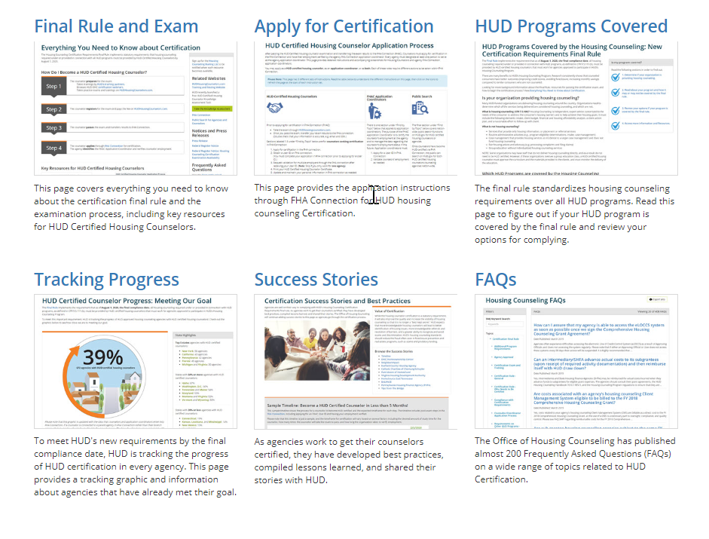
Housing Counselor Certification Landing Page
https://www.hudexchange.info/programs/housing-counseling/certification/
Notes:
We recently launched a new landing page for the Certification Final Rule. There are pages specifically on the following (from upper left to lower right): Final Rule/Exam, FHA Connection Application (you won’t need this yet, but if you participate and have housing counselors who need to apply for employment, this page walks through that process), HUD Programs Covered – this is brand –new and there are short examples for each type of program in terms of compliance, tracking progress is our way to have a thermometer to see how we’re doing with certification among counselors, Success stories for HUD-approved agencies, and finally FAQs.

Slide 35
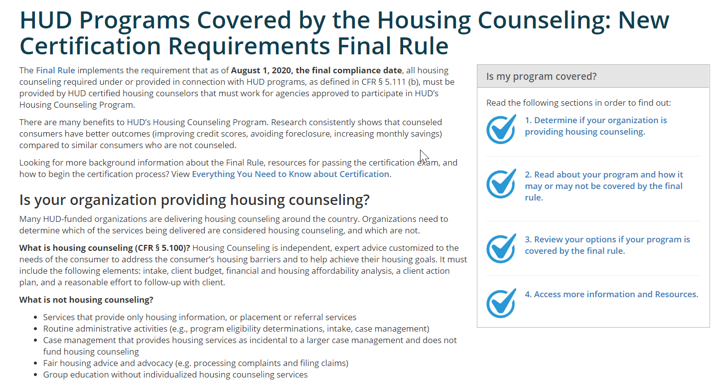
Other HUD Covered Programs Page
https://www.hudexchange.info/programs/housing-counseling/certification/covered-programs/
Notes:
Here’s a look at the Covered Programs page.

Slide 36
Certificate of Training
If you logged into the webinar, you will receive a Certificate of Training from GoToWebinar within 48 hours.
Please print it out and save for your records.

Slide 37
Get Credit!
Webinar materials will be posted on the HUD Exchange in the Webinar Archive
https://www.hudexchange.info/programs/housing-counseling/webinars/
Find by date or by topic
To obtain credit
select the webinar, and
click “Get Credit for this Training”

Slide 38
Conclusion
Time for Mentimeter!

