Slide 1

CARES Act Funding Closeout
HCV Program, Mainstream Vouchers and Moderate Rehabilitation Programs
PIH Notice 2022-21
Public Housing Agencies’ Briefing
August 2022

Slide 2
CARES Act Closeout
Important:
Today's webinar will be recorded. The recording and PowerPoint will be posted to the ”Webinars and Trainings” section of www.hud.gov/hcv, in about a week.
Stay connected by visiting www.hud.gov/hcv and subscribing to the HCV Connect Newsletter.

Slide 3
Agenda
PIH Notice 2022-21 CARES Act Reconciliation and Closeout
Closeout Timeline
Form SF-425 Instructions
Expectations post submission of SF-425s
Other Items
Q&As

Slide 4
PIH Notice 2022-21
Background
The Coronavirus Aid, Relief, and Economic Security Act, (CARES Act) (Public Law 116-136) provided supplemental HAP and Administrative funding to the HCV Program and the Mainstream Vouchers, and supplemental HAP to the Moderate Rehabilitation (Mod Rehab) Program.
CARES Act funding’s period of performance ended on December 31, 2021;
The notice describes closeout procedures per 2 CFR 200.344 (Closeout) for funds awarded to public housing authorities (PHAs)
It provides guidance to public housing agencies (PHAs) in the submission of the OMB Form SF-425 - Federal Financial Report to HUD.

Slide 5
Cares Act Closeout
Notification to PHAs
HUD notified all PHAs on August 8th, 2022, that the Notice was available.
The notification was through a cover letter that included the required OMB Form SF-425.
Guidance in Appendix A of PIH Notice 2022-21, or use “Instructions Tab” in OMB Form SF-425
SF-425 was prepopulated with CARES Act’s program description, period of performance and formulas for total awards and total disbursed to the PHAs.

Slide 6
Cares Act Closeout
Notification to PHAs
PHAs to fill out their expense information by program, by type of funding, in the FFR Attachment. The main form will auto-populate with the aggregated financial information.
PHAs Director or designee to complete field 12. Remarks, and field 13.
Forms due September 6, 2022.
HUD should respond by October 14, 2022

Slide 7
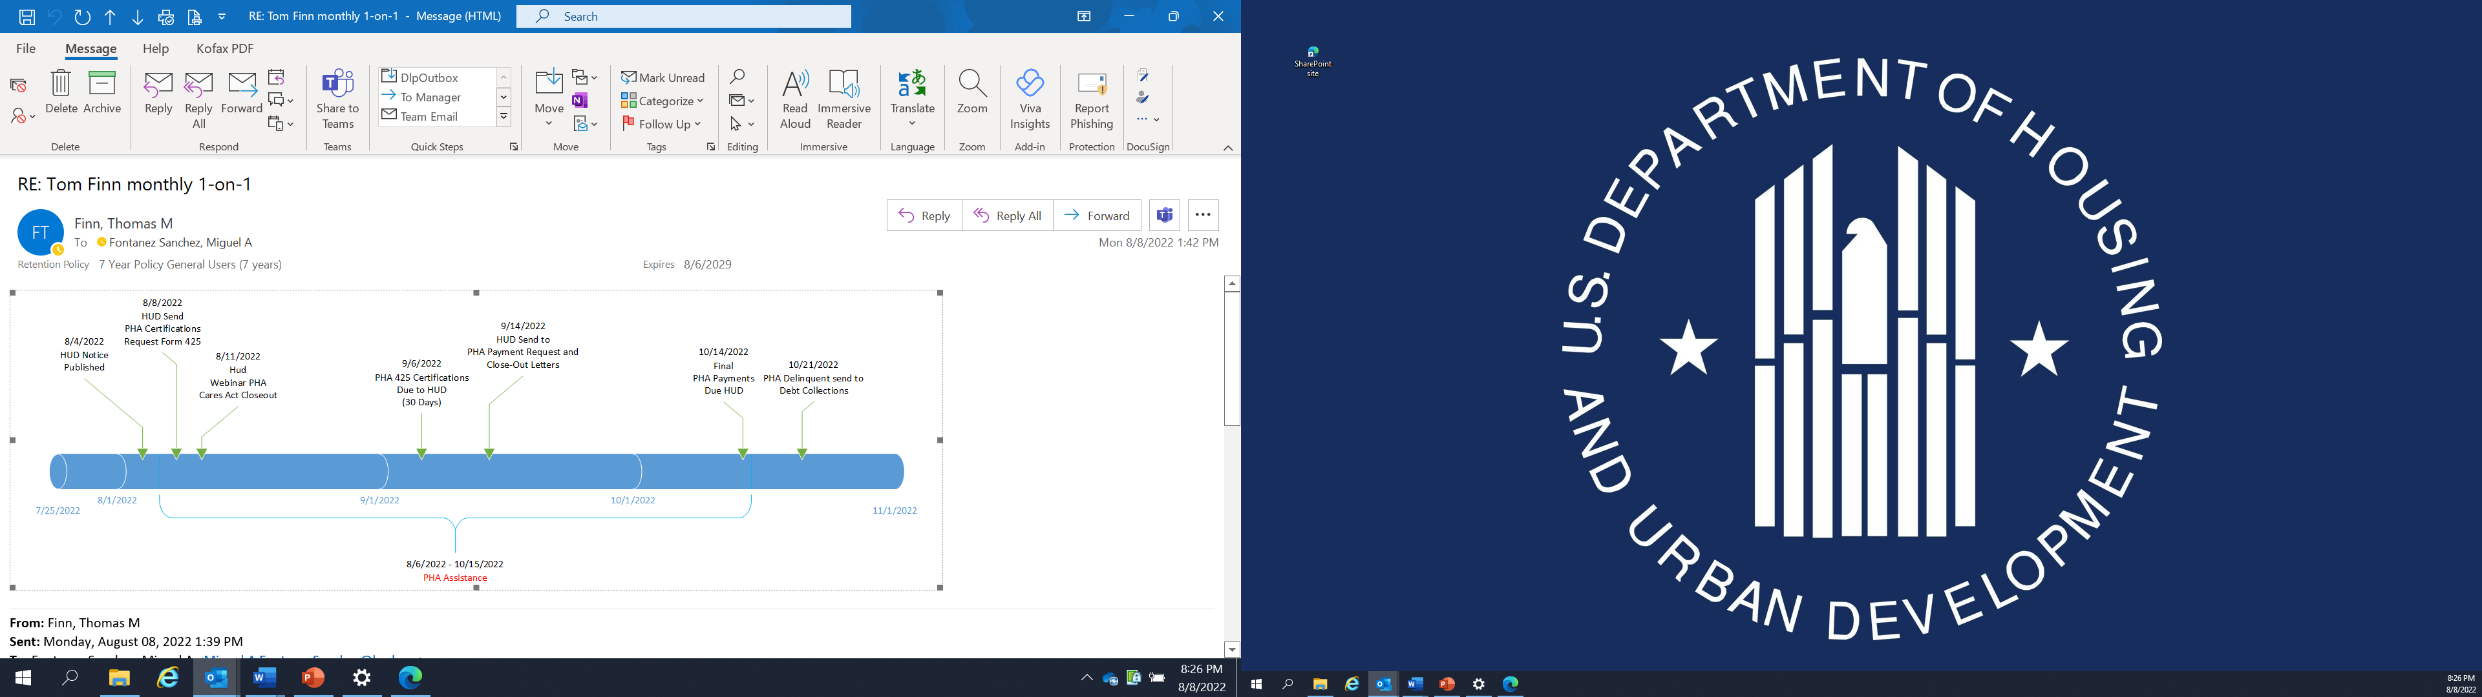
Timeline / Sequence of Closeout Events
Cares Act Closeout

Slide 8
Cares Act Closeout
Form SF-425, FFR Attachment tab
* Line b. Cash Disbursements must tie to FDS expense reporting per PIH Notice 2020-24

Slide 9
Cares Act Closeout
Form SF-425, Instructions Tab

Slide 10
Form SF-425
Main Form

Slide 11

Cares Act Closeout
Expectations post submission of OMB Forms SF-425:

Slide 12
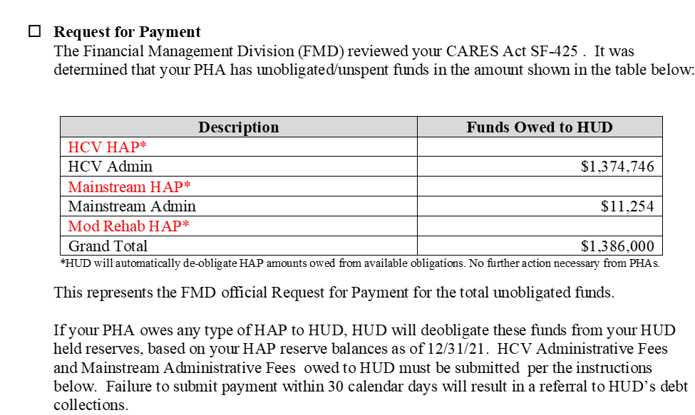
Cares Act Closeout
HUD Feedback:

Slide 13
Cares Act Closeout
HUD Feedback Continuation:

Slide 14
Cares Act Closeout
Mod Rehab CARES Act
PIH Notice 2020-20, Mod Rehab (PIH) CARES Act Notice
HUD advised PHAs that received Mod Rehab CARES Act HAP funding in their ACC that if CARES funding was needed due to increased HAP costs, they would need to submit a complete budget package requesting an increase in their monthly disbursements.
Only those PHAs that submitted a revised Mod Rehab budget specifically requesting the use of their CARES Act HAP funds should include expenses for the Mod Rehab program when they return their SF-425 response.
The full award will be automatically recaptured for PHAs that did not request the use of funds.
HUD will issue an Amended ACC to PHAs when funds are de-obligated and will communicate the program has been closed.

Slide 15
Questions and Answers:
1. Are there PHAs exempt from submitting the OMB Form SF-425?
No, all PHAs must submit this form.
2. Can we use unobligated CARES Act supplemental HAP or admin fee balances for either HAP costs or COVID/HCV admin related expenses in CY 2022?
No. The period of performance ended on December 31, 2021, and no additional funds can be utilized after this date. PHAs had 120 days to spend unliquidated obligations. For spending of unliquidated obligations past 120 days, please follow guidance in PIH Notice 2022-21.

Slide 16
Questions Continuation
3. We received CARES Act supplemental fees under both the HCV Program and Mainstream Vouchers. Can we report the accumulated expenses in the SF-425 FFR attachment tab?
Funding activity/expenses must be reported under each individual program (and fund type, supplemental HAP or Fees). Expenses cannot be combined.

Slide 17
Questions Continuation
4. Will PHAs be required to report again on the HUD Portal referenced in PIH Notice 2020-24, or in the Voucher Management System (VMS)?
HUD suspended work on the HUD Portal; therefore, the SF-425 became the reporting tool that HUD will utilize to collect CARES Act financial activity and closeout. PHAs do not have to report this information in VMS.

Slide 18
Cares Act Closeout
Other Items
Reach out to FMC FAs or email the FMD mailbox at PIH.Financial.Management.Division@hud.gov for questions on your submissions or status.
Monitoring:
Field Office Monitoring – based on monitoring protocols
HCV QAD Monitoring – QAD Analysts are including CARES Act as part of the normal course of their Financial Management Review process.

