Slide 1
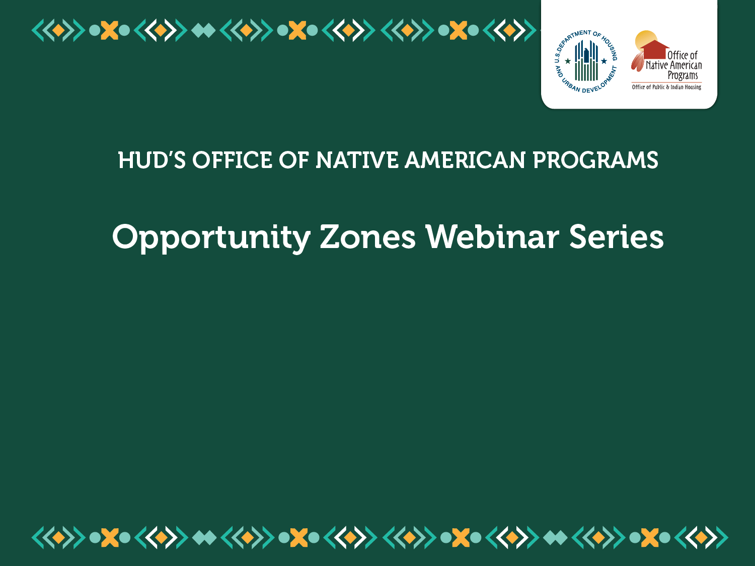
Opportunity Zones 101 for Tribes
February 13, 2020
Conference call dial-in 888-251-2949; Access Code: 5556669#

Slide 2
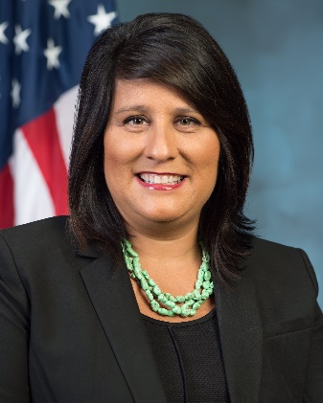
Welcome
Heidi J. Frechette serves as the Deputy Assistant Secretary for HUD’s Office of Native American Programs. In her capacity, she manages a number of programs dedicated to Native American communities – including one that is the largest source of housing assistance – and leads a team of professionals in Washington, D.C., and eight other offices located throughout the country.
Notes:
Welcome From Heidi.
Introduce Iris?
Introduce FirstPic???
Introduce Enterprise, turn over to ECP

Slide 3
Our Presenters
Enterprise was founded in 1982 as one of America’s original social enterprises, to work with partners in communities nationwide. Enterprise brings together the people and resources to create affordable housing in strong neighborhoods. Within Enterprise are entities that help communities develop programs, lend funds, finance development, and manage and build affordable housing.
Patrick Jordan serves as vice president of Enterprise Advisors, the mission-based consultancy for Enterprise Community Partners.
Russell Kaney serves as director of programs for the Rural and Native American Initiative (RNAI) at Enterprise Community Partners.
Mike Tedesco serves as the Executive Director of the Spokane Tribe .
Nothing in this primer is intended, nor should it be relied upon, as legal advice. Rather, it is meant to better equip tribal governments to work with legal and tax professionals they retain to harness the tax benefits of creating or expanding tribal businesses in such areas.
Notes:
Introduction of presenters and background on Enterprise and the work they do.

Slide 4
Overview: Background
Enacted as part of the 2017 Tax Cuts and Jobs Act
Opportunity Zones are specially-designated areas in low-income communities across the nation.
New tax incentive intended to:
Attract long-term private investment
Spur economic growth
Chance to develop strategies and align policies that harness the tax incentive, while serving the needs of residents
Notes:
Opportunity Zones are specially-designated areas in low-income communities across the nation. Created as part of the 2017 Tax Cuts and Jobs Act, Opportunity Zones provide a new tax incentive to qualified investments in these areas. Individuals and corporations that sell investments at a profit can, in turn, invest realized capital gains from such sales in businesses or property in Opportunity Zones and defer paying capital gains tax for up to 10 years. This incentive is intended to attract long-term private investment and spur economic growth in these communities. For communities across the United States experiencing increasing housing insecurity and growing economic inequality, an Opportunity Zone designation provides a chance to develop strategies and align policies that harness this incentive, while serving the needs of current and future residents.

Slide 5
Overview: Designations
Opportunity Zones are defined by census tract – more than 8,700 nationwide, including 362 that overlap with Tribal lands.
In early 2018, Governors nominated the census tracts to be designated as Opportunity Zones in each state.
In June 2018, U.S. Treasury approved Opportunity Zones in all 50 states, five territories, and Washington, D.C.
Notes:
Opportunity Zones are defined by census tract – more than 8,700 nationwide.
There are 362 Opportunity Zones that overlap with Indian tribal lands, including state and federally recognized American Indian and Alaska Native reservations and trust lands, Alaska Native villages, and tribal areas in Oklahoma. Unfortunately, because of the statutory limit on the number of eligible areas that could be nominated for designation, some of the poorest areas of Indian Country were not deemed as such despite being eligible.
In early 2018, governors nominated the census tracts to be designated as Opportunity Zones in each state. By June, Treasury had approved Opportunity Zones in all 50 states, five territories, and Washington, D.C.
Private investments in Opportunity Zones are made through Qualified Opportunity Funds, a new private investment vehicle authorized to aggregate and deploy capital into Opportunity Zones. U.S. investors are eligible to receive certain tax benefits on realized capital gains that are reinvested in Opportunity Zones through Qualified Opportunity Funds. Tax benefits increase with the length of time that the investment is held.

Slide 6
Overview: Eligibility
Low-Income Communities
Section 45D(e) - New Market Tax Credit program
Poverty Rate
Median Family Income Comparison
Tracts Contiguous with Low-Income Communities
Contiguity
Median Family Income Comparison
Notes:
In 2018 the U.S. Internal Revenue Service (“IRS”) identified low-income community tracts that qualified for designation as Opportunity Zones. A “low-income community” means any population census tract where:
-the poverty rate for the tract is at least 20 percent;
- the median family income for a tract not located within a metropolitan area does not exceed 80 percent of statewide median family income; or
-the median family income for a tract located within a metropolitan area does not exceed 80 percent of the greater of statewide median family income or the metropolitan area median family income.
Areas adjacent to eligible low-income communities that did not meet the definition of “low-income community” themselves were still eligible for designation, provided the median family income of the adjacent area did not exceed 125 percent of the median family income of the neighboring eligible low-income community.

Slide 7
Overview: How Tracts were Chosen
Each state could designate up to 25% of eligible census tracts
Based on Low-Income Community definition
Exception for states with less than 100 tracts
Exemption: Up to 5% of the tracts designated could be contiguous instead of Low-Income Community tracts
Governors submitted nominations by March/April of 2018
U.S. Treasury approved designations by June 2018.
Notes:
The IRS then turned the nomination process over to state and territorial governors, and the mayor of the District of Columbia. Each then nominated a maximum of 25 percent of the eligible areas in their respective state/territory to be designated as opportunity zones. Aside from the limitations set by the IRS on what areas qualified for nomination and designation, governors were free to pick whichever eligible areas they wanted to be designated as Opportunity Zones. Governors followed their own processes for deciding on what areas to nominate for designation. In Montana, for example, the governor nominated 25 areas for designation after reviewing proposals from eligible communities, including 7 federally recognized American Indian reservations.
The U.S. Treasury Department (“Treasury”) finalized the designations at the end of 2018.

Slide 8
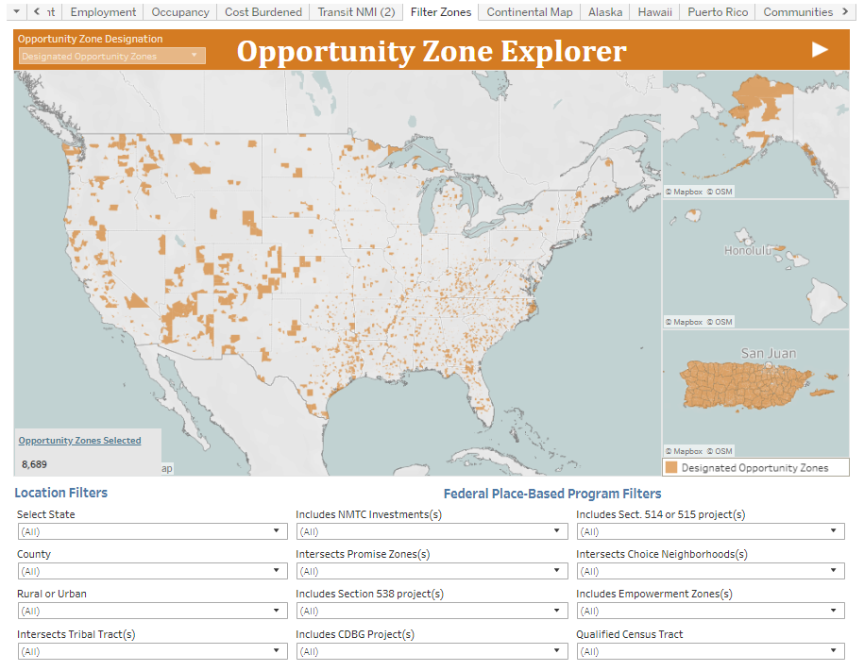
Overview: Finding Designated Tracts
https://www.enterprisecommunity.org/opportunity360/opportunity-zone-eligibility-tool

Slide 9
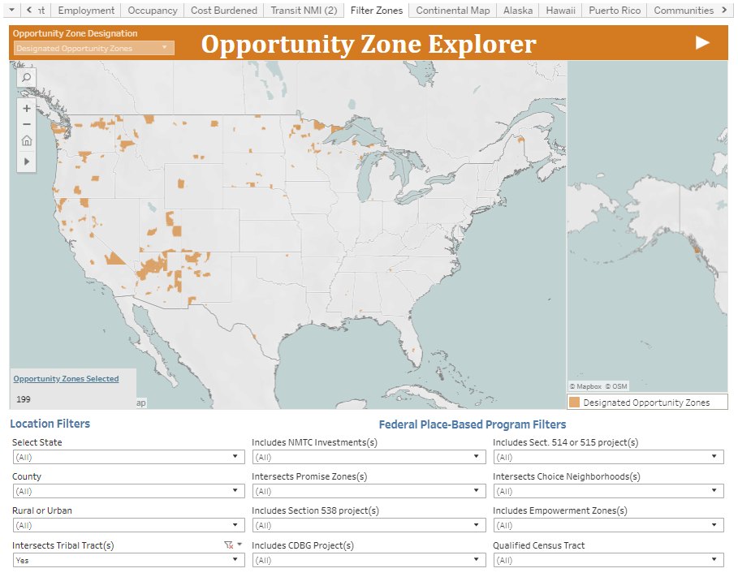
Overview: Finding Designated Tracts
https://www.enterprisecommunity.org/opportunity360/opportunity-zone-eligibility-tool

Slide 10
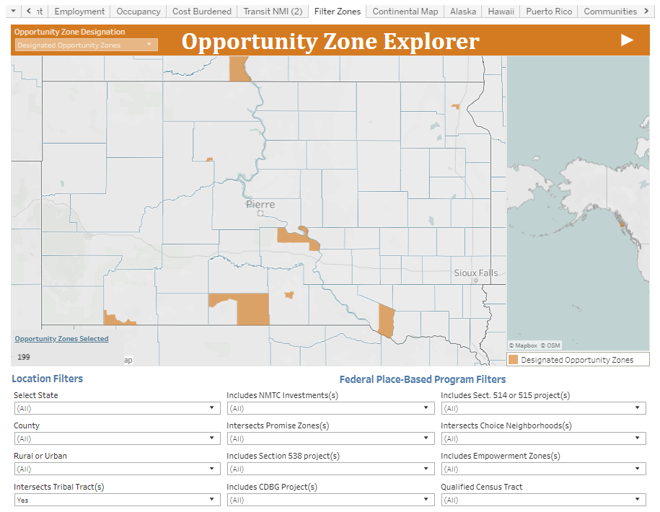
Overview: Finding Designated Tracts
https://www.enterprisecommunity.org/opportunity360/opportunity-zone-eligibility-tool

Slide 11
Terminology
Opportunity Zone Census Tract
Qualified Opportunity Fund
Investor
Capital Gains Taxes
Temporary Deferral
Step up in Basis Points
Tax Free Gains

Slide 12
What does this mean to you and your tribe?
Opportunity Zone Census tract
10-year designation
30% of all eligible Tribal tracts were designated
Qualified Opportunity Fund (QOF)
Investment vehicle, established as a partnership or corporation
Opportunity for outside investors to invest in your project
Funds must self-certify on IRS Form 8996
State involvement
Each state has an office that oversees OZ's and provides incentives, education, support, etc.
Notes:
In terms of timing, the designations for Opportunity Zone tracts last for 10 years.
In order to invest in an Opportunity Zone, investors pool their investments in an Opportunity Fund, which is an investment vehicle set up either as a partnership or corporation, for investing in eligible property or businesses located in an Opportunity Zone. Only a partnership or corporation organized in one of the 50 states, the District of Columbia, or U.S. territories is eligible to be an Opportunity Fund. Opportunity Funds must hold at least 90 percent of their assets in Opportunity Zone Property meaning tangible business property or stock or partnership interest in a business located in an Opportunity Zone.
Opportunity Funds must self-certify on IRS Form 8996 in their annual income tax filings. There are already at least 134 funds across the U.S. with $29 billion in capital.
Each state has an office that oversees OZ's and provides incentives/education/support/etc. In addition to the tax benefits that drive private capital, Federal agencies, as well as state, tribal, local, and territorial governments are also aligning resources with the Opportunity Zone program. These additional sources of support offer local stakeholders a chance to compete more effectively for private capital that can move to any designated Opportunity Zone, and to assure more reliably that tribal communities and residents receive concrete benefits from Opportunity Fund investments in real estate or business enterprises in their communities. Get to know who your state agencies are and find out if they have additional incentives or resources that could help your project.

Slide 13
What does this mean to you and your tribe? (cont)
Capital Gains Taxes
Capital gain is profit from sale of an asset
Flexible application to OZs under IRS regulations for reinvestment made within 6 months
Example:
Investor purchases $60,000 in stock.
Investor sells the stock for $100,000, earning a $40,000 in capital gains.
$40,000 can be reinvested in an Opportunity Fund to realize tax benefit.
Notes:
A capital gain is the difference between what a person or corporation paid for an asset and the amount of profit received when the asset is sold. Under regulations by the IRS, almost any kind of capital gain can be invested in an Opportunity Fund, including profits from the sale of stocks, mutual funds, real estate, or a business. If a seller reinvests the capital gains in an Opportunity Fund within 180 days of the sale, they can defer paying taxes on them.
For example, if a stock is sold for $100,000 and $40,000 of that amount was a gain, the seller could then reinvest the gain in an Opportunity Fund and defer their capital gains tax. The seller can do what they like with the remaining $60,000. Only the gains may be reinvested in the Opportunity Fund in order for the seller to defer paying capital gains taxes on it.

Slide 14
Overview: Tax Benefits
Benefit 1: Temporary Deferral of Capital Gains Taxes – investment in a qualified fund delays payment of capital gains until they exit the fund or December 31, 2026, whichever comes first.
Benefit 2: Step Up in Basis – Investments held for 5 years will be taxed at reduced rates – 90% (10% basis increase); and 85% for investments held at least 7 years (15% basis increase).
Benefit 3: Tax-Free Gains After Year 10 – for investments held for 10 years, capital gains achieved by the investment in the Opportunity Fund will not be taxed.
Notes:
Benefits of investing in Opportunity Zones can be summarized according to three major categories:
Benefit 1: Temporary Deferral of Capital Gains Taxes – Investors will not be taxed on the capital gains invested in an Opportunity Fund until they exit the fund or December 31, 2026, whichever comes first.
Benefit 2: Step Up in Basis – Investments held for a minimum of 5 years will be taxed at reduced rates – 90% for investments held at least 5 years (10% basis increase) and 85% for investments held at least 7 years (15% basis increase).
Benefit 3: Tax-Free Gains After Year 10 – If an investor holds a reinvestment for 10 years, capital gains achieved by the Opportunity Fund investment during that 10-year period will not be taxed. This is a permanent exclusion from taxable income.

Slide 15
Overview: Timing and Business Qualifications
Opportunity Funds themselves must deploy capital quickly into projects, properties, or companies in designated Opportunity Zones.
Opportunity Zone businesses must meet regulatory requirements regarding their tangible property, and their gross income must be derived by business activity.
Businesses that do not qualify:
Private golf courses and country clubs
Massage parlors, suntan facilities, and hot tub facilities
Race tracks and other facilities used for gambling
If principal business is sale of alcohol for off-site consumption.
Notes:
By law, investors who want to use the Opportunity Fund mechanism must reinvest their prior gains quickly, and then the Opportunity Funds themselves must deploy capital quickly into projects, properties, or companies in designated Opportunity Zones.
Opportunity zone businesses must meet regulatory requirements regarding their tangible property, and their gross income must be derived by business activity. Specifically, there are 4 requirements:
trade or business in which:
-substantially all of the tangible property owned or leased is Opportunity Zone business property;
-fifty percent of the total gross income of the business is derived from the active conduct of the business;
-a substantial portion of the intangible property of the business is used in the active conduct of the business; and
-less than five percent of the average of the aggregate unadjusted bases of the property of such entity is attributable to nonqualified financial property.
There are a few types of businesses that do not qualify for OZ investment, so please take note of these exceptions.

Slide 16
Overview: Business Property and Indian Trust Land
Opportunity Zone business property must meet three requirements on timing of acquisition and use.
Indian trust land qualifies as Opportunity Zone business property, if:
Lease begins after December 31, 2017, and
Substantially all of the use of the leased property is in an Opportunity Zone during substantially all of the period for which the business leases the property.
Notes:
Opportunity Zone business property means tangible property used in a trade or business of an Opportunity Fund where:
-the property was acquired after December 31, 2017;
-the original use of such property commences with the Opportunity Fund, or the fund substantially improves the property; and
-during substantially all of the fund’s holding periods of the property, substantially all of the use of the property was in a qualified Opportunity Zone.
The IRS has regulations that deal directly with the unique features of Indian trust land that is typically leased to tribal businesses or tribal members. According to the regulations, leased property will be treated as Opportunity Zone business property if:
-the leased property was acquired under a lease after December 31, 2017; and
-substantially all of the use of the leased property is in an Opportunity Zone during substantially all of the period for which the business leases the property.
The meaning of “substantially all” throughout the statute and regulations depends on the context where it is used. For example, in the context of the amount of tangible property owned or leased by the business, the meaning is 70 percent.

Slide 17
Opportunity Zones benefits for Tribal Communities
Many Tribal communities have assets they can use to support Opportunity Zone investments, such as land, plans, and limited zoning requirements.
Investments can support expansion of existing or creation of new businesses
Investments can support development and redevelopment of real property
There is no limit on the amount on investment that can be made in an Opportunity Fund.
Notes:
Opportunity Zones offer Tribal communities a new tool they can use to attract investments in a wide range of projects to improve the economic conditions on tribal lands.
Opportunity Funds must hold at least 90 percent of their assets in Opportunity Zone property, which can include stock or equity in businesses. Tribally owned businesses already operating within an Opportunity Zone could seek new investments to further expand, or new businesses could be established.
Opportunity Funds can also choose to hold their assets in tangible property within an Opportunity Zone, which could lead to the development or redevelopment of properties within Indian Country. This could attract new investments for the construction of new buildings or the redevelopment of existing buildings, such as warehouses, office buildings, hotels, or apartment buildings, thereby leading to an increase in jobs in the Opportunity Zone area. The potential impacts of constructing or redeveloping properties in Indian Country might include the creation of other, new secondary businesses, such as coffee shops or restaurants, that while not direct recipients of Opportunity Funds, support Opportunity Zone businesses.
Finally, since there is no fixed ceiling on the number of Opportunity Zones that can receive investments in any given year, all eligible zones can receive any amount of capital through Opportunity Funds during the year. This represents a new way for Indian Country to attract financing for projects that would improve the economic outlook of the Opportunity Zone area, and, by extension, the tribe and its members

Slide 18
Implementation: Planning in Opportunity Zones
Consistent with HUD’s Community Toolkit for Opportunity Zones, there are steps you can take to plan for your projects:
Understand the current environment, including assets, needs, opportunities, and potential partners
Align community assets and resources to help steer investment toward your economic development goals
Partner with aligned organizations to support equitable and inclusive opportunities
Notes:
Focus on an example, as Iris requested, on work force housing. After the “4 steps” slides, culminate in initial development steps.
Acknowledge this is the way many tribes already do community development activities.

Slide 19
Implementation: Understand
Understand the current environment, including assets, needs, opportunities, and potential partners
Assess housing needs
Conduct an assessment of commercial market conditions
Identify key economic growth drivers
Conduct workforce analysis to understand needs and opportunities
Understand investor priorities and interests

Slide 20
Implementation: Align
Align assets and resources to steer market investment toward community economic development
Deploy underutilized land and property
Align plans for capital investments in local infrastructure
Align and leverage financial resources, including:
state funding and incentives
local community development resources
philanthropic resources
federal resources
private equity

Slide 21
Implementation: Partner
Partner with aligned organizations to support equitable and inclusive opportunities
Identify and establish partnerships with stakeholder organizations, including:
Federal, state, and local government agencies
Nonprofits and community organizations
Anchor institutions, such as colleges and medical centers
Local industry

Slide 22
Implementation: Project Development
As you identify clarity on specific projects, develop a project overview or “pitch deck”
In vetting potential investors, request the term sheet for their Qualified Opportunity Fund
Use the term sheets to identify which fund(s) match the financial terms and expected rates of return for your project.
Commitments of funds will require due diligence and project underwriting based on a project pro forma.

Slide 23
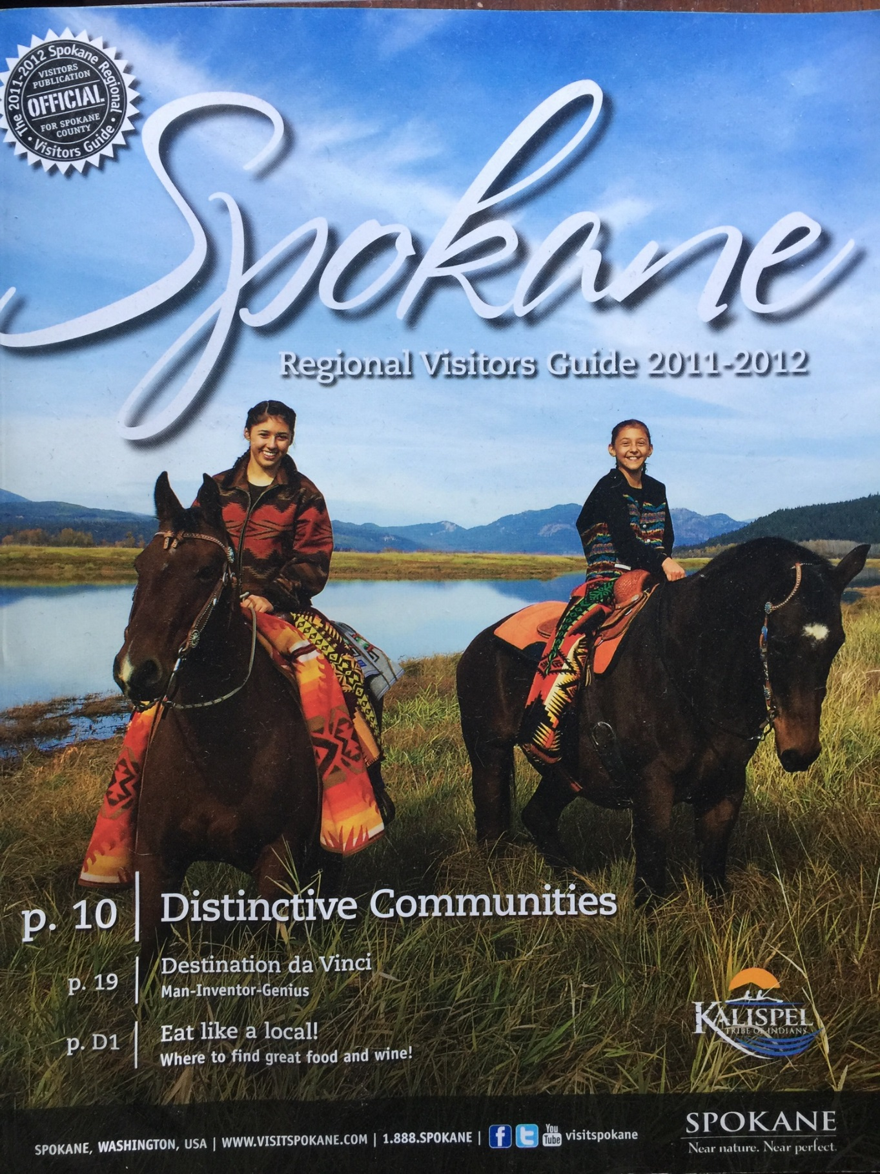
Opportunity Zones

Slide 24
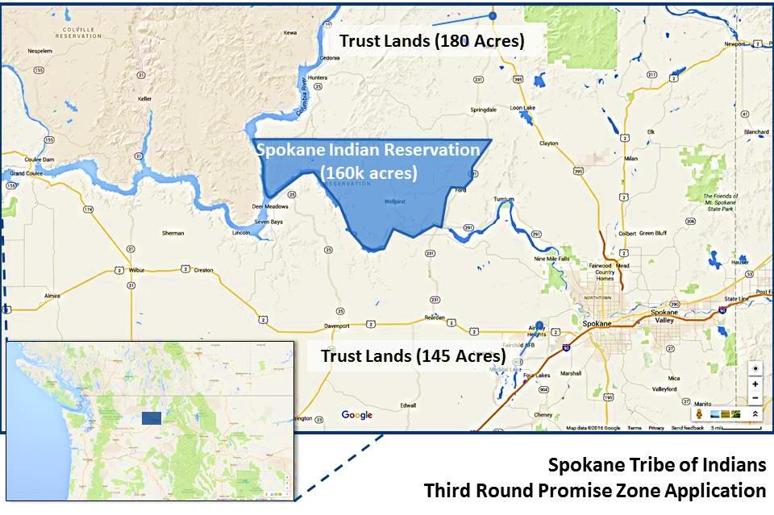
Opportunity Zones

Slide 25
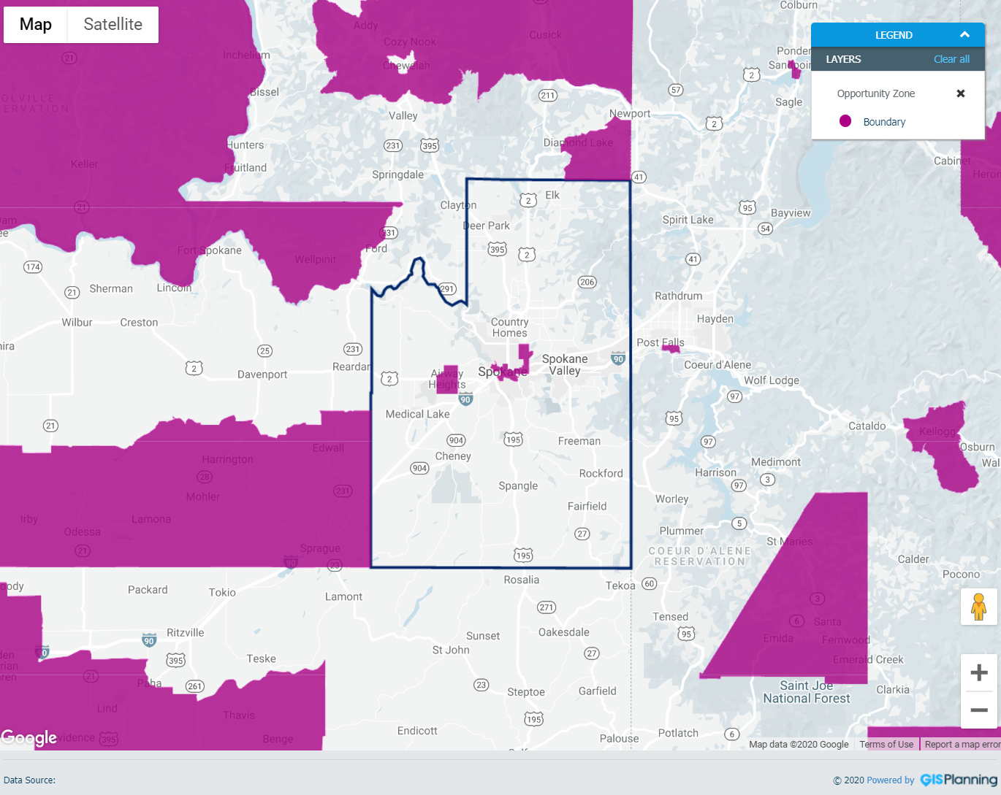
Opportunity Zones

Slide 26
≈ 2,900 Citizens
≈ 41% Unemployment
≈ 33% Poverty
Opportunity Zones

Slide 27
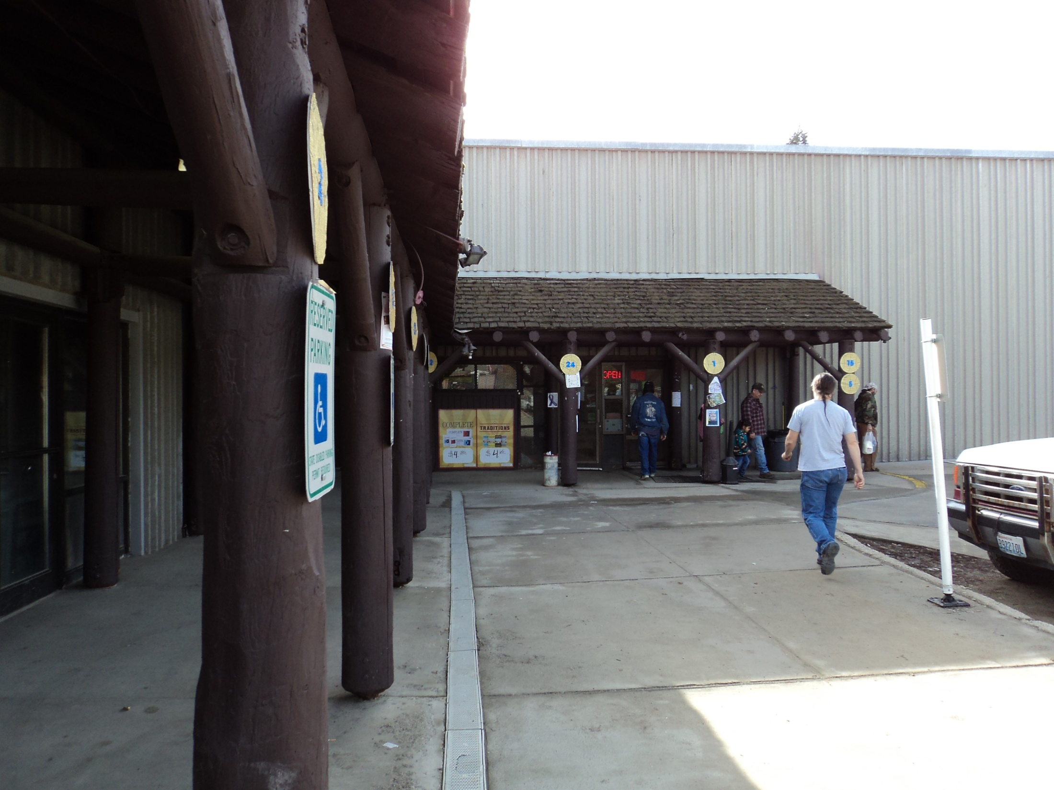
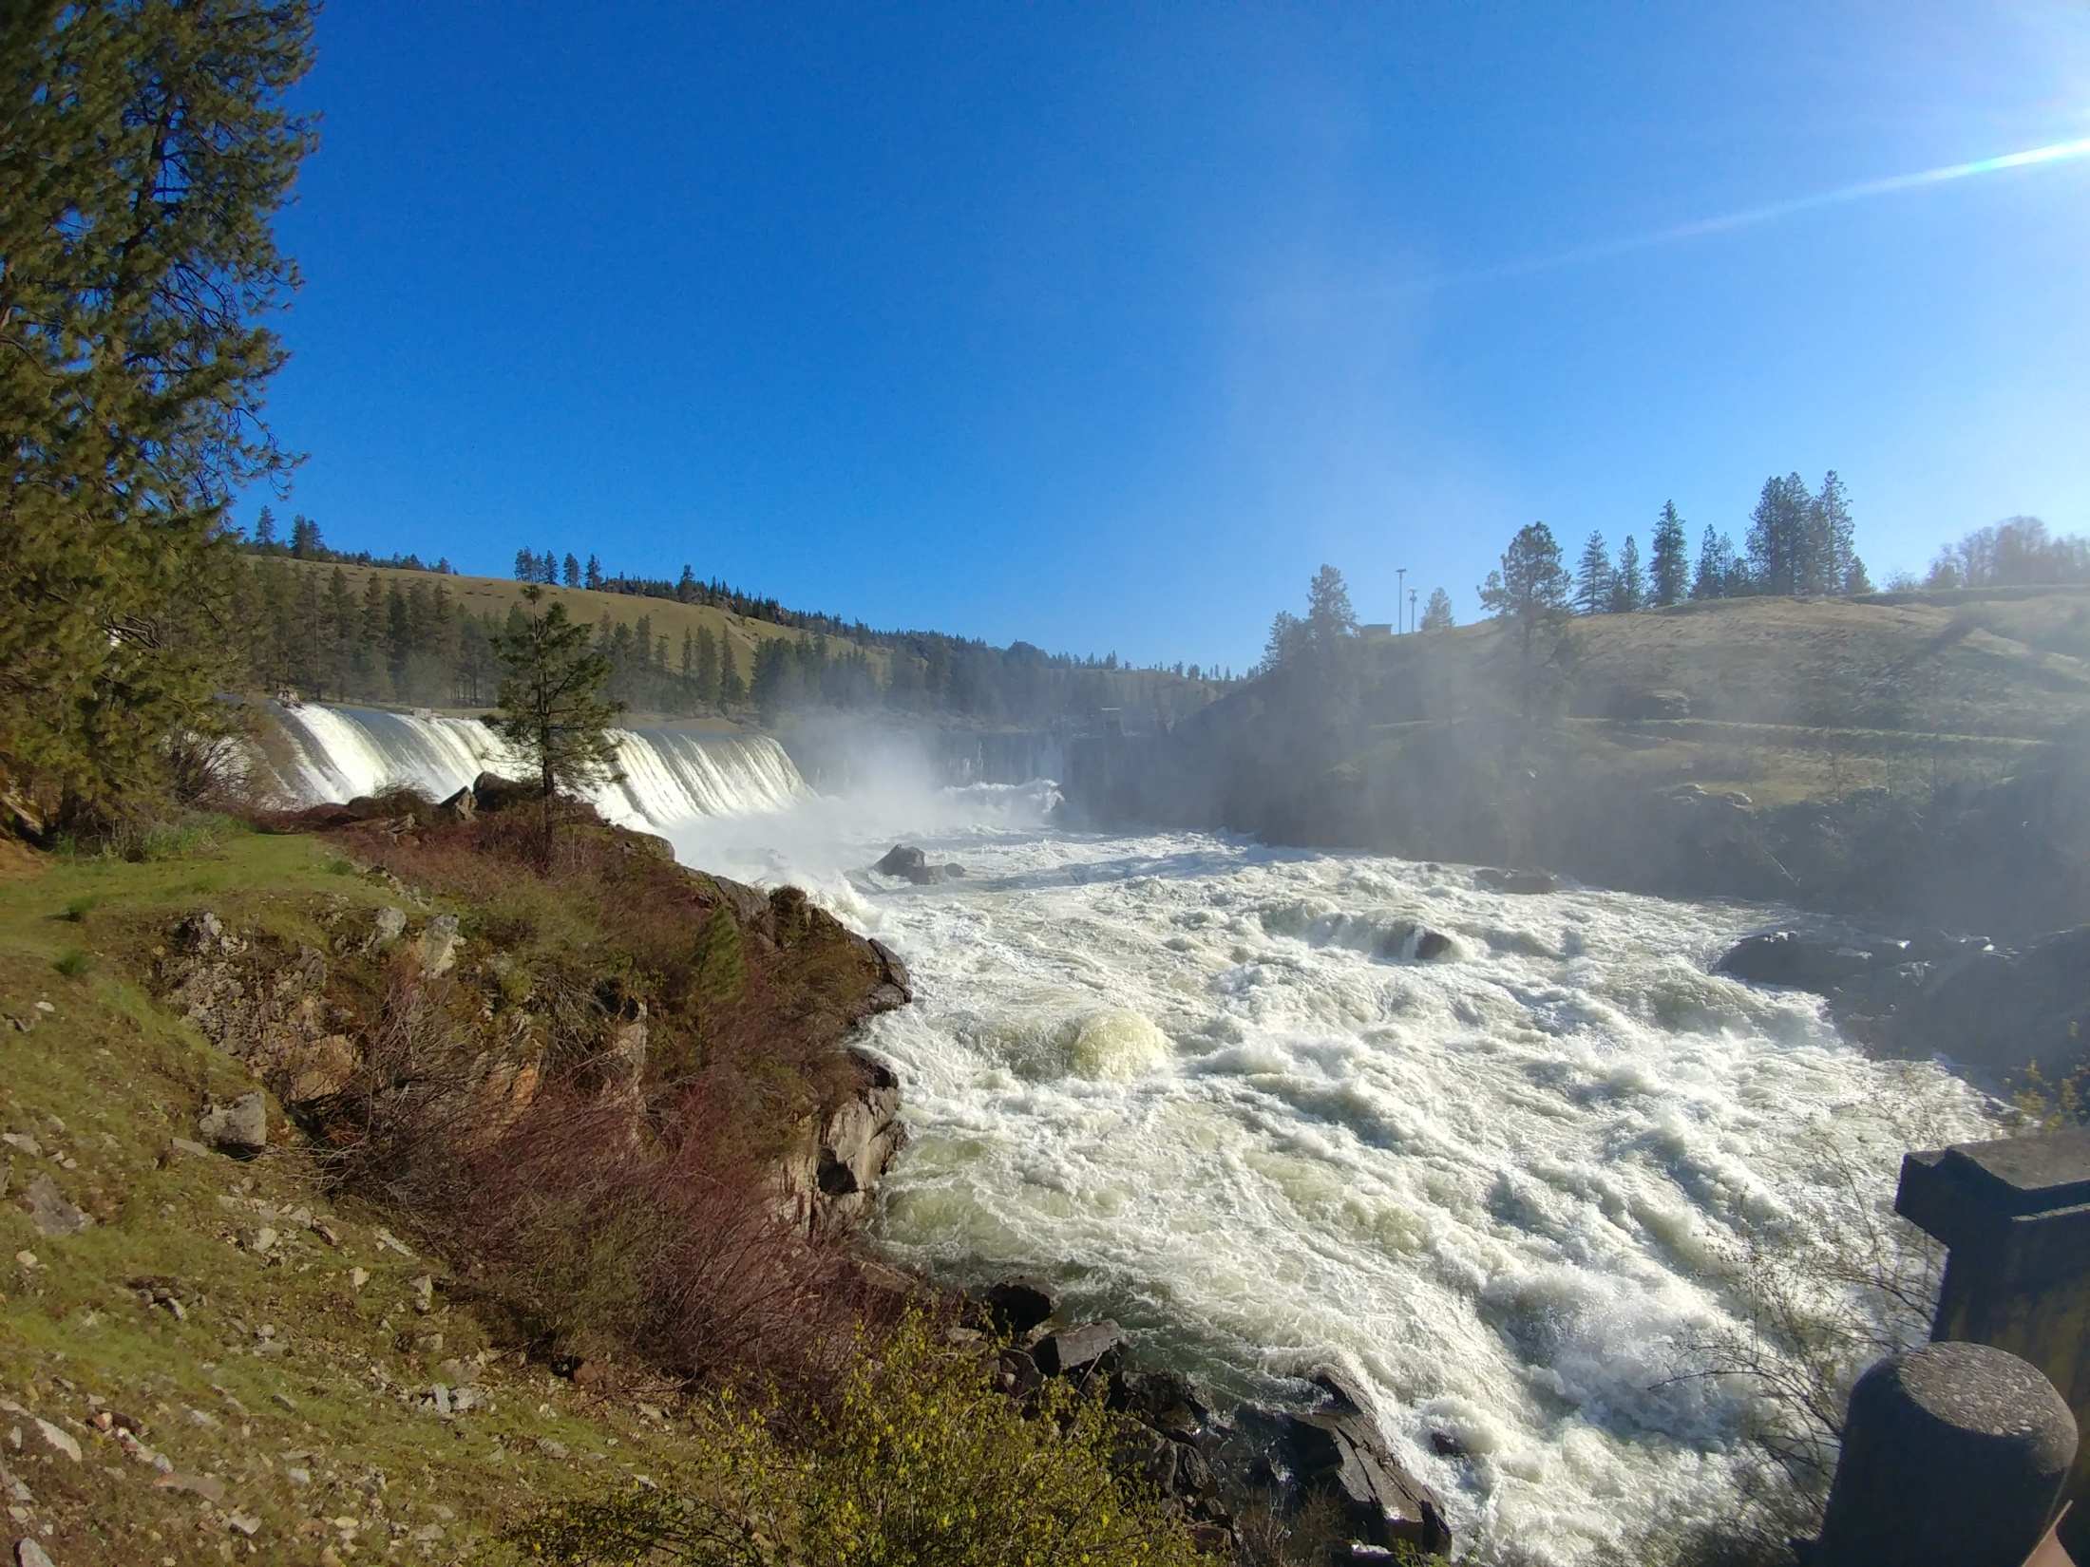
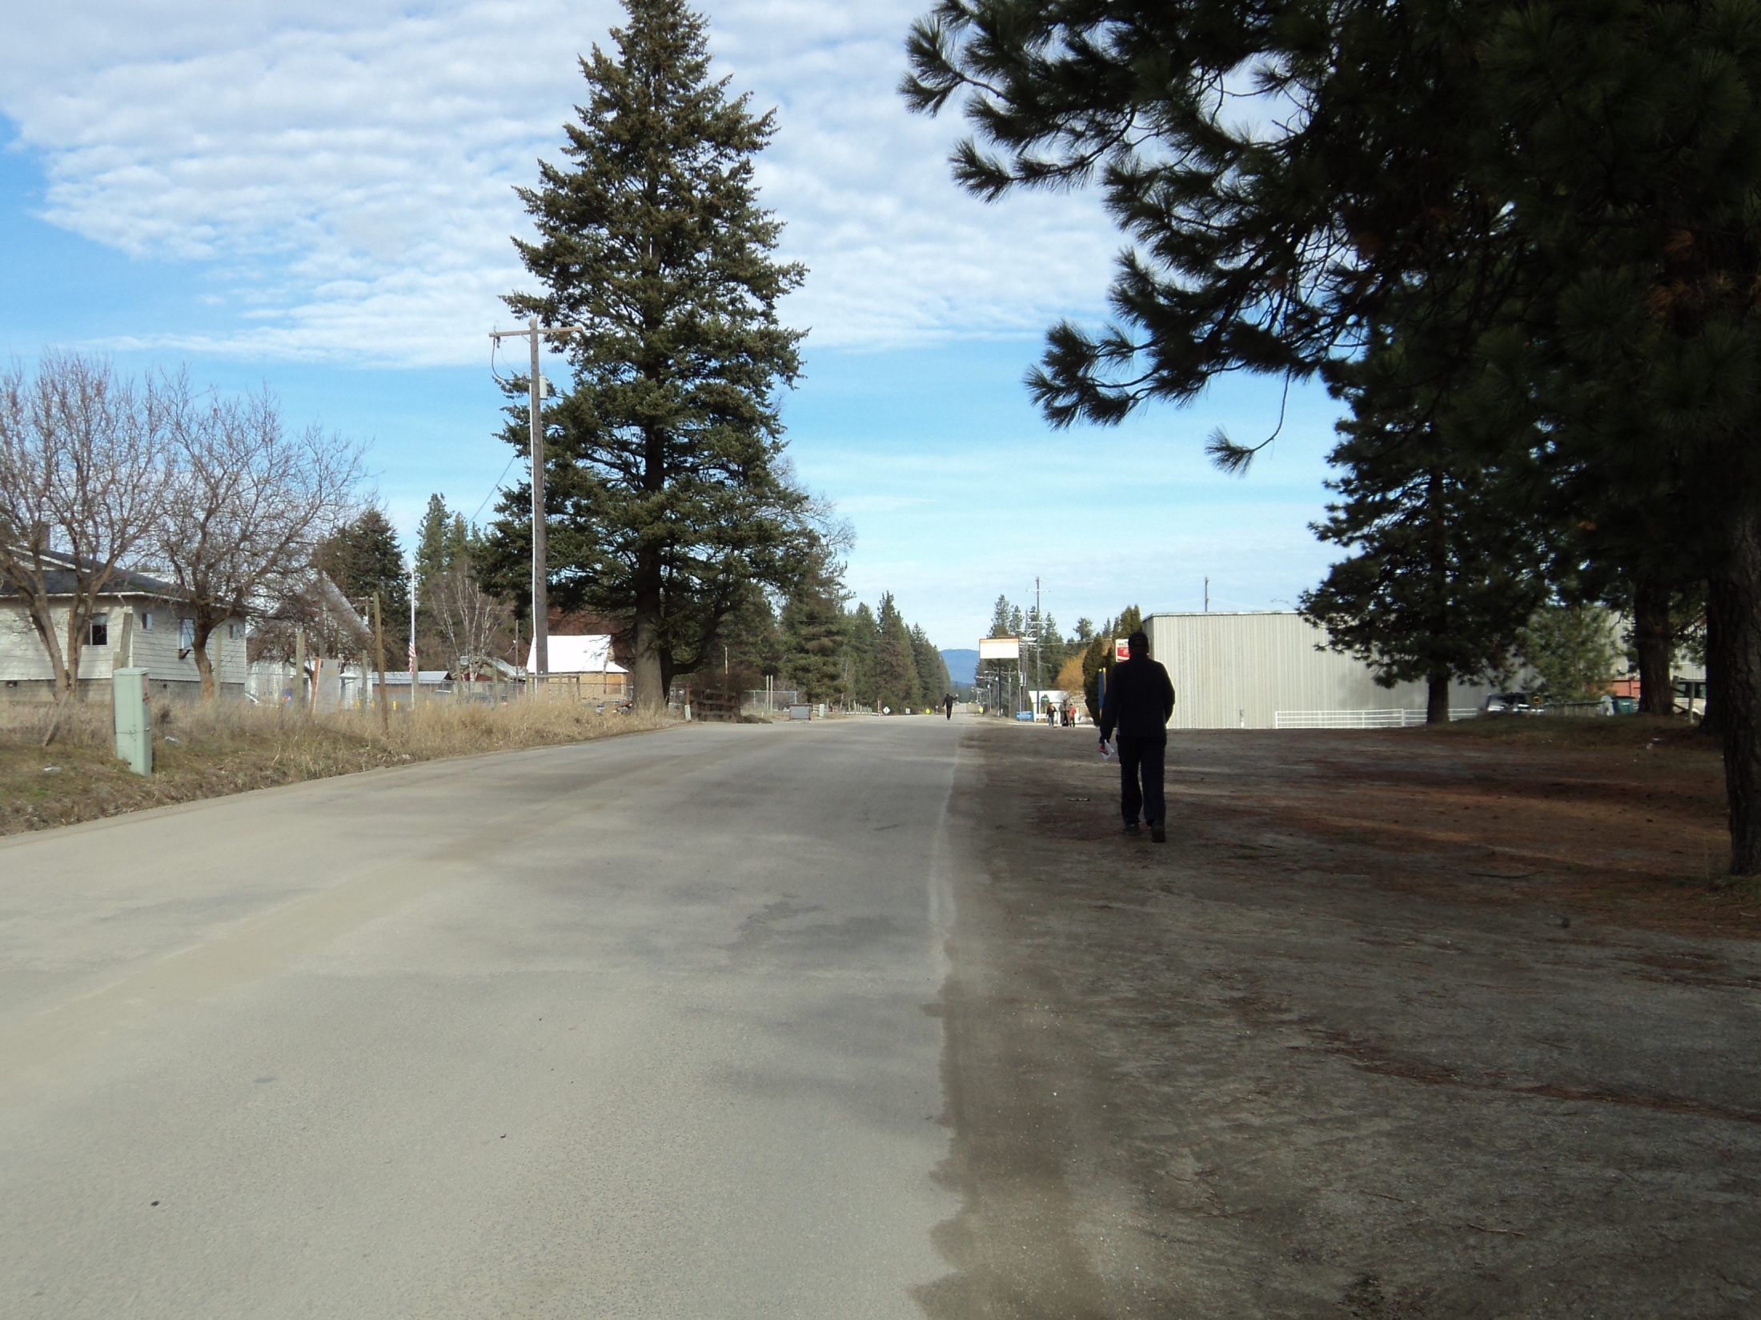
Wellpinit

Slide 28
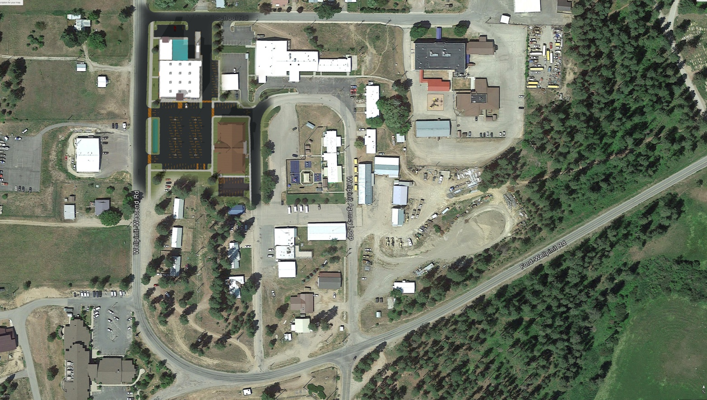
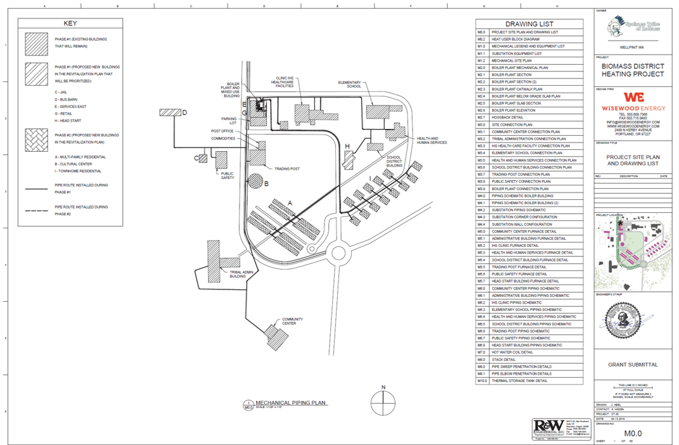
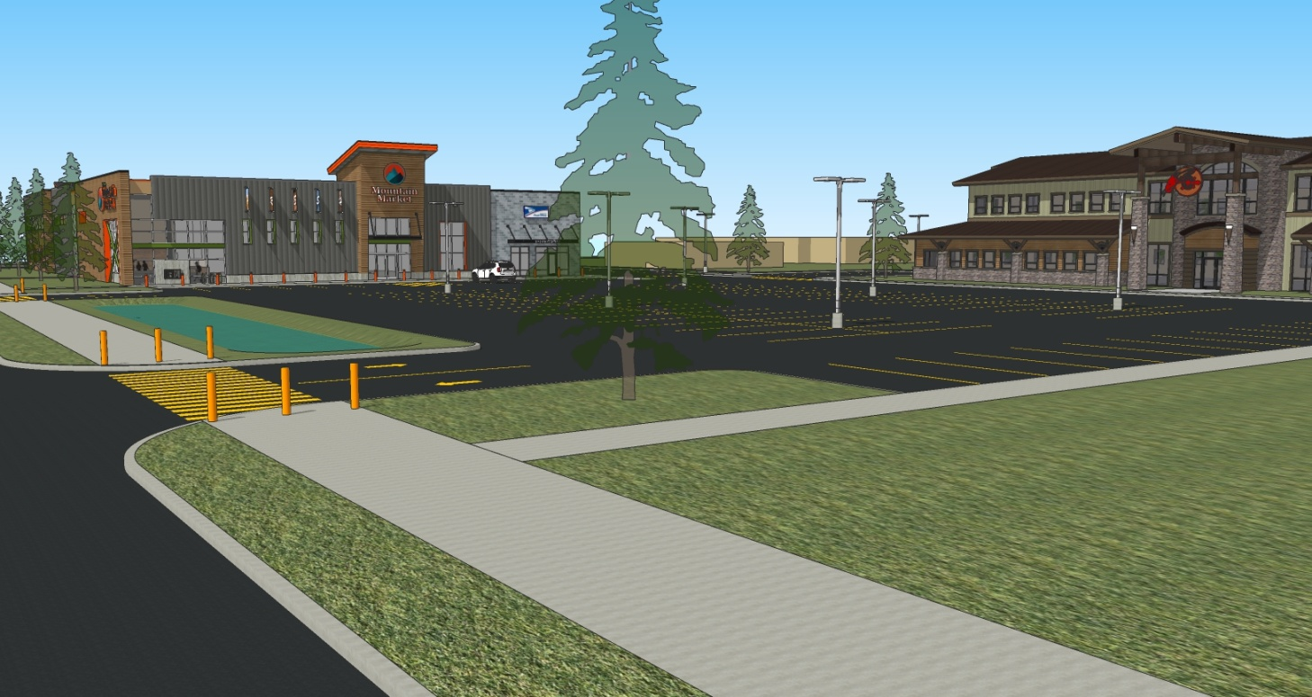
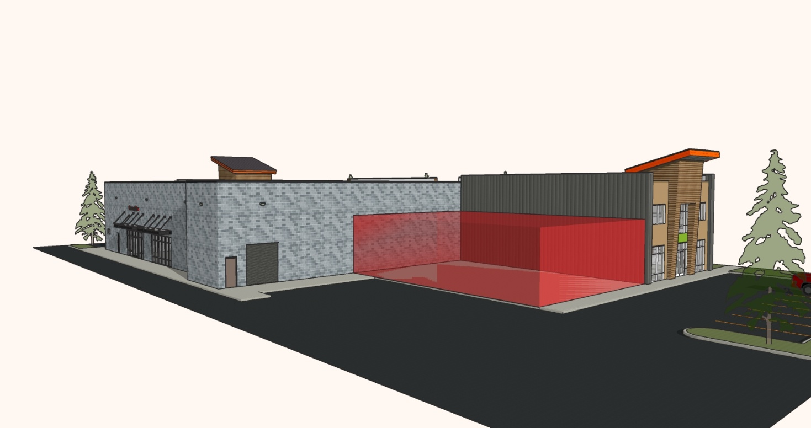
Wellpinit

Slide 29
Additional information
HUD website
https://opportunityzones.hud.gov/
IRS website
https://www.irs.gov/newsroom/opportunity-zones-frequently-asked-questions
CDFI website
https://www.cdfifund.gov/Pages/Opportunity-Zones.aspx
Interior – BIA
https://www.bia.gov/sites/bia.gov/files/assets/as-ia/ieed/ieed/pdf/Opportunity_Zones_Primer.pdf
Notes:
From Enterprise

Slide 30
Questions to think about
Is your tribe in or near an Opportunity Zone?
Do your project(s) fit into Opportunity Zone type investments (housing, businesses, infrastructure, etc.)?
Discuss internally whether the Opportunity Zone structure is a good fit for you (taking on partners, equity investment, etc.)
What Opportunity Zone funds that may work for your project (marketing, recruiting a fund)?
Notes:
From Enterprise

Slide 31
CONVERSATION WITH HEIDI

Slide 32
Overview: WHORC
The White House Opportunity and Revitalization Council (WHORC) was set up by Presidential Executive Order in December 2018 and is chaired by HUD Secretary Carson
The Council includes 17 Federal agencies and Federal/State partnerships
The Council has taken action on more than 200 items across the federal government.
Some examples of the HUD actions taken include:
Reduced application fees for FHA mortgage insurance for properties in OZs
Preference points for numerous HUD competitive grants, including IHBG Competitive and ICDBG

Slide 33
Overview: WHORC cont’d
The Council, led by Executive Director Scott Turner, has visited more than 60 places across the US—including tribal lands
On February 7, 2020, the Council submitted a one-year report to President Trump
And, also hosted an Opportunity Now summit in Charlotte, NC
For up-to-date info on OZ’s visit www.OpportunityZones.gov
Notes:
Executive Director Turner hosts roundtables to learn firsthand about the challenges, needs, and strengths of the community and takes their ideas back to Washington, DC.
Federal Agency partners are working with state partners and OZ communities to support community projects

Slide 34
Resources
Webinar series
I: OZ 101, February 13, 2020
II: Opportunity Zones and Tribes, TBD
III: Engaging Investors, TBD
Technical Assistance

Slide 35
Thank you!
Questions?
QUESTIONS??? QUESTIONS??? Press #2 for the phone line or use the chat box
Press #2 for the phone line or use the chat box
Press #2 or use the chat box??? Press #2 for the phone line or use the chat box

Slide 36
Thank you!
THANK YOU
for joining

