Slide 1
HCV Utilization Webinar Series: Practices in Housing Search Assistance June 16, 2022

Slide 2
Agenda
Welcome
Office of Housing Voucher Programs update
Housing search assistance definition and considerations for developing a tenant search assistance strategy
Emerging strategies for housing search assistance
Local experience with housing search assistance in Fairfax County, Virginia
Q&A

Slide 3
Today’s Presenters
Steven Durham
Director, Office of Housing Voucher Programs
Alison Bell
Senior Housing Programs Specialist, Housing Voucher Management and Operations Division
Janie Oliphant
Senior Analyst, FirstPic Inc
Jon A. Miskell Jr.
Housing Community Developer III and Program Manager-Rental Subsidy and Services Program, Fairfax County Department of Housing and Community Development
Samantha Gallo
Program Manager for Self-Sufficiency and Special Purpose Voucher Programs, Fairfax County Department of Housing and Community Development

Slide 4
Welcome!
Today's webinar is being recorded. The recording and PowerPoint will be posted to the ”Webinars and Trainings” section of www.hud.gov/hcv. In about a week.
We need your feedback. Please enter any suggestions you have for additional webinar topics, or resources HUD could provide to help your HCV program administration in the chat.
Stay connected by visiting www.hud.gov/hcv and subscribing to the HCV Connect Newsletter.

Slide 5
Office of Housing Voucher Program Updates
PIH Notice 2022-18: Use of Housing Choice Voucher (HCV) and Mainstream Voucher Administrative Fees for Other Expenses to Assist Families to Lease Units
Webinar Thursday, July 21st at 2 pm eastern
PIH Notice 2022-19: Mainstream Vouchers – Non-Competitive Opportunity for Additional Vouchers Authorized by the CARES Act and Extraordinary Administrative Funding, Correction
HAP Set Aside Application Deadline Extension

Slide 6
What is housing search assistance?
Direct services related to a family’s search for a unit
Pre-move counseling
Understanding family’s housing needs and potential barriers to leasing
Helping a family identify and visit potentially available units during their housing search, including units that meet the household’s disability-related needs
Providing transportation and directions
Assisting with the completion of rental applications
Owner recruitment and outreach activities, including the costs associated with materials or webpages specifically geared to owners
Landlord liaison staff and associated expenses.
Post-lease up activities

Slide 7
Developing a housing search assistance strategy
What are the issues the PHA is trying to resolve?
Challenges with utilization?
Low success rate?
Extended voucher search process?
Multiple RTAs per family due to inspection fails and other issues?
Special populations that have more challenges navigating rental market?

Slide 8
Assessing current HCV program to determine what strategies might best resolve identified challenges and meet PHA’s program goals
Analyze available data and understand HCV program metrics
Number of days from voucher issuance to lease-up
Number of days from RTA receipt to inspection to lease-up
Number of initial inspection fails
Families searching without currently being under HAP contract
Voucher success rate
Are there certain populations that are struggling searching for units?
Examine current HCV processes
Process for monitoring vouchers on the street
Voucher extension process
Assess quality of landlord lists and rental unit listings
Talk to staff and landlords

Slide 9
Assessing available resources
Eligible uses of Administrative Fees: PIH Notice 2022-18
Eligible uses of EHV Services Fee: PIH Notice 2021-15
Does the PHA have available staff or funding to provide housing search assistance?
Would an increased voucher success rate result in cost savings in eligibility staffing?
Would increased leasing result in earning more administrative fees?
Are there service providers that the PHA could leverage to provide housing search assistance?

Slide 10
Strategies for Housing Search Assistance
Janie Oliphant | 16 June 2022

Slide 11
Outline
Pre-move
Identifying motivation for moving
Prioritizing needs and wants
Setting families up for a successful rental application
Family preparation
Referring families to external providers
Workshops
Preparing for applications
Housing search assistance
Owner outreach
Unit referrals
Increasing owner participation
Competitive payment standards
Minimizing lease-up delays
Owner incentives

Slide 12
Pre-move: Identifying Motivation for Moving
“Why are you considering making a move?”
Unit is not meeting the family’s needs
Neighborhood is not meeting the family’s needs
Move prompted by something outside of the family’s control
Use the family’s stated goals to build motivation and develop list of needs

Slide 13
Pre-move: Prioritizing Needs and Wants
All people want to live in a unit and neighborhood that meets their family’s spatial needs, with access to community resources, and a high level of community social cohesion
These universal goals have to be balanced against: unit availability, transportation options, and access to work, social services, and established social networks
Staff working with participants should be familiar with general unit availability across their jurisdiction
Where are there affordable units?
What neighborhoods offer reliable public transportation?

Slide 14
Selecting Priorities
High Quality School
Low Crime
Bigger unit
Closer to job
Often, families will have to choose to prioritize one factor over another in making a decision
There is no “perfect home” in the “perfect location”
Participants have to choose what is most important for their family

Slide 15
Pre-move: Setting families up for a successful rental application
Review barriers to moving
Credit report and score
Previous rental history
Interactions with judicial system
Highlight family’s strengths
Length of tenancy
Positive tenant-owner relationships
Help participants mitigate barriers and advocate for themselves with owners

Slide 16
Family Preparation: Referring Families to External Providers
Help families mitigate barriers by partnering with other providers for:
Credit building
Legal Services
Others?

Slide 17
Family Preparation: Workshops
Many housing authorities have developed workshops to build skillsets in specific areas:
Housing Search
First Time Renters
Financial Fitness

Slide 18
Family Preparation: Preparing for Applications
Help families gather their needed materials to submit applications
Work with families to make an “elevator pitch” about themselves
Have participants write a cover letter for their rental applications

Slide 19
Housing Search Assistance: Owner Outreach
Reach out to owners with available, affordable units on the market that meet participants’ needs
Market new updates to the program and reliable customer service
For Rent

Slide 20
Housing Search Assistance: Unit referrals
Provide participants with leads on available units where you have already made an initial connection with the owner
Offer to connect the participant with the owner
Tour properties with participants
“Hello, I’ve come across these properties that I think could be a great fit for you and your family. Please let me know what you think:”
#1: [unit link]
#2: [unit link]
#3: [unit link]

Slide 21
Increasing Owner Participation: Competitive Payment Standards
In competitive markets, owners are unlikely to select subsidized tenants at a lower rent price than what they can achieve on the private market
Align payment standards to the market:
Small Area FMRs as exception rents
Success rate payment standards
Setting FMRs up to 120% if certain neighborhood conditions are met
See additional writing on these strategies here: https://www.hudexchange.info/resource/6314/hcv-landlord-strategies-guidebook-for-phas/

Slide 22
Increasing Owner Participation: Minimizing Lease-up Delays
Courting property owners to lease to subsidized families is easiest when the leasing process matches or improves upon the business opportunity available on the private market
Reduce lease-up times:
Expedite RFTA processing
Initial inspections and re-inspections
Initiate HAP contracts every day of the month

Slide 23
Increasing Owner Participation: Owner Incentives
Lease-up Bonus
Vacancy Loss Fund
Damage Mitigation

Slide 24
Questions & Comments
Q&A section towards the end of the webinar
Get in touch directly: joliphant@firstpic.org

Slide 25
Local Strategies for Housing Search Assistance
Jon Miskell, Jr., and Samantha Gallo, Fairfax County Department of Housing and Community Development

Slide 26
Housing Location & Coordination Services in Fairfax County
June 16, 2022
HUD Utilization Webinar

Slide 27
FCRHA Overview
Fairfax County occupies 406 sq. miles bordering Arlington County, Loudoun County, Alexandria City, and Prince William County. The center of the county is roughly 17 miles west of Washington, D.C.
Avg 1-BR rent: $1,862/Avg 2-BR rent $2,211
FCRHA houses nearly 20,000 people through our affordable and subsidized housing programs.
4,168 Vouchers / 1,060 RAD Units
Average Household Income: $22,700 (22% AMI for a family of two)
35% of our household include at least one person with a disability
Approximately 75% of homeless households placed in long-term affordable housing are served by FCRHA resources.
Notes:
Fairfax county occupies 406 sq. miles bordering Arlington County, Loudoun County, Alexandria City, and Prince William County. County center is approximately 17 miles west of Washington, D.C.
Average rents in this area are projected to increase by at least 6% over the next 2 years
Currently, 1BR’s average $1862 per month and 2BR’s average $2211
FCRHA is the largest provider of affordable housing in Fairfax County – Housing over 20,000 individuals annually.
In addition to developing affordable units, the FCRHA also administers a local rental program that includes 2,122 multifamily units, 482 senior housing units, and 115 mobile home pad sites.
For our purposes today, we are focusing on our subsidized units.
We administer 4,168 vouchers – this number is inclusive special purpose vouchers (fup, mainstream, vash, Homeownership, tenant protection, and EHV)
Currently we have 1066 RAD PBV units
* The average household income amongst our participants is around 22% AMI – for a family of Two, that works out to be $22,700.
* 35% of our households include at least one individual with a disability
* Approximately 75% of homeless households in Fairfax County who are placed in long-term affordable housing are served by the FCRHA.
- We attribute this to our close ties with Fairfax’s continuum of care and our flexibility as an MTW agency, but also our agency is unique in that our homeless services system is incorporated into our organizational structure. Intake and Occupancy staff work very closely with our Office to Prevent and end Homelessness to prioritize this population.

Slide 28
Tenant Search Assistance: Standard Practices
Primary Focus is to preserve relationships with existing and former landlords
Landlord Outreach Workshops
Informational opportunities for all existing and new landlords
Opportunity to update new property management staff in communities we have established relationships
Encourage potential landlords to learn about the benefits of renting to voucher holders
Metropolitan Regional Information System (MRIS) leads
Common Housing search sites
Notes:
With low vacancy rates and high rents, it is understandable difficult for families to locate housing.
This is even more difficult because, with the exception of EHV, neither Fairfax County nor the FCHRA fund housing search assistance for our participants.
As an agency, our primary focus is to preserve our existing relationships – we work closely with our existing landlords to mediate and resolve tenant issues, as well as keeping in contact with previous landlords who are not currently leasing to one of our tenants.
We maintain Landlord Listings, allowing landlords to advertise their units with us, which we share with tenants
With the help of our Homeownership team, we utilize the MRIS system
And we rely on common websites like Realtor.com, Zillow, Apartments.com, and Pad Mapper
(***4% vacancy rate is just under national average of 5%)

Slide 29
Housing Opportunities Collaborative (HOC)
The Collaborative is an initiative to expand housing opportunities for individuals and families experiencing homelessness.
Assists partner agencies in landlord engagement and recruitment efforts.
Streamlines information and communication between partner agencies and the larger community regarding housing location services.
Provides training and professional development opportunities to frontline staff who provide housing location services.
Jointly administered by the FCRHA’s Office to Prevent and End Homelessness and Cornerstones, a local non-profit.
Membership includes stake holders in the homeless services system, including shelter operators, non-profit and faith-based organizations and local government agencies.

Slide 30
Housing Opportunities Collaborative
The Collaborative’s goals include:
Actively seek out, obtain and maintain relationships with landlords, private and non-profit.
Working with clients dealing with specific barriers and matching them with potential landlords.
Recommending a financial assistance package to assist with a successful move-in.
Incentives
Landlord Leasing Incentives: Up to $700 (EHV only)
Risk Mitigation Funds: $1000 (Non-EHV) / $2000 (EHV)

Slide 31
Enhanced EHV Search Assistance
The Collaborative’s role and reach expanded in 2021 in response to the allocation of Emergency Housing Vouchers
Dedicated Staff includes a Supervisor, 2 Housing Coordinators, and Community Housing Locators assigned to provided direct assistance to EHV applicants
Access to Housing Search Assistance Fund: $543,457.80
Application and holding fees: $10,205
Landlord Leasing Incentives: $9,100
Security Deposits: $116,243
Utility Deposits: $2,483
Renters Insurance: $1,479
Moving assistance: $8,941
Essential Household Items: $4,110

Slide 32
Questions/Comments

Slide 33
Q&A

Slide 34
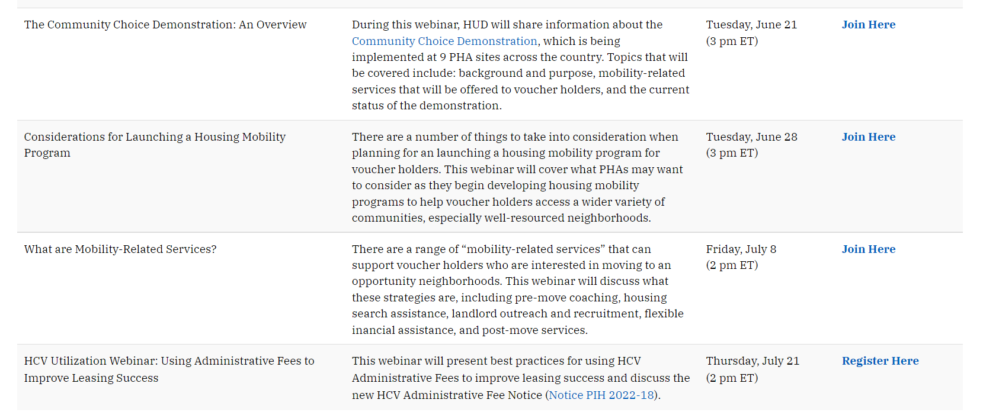
Upcoming Webinars

Slide 35
Thank you!
alison.bell@hud.gov

