Slide 1
HCV Utilization Webinar: Considering Small Area FMRs (SAFMR)
August 17, 2023

Slide 2
Welcome!
Today's webinar is being recorded. The recording and PowerPoint will be posted to the "Webinars and Trainings” section of www.hud.gov/hcv. In about a week.
We are always interested in your feedback. Please enter any suggestions you have for how we can make these webinars or the program resources more useful to you in the chat.
Stay connected by visiting www.hud.gov/hcv and subscribing to the HCV Connect Newsletter.

Slide 3
Agenda
Presenter Introductions
PHA Stories
HUD's Small Area Fair Market Rents (SAFMRs) page
SAFMR Dashboard
Notice PIH 2018-01
Demo – Two-Year HCV Forecasting Tool
Q & A

Slide 4
Today's Presenters
John Hillis
Director of Leased Housing & Admissions
Brookline Housing Authority
Jhillis@brooklinehousing.org
Brendan Goodwin
Senior Housing Program Specialist
OHVP Management And Operations Division
US Department of Housing & Urban Development
Brendan.C.Goodwin@hud.gov
Eric Swenson
Program Analyst
OHVP Program Support Division
US Department of Housing & Urban Development
Eric.J.Swenson@hud.gov
David Gleich
Deputy Administrator of Housing Programs
Boston Housing Authority
David.Gleich@bostonhousing.org
Geoff Blackwell
Management Analyst
OHVP Program Support Division
US Department of Housing & Urban Development
Geoffrey.S.Blackwell@hud.gov

Slide 5
BHA SAFMR Implementation

Slide 6
Some Background
Small Area Fair Market Rents (SAFMRs) replace the Metropolitan Area Fair Market Rent (FMRs) providing a more refined tool for housing choice voucher subsidy implementation.
Zip Code vs. Metropolitan Area
SAFMRs required in 24 metropolitan areas with high concentrations of voucher families.
SAFMRs are intended to provide families with access to low-poverty areas by providing rental assistance at a level that makes the higher rents in more areas affordable to them.
Notes:
SAFMRs were first used in the Dallas area in fiscal year 2011 following settlement of a lawsuit claiming that metro-wide FMRs prevented minority voucher holders from moving to predominantly white neighborhoods with higher rents. Two years later, HUD initiated an SAFMR demonstration allowing five agencies in other parts of the country to test the approach. After early results suggested that SAFMRs were effective at helping voucher holders in these areas move to higher-opportunity neighborhoods without undue administrative burdens, HUD issued the 2016 expansion regulation with the goal of providing similar opportunities to families in other parts of the country.

Slide 7
Why 2019 Implementation?
An appeal of Metropolitan Area Fair Market Rents, put the BHA is in a unique circumstance.
The appeal resulted in dramatic increase in the Boston-Cambridge-Quincy Metropolitan Area FMR.
2BR FMR went from $1740 for Area 1 → $2194 – a 26% increase.
A previous implementation of the SAFMR would have resulted in a dramatic decrease in the payment standard in some zip codes – not the case because of the appeal.

Slide 8
Options for Implementation
See HUD’s SAFMR Implementation Guidebook
Formal Opt-in Request Considerations
Consider unit availability and affordability
Decide whether to hold harmless or gradual reduction
SAFMRs as they apply to PBVs
Exception Rents
No formal request process
FMR would still be the baseline

Slide 9
Pros & Cons of Implementation
Pros | Cons
More accurately matches neighborhood rents | Zip codes are not markets
Does not inflate rents in Boston neighborhoods | Potential Administrative Burden
Deconcentration | Cost per unit and Budget Inflation.
Expands choices for voucher holders

Slide 10
Implementation Decisions
Decrease in Payment Standard / Hold Harmless
Banding Payment Standards or Zip Codes
Effective Communication of Changes to Families
Applicability of SAFMRs to PBVs
How to set Payment Standards.
Challenges Unique to Massachusetts
- Jurisdiction for each PHA is the State of MA
- Potentially Competing Payment Standards
See www.bostonhousing.org/paymentstandards for charts and calculators developed for SAFMR implementation.
Notes:
SAFMRs were first used in the Dallas area in fiscal year 2011 following settlement of a lawsuit claiming that metro-wide FMRs prevented minority voucher holders from moving to predominantly white neighborhoods with higher rents. Two years later, HUD initiated an SAFMR demonstration allowing five agencies in other parts of the country to test the approach. After early results suggested that SAFMRs were effective at helping voucher holders in these areas move to higher-opportunity neighborhoods without undue administrative burdens, HUD issued the 2016 expansion regulation with the goal of providing similar opportunities to families in other parts of the country.

Slide 11
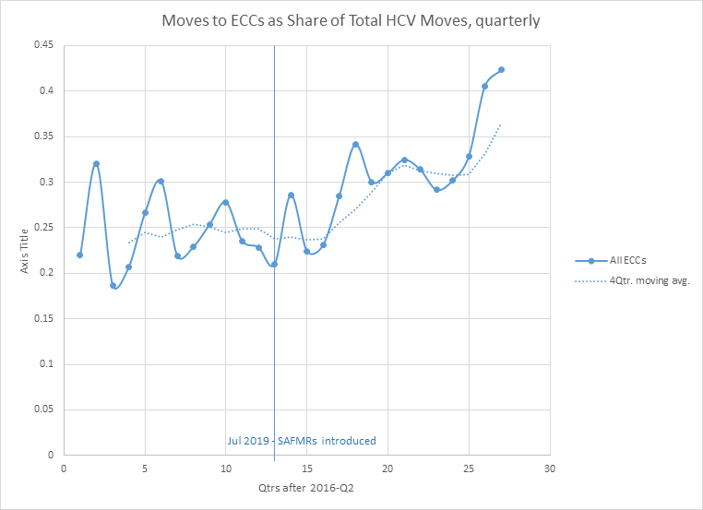
% Vouchers in ECCs
Jul 2019 | 24.59%
July 2022 | 27.42%
July 2023 | 28.73%

Slide 12
Small Area Fair Market Rent

Slide 13
Small Area Fair Market Rent Overview
The Brookline Housing Authority instituted SAFMR in 2020 with the goal of allowing Brookline residents access to safe and affordable housing within the community.
SAFMRs are updated annually
SAFMR allows for housing to be available in any neighborhood, furthering choice for subsidy recipients to live in the community of their choice or that is best suited to their needs
Payment Standards based upon the SAFMR allows for landlords to be paid fairly for their property based upon the unsubsidized market value, increasing housing stock available to voucher recipients

Slide 14
Comparing FMR to SAFMR
Current Payment Standards were set at 92% of the SAFMR in January 2023
Unit Size | Large Area FMR | 02445 SAFMR (PS) | 02446 SAFMR (PS) | 02447 (PS)
Studio | $2025 | $2850 ($2622) | $3,040 ($2797) | $2700 ($2484)
1 Bedroom | $2198 | $3100 ($2852) | $3,300 ($3036) | $2940 ($2705)
2 Bedroom | $2635 | $3710 ($3413) | $3950 ($3634) | $3520 ($3168)
3 Bedroom | $3207 | $4520 ($4148) | $4810 ($4425) | $4280 ($3938)
4 Bedroom | $3540 | $4980 ($4582) | $5310 ($4885) | $4730 ($4352)

Slide 15
Impact of SAFMR
Voucher Utilization By Zip Code:
Zip Code | 2018 | 2019 | 2020 | 2021 | 2022
02445 | 35 | 36 | 33 | 31 | 35
02446 | 140 | 127 | 121 | 155 | 159
02467 | 5 | 4 | 4 | 17 | 26
Other | 379 | 376 | 359 | 398 | 423
Total Vouchers | 559 | 543 | 517 | 601 | 643
From 2020 – 2022, the percentage of vouchers utilized in Brookline increased from 30.5% to 34.2%

Slide 16
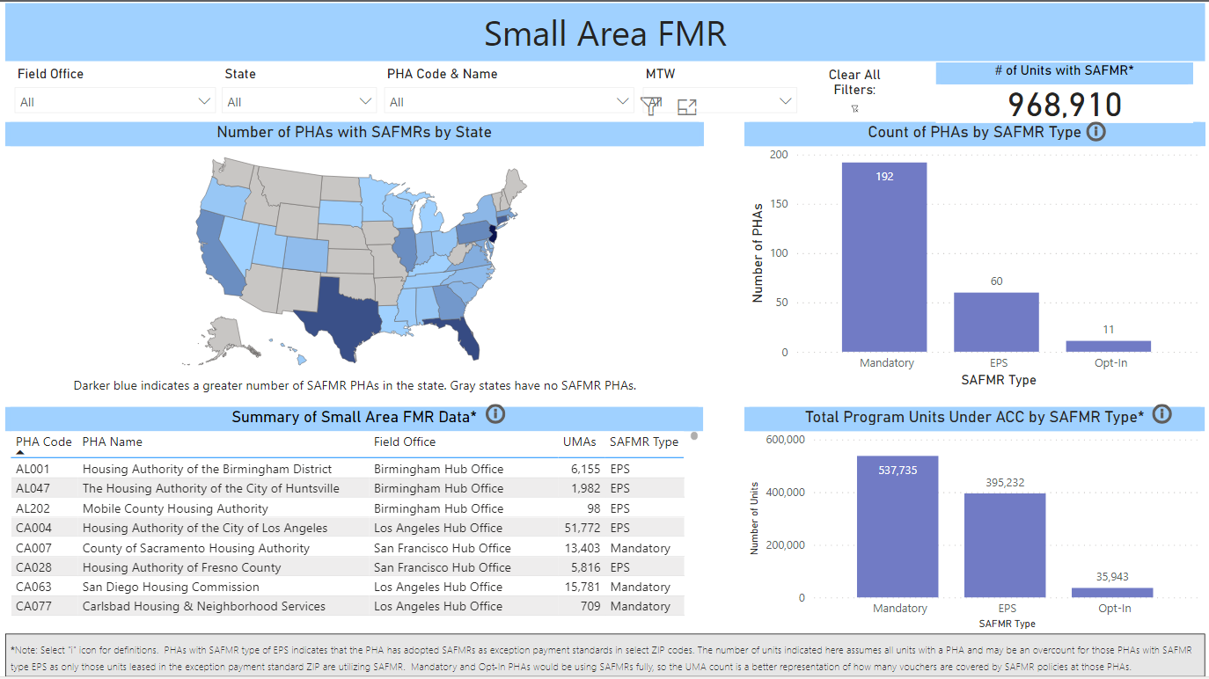
SAFMR Dashboard Demo
SAFMR Web Page | SAFMR Dashboard

Slide 17
SAFMR Resources
PIH Notice 2018-01
Instructions for adopting SAFMR or establishing SAFMR-based exception payment standards
HUD Exchange
FAQs
Implementation Guidebook
Sample Documents
Case Studies
SAFMR Lookup Tool
Current and Previous Year SAFMR Lookup by Metro Area or County
SAFMR
Rulemaking Info
PIH Notice 2023-07
Special Fees for adopting SAFMR or establishing SAFMR-based exception payment standards
Applications Due October 31, 2023

Slide 18
PHA Designations
Designated SAFMR aka “Mandatory” PHA
Required by HUD to adopt SAFMRs
Opt-in SAFMR PHA
Not required to adopt, but voluntarily adopt SAFMRs (entire jurisdiction)
Non-SAFMR PHA
Not required to adopt and chooses not to
Non-SAFMR PHAs may still choose to establish SAFMR-based exception payment standards

Slide 19
Opt-in SAFMR PHAs
Analysis
Section 5(b) of PIH Notice 2018-01
Request
PHAs may request approval at anytime
Request must state that PHA has completed analysis of PIH Notice 2018-01 (5)(b)
Upon Approval
PHA must amend Admin Plan
PHA may establish payment standards within “basic range” (90-110%) of SAFMR
Any adverse effect on availability of units
Estimate effects on families, consider tenant protection policies when reduction in payment standard
Identify areas where rent reasonableness determinations will be triggered (difference between MAFMR and SAFMR is 10%)
Submit requests to HUD field office via SAFMRs@hud.gov
State it will utilize SAFMR
Include any policies adopted in respect to SAFMRs (PBV, tenant protections)
Requests must include proposed effective date
Opt-in PHA may later opt-out by revising Admin Plan and notifying HUD via SAFMRs@hud.gov
PHAs whose jurisdiction consists of a single ZIP code are considered Opt-in PHAs
PBV Application

Slide 20
SAFMR-Based Exception Payment Standards
Options
A non-SAFMR PHA may establish an exception payment standard for a ZIP code area of up to and including 110% SAFMR
Notification
Implementation
PHAs that establish exception payment standards must revise their briefing materials to make families aware of the exception payment standard and the area it covers
Any PHA that has jurisdiction in the ZIP code may utilize the exception payment standard
Limitation of §982.503(c)(5) does not apply
Must apply to entire ZIP code area for both HCV and PBV program (if applicable)
Simply send a notification to SAFMRs@hud.gov to notify HUD that PHA has adopted a SAFMR-based exception payment standard
It’s always good to copy your field office
Please include the ZIPs where you are intending to use SAFMR-based exception payment standards
Please also include a proposed effective date
Notes:
Limitation Notes: - PHAs that use MAFMRs, the total population of HUD-approved exception areas in an FMR area may not be more than 50% of the population of the FMR area. That cap may not work within a ZIP code, so the 50% threshold has been eliminated for PHAs that implement SAFMRs.

Slide 21
Considerations
Grouping ZIP codes
Reduce payment standard areas by grouping multiple ZIPs into a payment standard area
Budget impacts
Utilize HUD Tools to estimate HAP and budget impacts
Tenant protections
Revisit PHA Policy on payment standard reductions
Project-based Vouchers
No PHA is required to utilize SAFMRs in its PBV portfolio
PHAs must choose to apply or not apply SAFMRs to their PBV units

Slide 22
Special Fees – PIH Notice 2023-07
Special fee funding is available to PHAs for the reimbursement of costs associated with adopting SAFMRs or establishing SAFMR-based exception payment standards
Up to $25,000 available to opt-in PHAs
Up to $15,000 available to PHAs establishing exception payment standards
Only for PHAs where the exception payment standard(s) cover the majority of ZIPs in PHA’s service area where SAFMR > metro FMR and will result in the PHA administering different payment standards for at least three different geographic areas
Eligible Activities/Expenses include but not limited to:
Additional outreach to families and landlords
Development of additional briefing materials
Hiring of additional staff
Staff training
Changes to rent reasonableness determinations methodology
Required software modifications
Hurry! Applications for special fees must be received no later than 5pm (PHAs time zone), Tuesday, October 31, 2023
Notes:
Special Fees – page 10

Slide 23
SAFMR Analysis: HCV Two-Year Forecasting Tool & Payment Standard Tool
How about a….
DEMO!

Slide 25
Reminders
HUD has been working to improve the HCV utilization resources available to PHAs, in case you missed it here are a few new items:
HCV Connect – A email newsletter focused on the HCV program with reminders of program guidance, notification of webinars, events, and research.
HCV Utilization Webinars – These webinars will provide HCV program updates and share best practices. They are scheduled for every third Thursday at 2:00 Eastern.
HCV Overview Video Series with short videos covering common topics in HCV program administration.
Plus, we have ongoing support for the HCV Utilization Tools and the HCV Data Dashboard.
All of this is available at www.hud.gov/hcv.

Slide 26
Reminders
We urge PHAs to take advantage of the recent program updates to support leasing:
New 2023 FMRs
Payment Standard Waivers (PIH Notice 2022-30)
Administrative Fee Flexibility (PIH Notice 2022-29)
Now is not the time to press pause on HCV leasing. Please continue to use the Two-Year-Tool to make HCV program decisions.
Need help?
Contact your local Public Housing Field Office and/or visit www.hud.gov/hcv.

