Slide 1
HCV Utilization Webinar: Improving Program Data & 2023 Funding Update
January 19, 2023

Slide 2
Welcome!
Today's webinar is being recorded. The recording and PowerPoint will be posted to the "Webinars and Trainings” section of www.hud.gov/hcv. In about a week.
We are always interested in your feedback. Please enter any suggestions you have for how we can make these webinars or the program resources more useful to you in the chat.
Stay connected by visiting www.hud.gov/hcv and subscribing to the HCV Connect Newsletter.

Slide 3
Agenda
2023 Funding Update
Overview of 2023 funding
Using the Two-Year Tool to prepare for 2023
Reminder of program resources to help improve utilization
Improving Program Data
Resources to help improve IMS/PIC Data
New updates to the PIC Error Dashboard
Better issuance and leasing success rate data will improve utilization

Slide 4
Significant 2023 Funding Increases
($ in Millions)
These are historic funding increases!!!
Notes:
Total Appropriations $30.4b
HAP renewals 2.3b increase to maintain leasing levels 2.3m households
Admin fees will support PHA operations at 91% proration
MS leasing increasing at approximately 400 voucher per month, and expected increase leasing to approx. 700 vouchers per month starting early Spring of 2023
TPV largest increase in the history of the account, over 26k units could be in need of TPVs, to include approx. 7k units from NYCHA, 10k in Section 18, CN and SVCs, 5,400 MF Conversions and another 4k units for RAD blends.

Slide 5
Funding Timeline
VMS data due on January 27th (deadline extended 5 days)
HUD's VMS Validation - week of February 27th
2023 Contract Renewal Awards – week of April 7th
HCVP Implementation Webinar – week of April 17th
2023 HCVP Funding Notice – week of April 17th

Slide 6
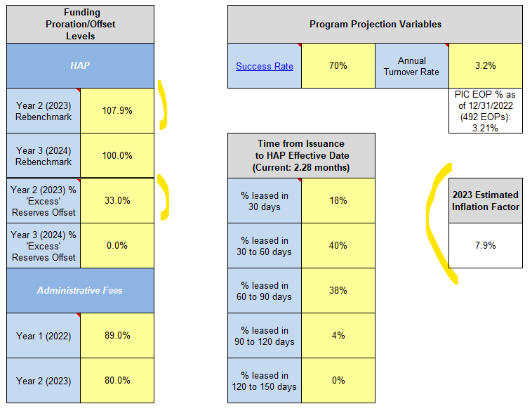
Until then... as always... the Two-Year Tool

Slide 7
Reminders
We urge PHAs to take advantage of the recent program updates to support leasing:
New 2023 FMRs
Payment Standard Waivers (PIH Notice 2022-30)
Administrative Fee Flexibility (PIH Notice 2022-29)
Now is not the time to press pause on HCV leasing. Please continue to use the Two-Year-Tool to make HCV program decisions.
Need help?
Contact your local Public Housing Field Office and/or visit www.hud.gov/hcv.

