Slide 1
HCV Utilization Webinar: Using Administrative Fees to Improve Leasing Success
July 21, 2022

Slide 2
Welcome!
Today's webinar is being recorded. The recording and PowerPoint will be posted to the ”Webinars and Trainings” section of www.hud.gov/hcv. In about a week.
We are looking for more HCV Utilization Webinar topics. Please enter any topic ideas or other suggestions for how we can make these webinars useful to you in the chat.
Stay connected by visiting www.hud.gov/hcv and subscribing to the HCV Connect Newsletter.

Slide 3
Agenda
Administrative Fee Funding
Review of Notice PIH 2022-18
Best Practices in Admin Fee Usage
Frequently Asked Questions

Slide 4
Administrative Fees Funding
How administrative fees are determined?
The admin fee formula is established under section 8(q) of the 1937 Act; however, Congress has modified the formula through the appropriations acts
PHAs' administrative fees are determined based on vouchers leased as of the first day of each month
PIH extracts HCV and Mainstream leasing and costs from VMS monthly, after each reporting cycle
Leasing and cost data is validated prior to use
Notes:
- For example in CY 2022, administrative fees are been calculated as provided for by Section 8(q) of the United States Housing Act, and related Appropriation Act provisions, as in effect immediately before the enactment of the Quality Housing and Work Responsibility Act (QHWRA) of 1998 (P. L. 105-276), unless overridden by Congress in the appropriations act.
- PHAs earn administrative fees based on units leased as of the first of the month and reported in the Voucher Management System
And, it is HUD's due diligence to validate PHA reported data in VMS prior to its use for any purpose, to include dashboards, budget formulation, budget implementation, reconciliations and funds control

Slide 5
Administrative Fees Funding
How administrative fees are determined? Cont.
Two admin fee rates are calculated annually; Columns A and B rates
PHAs can apply for blended administrative fee rates
PHAs can apply for higher administrative fee rates
HUD advances 1/12 of the Admin Fee appropriation monthly
Advances are reconciled quarterly to actual leasing
Notes:
-To calculate the administrative fees HUD uses two admin fee rates, Column A and Column B rates, which are based on a percentage of the 1993 or 1994 FMR, limited by floor and ceiling amounts, multiplied by an inflation factor that captures the increase in local wage rates over time.
PHA could request a blended fee rate to proportionately all areas in which participants were located. Once a blended rate is established, it is used to determine the PHA’s fee eligibility for the entire CY.
- PHAs operating over large geographic areas, defined as multiple counties, could request a higher administrative fee rate
-FMD reviews and approve blended rates, and FMC review and approve higher admin fee rates.
-To ensure PHAs are based on actual leased up units, HUD perform monthly advances and reconcilie quearterly to actual earnings our units leased.

Slide 6
Administrative Fees Funding
Uses of Administrative Fee Funding:
Regulation - 24 CFR 982.152
Admin fees will cover costs incurred to perform PHA admin responsibilities of the HCV Program per regulations
Operating expenses, including eligible payments to COCC
costs to help families facing difficulty finding or renting housing,
extraordinary costs as determined necessary by HUD, and
preliminary fees, among others.
HCV Admin Fees may never be loaned to another program
Notes:
- The HCV program regulations at 24 CFR 982.152 provide that PHA administrative fees may only be used to cover costs incurred to perform PHA administrative responsibilities for the program.
Up to CY 2022, the program responsibilities include Operating expenses, including payments to the Central Office Cost Center, preliminary fees, assistance costs to families in search of housing, and extraordinary costs as determined by HUD.
- HCV administrative fees are restricted for HCV related operating costs and may never be loaned to another program in order to cover that program’s expenses, regardless of whether the PHA intends to reimburse the HCV program at a later date.

Slide 7
Administrative Fee Funding – Eligibility vs Appropriation
Notes:
This is how the national eligibility trend looks like compared to the appropriation trend. That downward heartbeat in 2013 was related to the sequester at 69%. Since 2017, however, the trend is running in the right direction, getting closer to the national eligibility.

Slide 8
Review of Notice PIH 2022-18
Title: Use of HCV and Mainstream Voucher Admin Fees for Other Expenses to Assist Families to Lease Units
The notice provides guidance on the "other expenses" eligible activities that PHAs may use administrative fees to facilitate leasing:
security and utility deposits,
landlord outreach and incentives,
application fees,
holding fees, and
renter's insurance (if required by the lease).

Slide 9
Review of Notice 2022-18 How can PHAs spend Administrative Fees?
Administrative Activities
Application intake and income determinations
Unit inspections
Operational planning
Financial management
Legal and administrative services
HCV program expenses
Other Eligible Activities
Owner incentive and/or retention payments
Security deposit assistance
Utility deposit assistance/utility arrears
Application fees
Holding fees
Renter’s insurance if required by the lease

Slide 10
Review of Notice PIH 2022-18
Planning for other eligible activities:
PHAs must adopt a policy in the PHA administrative plan that governs the terms and conditions of the activity, including limitations or eligibility criteria for these activities.
Is your policy fair and consistent with no discrimination?
Are your costs necessary and reasonable?

Slide 11
Review of Notice PIH 2022-18 PHA may need to establish a PHA/Tenant Agreement
PHA/Tenant Agreement
If the PHA is using Administrative fees for a security and/or utility deposit, the PHA must establish an agreement with the tenant to ensure that any assistance not used for a deposit will be returned promptly to the PHA. (See Notice PIH 2022-18 for more details.)

Slide 12
Is this only for FY 2022 Administrative Fees?
HUD has determined that PHAs may use ongoing administrative fee funding for the activities described in this notice as they qualify as “administrative and other expenses in administering the section 8 tenant-based rental assistance program” under paragraph 3 under the heading “Tenant-Based Rental Assistance” (TBRA) in the 2022 Act.
These costs will remain eligible administrative fee expenses in future years provided the appropriations Act language continues to include “other” expenses as an eligible use of administrative fee amounts.
If there are substantive changes in future appropriations Acts impacting the eligible uses of administrative fees, HUD will revise this notice.

Slide 13
Considerations
What are the costs for the necessary HCV activities (e.g. intake, reexams, inspections, record-keeping, administration)?
How would improving leasing success increase future HCV funding (Housing Assistance Payments and Administrative Fees)?
Am I meeting my local HCV program goals?
Keep in mind, Administrative Fee funding is based on the number of households served (i.e., units leased on the first of the month), and annual HCV Renewals funding is based on the prior year's Renewal funding utilization.

Slide 14
Considerations
What are the issues the PHA is trying to resolve?
Challenges with utilization?
Decreased landlord participation?
Trying to help voucher holders increase neighborhood options?
Special populations that have more challenges navigating rental market?
Are eligible voucher holders unable to lease because of pre-admission utility arrears or inability to pay application fees/deposits?

Slide 15
Previous webinars and materials related to flexibilities allowed by PIH 2022-18
Resource | Link
HCV Utilization Webinar: Practices in Tenant Search Assistance | https://www.hud.gov/program_offices/public_indian_housing/programs/hcv/program_trainings_and_resources
Landlord Strategies Guidebook | https://www.hudexchange.info/resource/6314/hcv-landlord-strategies-guidebook-for-phas/
Landlord Taskforce Webinars | https://www.hud.gov/program_offices/public_indian_housing/programs/hcv/landlord2
Landlord Symposium Toolkit | https://www.hudexchange.info/programs/public-housing/hcv-landlord-symposium-toolkit/
Housing Mobility Webinar Series | https://www.hud.gov/program_offices/public_indian_housing/programs/hcv/program_trainings_and_resources
EHV Webinar Series on Landlord Engagement | https://www.hud.gov/program_offices/public_indian_housing/ehv/archives
All these resources can be found through www.hud.gov/hcv

Slide 16
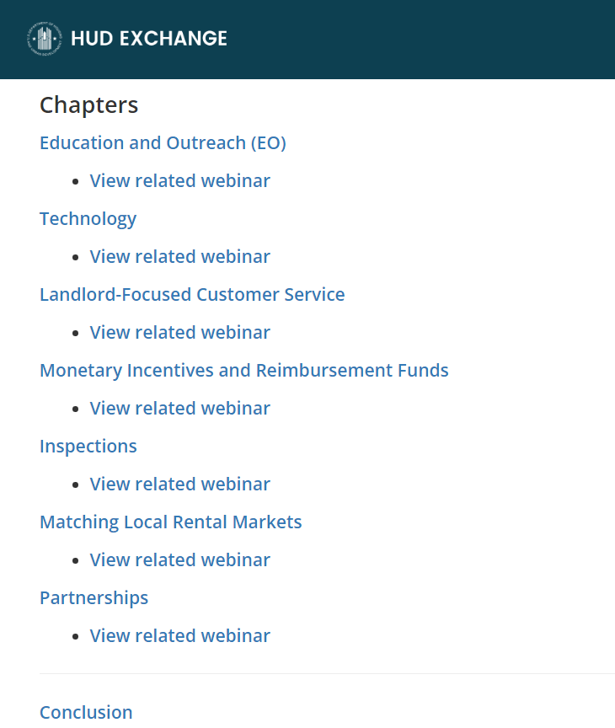
HCV Landlord Strategies Guidebook

Slide 17
Examples Community Choice Demonstration Sites
Flexible financial assistance to families
Application fees, administration and processing fees, bus or train passes, utility arrears/connection fees, move-in fees or deposits
Holding fees (up to half security deposit amount)
Security deposit (up to two months’ rent)
Housing search assistance in opportunity areas
Property owner lease-up bonus (50% of one month’s contract rent)
Damage mitigation fund

Slide 18
Examples EHV Programs with High Utilization
Housing Authority of Santa Barbara
Signing bonus: $1,500 signing bonus to landlords leasing a unit to a EHV family.
Security deposit: $2,000 Security Deposit for each unit leased to a EHV family.
Landlord mitigation fund: Provides a landlord mitigation fund which is financial assistance to landlords of housing units in the case of damages to the unit

Slide 19
Examples EHV Programs with High Utilization
Greenville Housing Authority
Landlord leasing incentive:
New landlords: $1,000 for new landlords leasing to an EHV family and $250 for each additional unit leased to an EHV family
Current landlords: $500 for current landlords for first EHV unit leased and $250 for each additional EHV unit
Landlord mitigation fund: Landlords may apply for up to $2500 per unit for damages. The claim can be filed for amounts over and above the security deposit for damages in excess of normal wear and tear.
Security deposit assistance: Households may apply for security deposit assistance.
Application fee assistance: Households may apply for application fee costs up to $50.

Slide 20
Examples Utility Deposit Assistance/Utility Arrears
PHAs may pay some or all of utility deposit
PHAs may pay utility company directly, or pay the voucher holder
If a PHA pays a voucher holder, the PHA must establish an agreement with the family and verify that utility expenses were paid (see Notice PIH 2022-18 for more details)
PHA may establish an agreement with family or utility provider to pay for pre-admission past due amounts

Slide 21
Frequently Asked Questions
Question: Did HUD make more Administrative Fees available for these purposes in PIH Notice 2022-18?
No, there are no additional funds being made available and no application process.

Slide 22
Frequently Asked Questions
Question: Are PHAs required to use their administrative fees to cover activities outlined in PIH 2022-18?
No. The decision to provide such assistance or use administrative fees to cover the costs rests solely with the PHA. PHAs are not required to use their administrative fees for these other activities.

Slide 23
Frequently Asked Questions
Question: Do I have to update my Administrative Plan before I can use my Administrative Fees for the uses described in PIH Notice 2022-18?
Yes. PHAs must outline a fair and consistent policy for using Administrative Fees.

Slide 24
Frequently Asked Questions
Question: How much may a PHA spend on activities described in PIH 2022-18 (i.e., security deposits, landlord incentives, utility deposit assistance, etc.)?
PHAs must follow the standards described in 2 CFR 200 and ensure that all costs are necessary and reasonable, furthermore security deposits may not exceed the actual security deposit required by the owner or the maximum allowed under state/local law.

Slide 25
Frequently Asked Questions
Question: Can PHAs apply this same flexibility to Mainstream Voucher Administrative Fees?
Yes. Just keep in mind that PHAs may only use Mainstream administrative fees to pay for administrative expenses and other expenses associated with Mainstream vouchers, and vice versa for the regular HCV program.

Slide 26
Frequently Asked Questions
Question: How are PHAs required to report other expenses?
Voucher Management System (VMS) Reporting: PHAs must continue to report total administrative expense in VMS on a monthly basis in the “Administrative Expense” field.
Financial Data Schedule (FDS) Reporting: Other expenses must generally be reported on FDS Line 92400 Tenant Services – Other. However, fees used for deposits may be accounted for differently.

Slide 27
Frequently Asked Questions
Question: How do PHAs report security deposits on their FDS submission to HUD?
The accounting treatment is typically based on the PHA’s and its auditor’s interpretation of GAAP for these deposit transactions and individual state law, with only limited deposits ever coming back to the PHA. Therefore, HUD will not require any specific FDS reporting for funds used for deposits as long as the accounting and reporting conforms to GAAP.
However, the PHA’s records must be able to link the specific fee used by family to the actual deposit made on behalf of the family. Any deposits that are returned to the PHA retain their original source fee type and can be used for an eligible cost of that fee type.

Slide 28
Reminders
If you have any questions regarding Notice PIH 2022-18, please email HCVUtilization@hud.gov
This webinar was recorded and will be posted in the webinars section of www.hud.gov/hcv

Slide 29
Reminders
HUD has been working to improve the HCV utilization resources available to PHAs, in case you missed it here are a few new items:
HCV Connect – A email newsletter focused on the HCV program with reminders of program guidance, notification of webinars, events, and research.
HCV Utilization Webinar Series with topics like tenant search assistance, 2022 funding, using project-based vouchers, landlord engagement, using the payment standard and two-year tool, etc.
HCV Overview Video Series with short videos covering common topics in HCV program administration.
Plus, we have ongoing support for the HCV Utilization Tools and the HCV Data Dashboard.
All of this is available at www.hud.gov/hcv.
Registration is open for our next HCV Utilization Webinar on Rent Reasonableness Thursday, August 25 at 2:00 Eastern Time.

