Slide 1
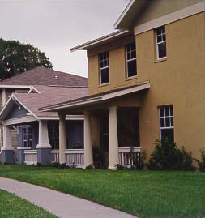
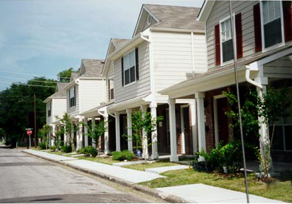
FSS Escrow Calculation: Regulatory Updates & the New Escrow Calculation Workbook

Slide 2
Welcome from HUD

Slide 3
Funding your local housing strategy
Agenda
New FSS escrow terminology
Quick summary of Final Rule changes to FSS escrow calculation
Basic overview of the FSS escrow calculation
Introduce FSS escrow workbook
Explore examples using FSS escrow workbook
Explore multifamily FSS escrow workbook
Review of key points

Slide 4
Uses for locally generated housing funds
New FSS Escrow Terminology
Term | Definition
Baseline annual earned income | FSS family’s total annual earned income from wages and business income (if any) as of the effective date of the FSS contract.
Baseline monthly rent | FSS family’s total tenant payment (TTP), as of the effective date of the FSS contract, or the amount of the flat rent (which includes the applicable utility allowance) or ceiling rent as of that date.
Current annual earned income | FSS family’s total annual earned income from wages and business income (if any) as of the most recent re-examination of income
Current monthly rent | FSS family’s TTP as of the most recent re-examination of income, or the amount of the flat rent (which includes the applicable utility allowance) or ceiling rent, as of that date.

Slide 5
Uses for locally generated housing funds
Quick Summary of Final Rule Changes to FSS Escrow Calculation
Escrow is no longer capped for people with income above 50% of AMI
Escrow will be capped based on gross rent and voucher payment standard
Earned income disregard from EID, JPEID (or other self-sufficiency incentives) will NOT be considered in determining the family’s baseline earned income but WILL be considered in determining current earned income
Clarifies that baseline is full TTP, so baseline rent should never be negative.
The new definitions and workbook will now work for families paying the flat rent or ceiling rent

Slide 6
Uses for locally generated housing funds
Basic overview of the FSS escrow calculation – an example
Conceptually:
Escrow is generally calculated as the increase in monthly rent due to the increase in earned income
Operationally:
FSS generally equals lower of:
(1) increase in monthly TTP ($450-$150 = $300)
(2) 30% of increase in earned income divided by 12 (30% of $12,000 /12 = $300)
 | Baseline | Current Month
Annual Earned Income | $6,000 | $18,000
Monthly Rent (TTP) | $150 / mo | $450 / mo

Slide 7
FSS Escrow Workbooks

Slide 8
Uses for locally generated housing funds
FSS escrow calculations (review)
When a family has unearned income, the two prongs of the FSS escrow calculation will not always be the same. The escrow equals the lower of the two prongs.
When a family is paying the flat or ceiling rent, enter that amount as their baseline or current rent instead of the income-based TTP.
Families whose income exceeds 80% of AMI cannot earn escrow
Both the gross rent and (for HCV participants) the payment standard act as caps on escrow accumulation

Slide 9
Uses for locally generated housing funds
Remember!
You must (re)compute the FSS escrow every time the family has an income reexamination
Use of the FSS escrow workbook is optional
The FSS escrow workbook identifies the 50058 or 50059 line items for each row

