Slide 1

Tribal HUD VASH Training
FY25 Expansion Grant Applications
(PIH 2025-02)

Slide 2
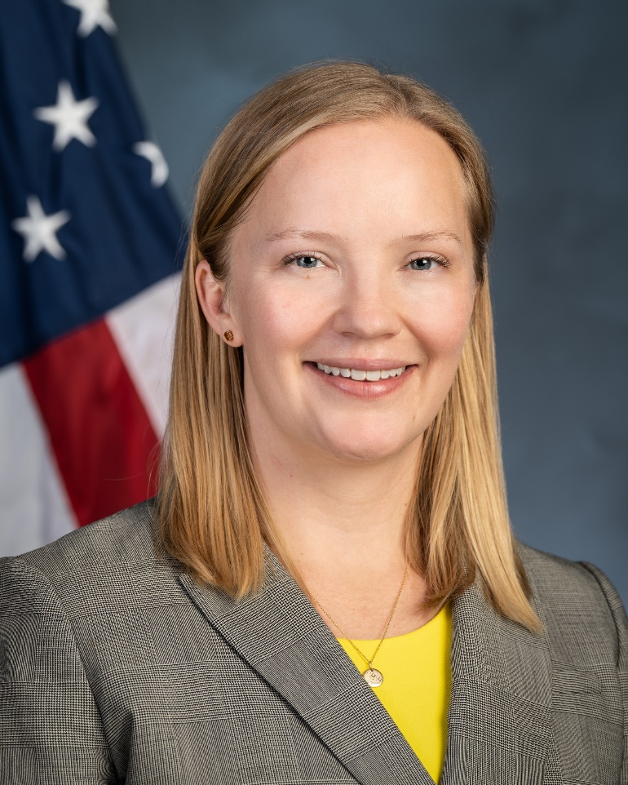
Hilary Atkin
Acting Deputy Assistant Secretary for Native American Programs

Slide 3




AGENDA
I. Funding Opportunity Description
II. Award Information
III. Eligibility Information
IV. Application and Submission Information

Slide 4
PURPOSE
Pursuant to the Consolidated Appropriations Act, 2017, P.L. 115-31 (2017 Appropriations Act), the U.S. Department of Housing and Urban Development (HUD) can expand the Tribal HUD-VASH (THV) program by making new grants or expanding existing grants.
THV grants provide rental assistance and administrative fees to Eligible Indian tribes and Tribally Designated Housing Entities (TDHEs) that meet applicable program requirements established in the 2015 Implementation Notice and the 2018 Consolidation Notice, based on need and administrative capacity.
Approximately $2.2 million is available.

Slide 5
I. Getting Started

Slide 6
BACKGROUND
The Tribal HUD-VASH program provides rental assistance and supportive services to Native American Veterans who are homeless or at risk of homelessness living on or near a reservation or other Indian areas.
HUD provides rental assistance and administrative fees through a grant to participating Tribes or TDHEs. Each year, grants are renewed, subject to appropriations.
The U.S Department of Veterans Affairs (VA) provides case management and clinical services.

Slide 7
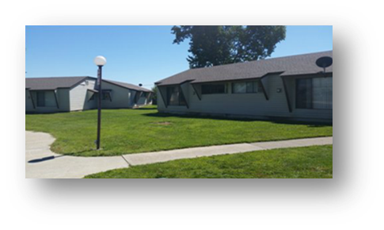
FEDERAL AGENCY ROLES
HUD’s Role – Rental Assistance
Provide housing assistance
Support Tribes/TDHEs to provide access to housing
Offer policy direction
VA’s Role – Case Management
Address health and case management needs of tribal veterans
Provide access to veterans’ benefits
Supports veterans in maintaining their tenancy, addressing outstanding issues, and supporting their personal goals

Slide 8
BACKGROUND – Participant Eligibility
Tribal Veterans must be willing to accept VA case management
The VA prioritizes Veterans based on their level of need.
VA screens for Veterans who are:
Meet the definition of “veteran” which is defined as “a person who served in the active military, naval, air, or space service, regardless of length of service, and who was discharged or released therefrom,” excluding anyone who received a dishonorable discharge from the Armed Forces or was discharged or dismissed from the Armed Forces by reason of the sentence of a general court-martial. 38 USC § 2002 (b).
Are homeless or at risk of being homeless (per McKinney-Vento Homeless Assistance Act)
Have a clinical need for case management services
Then, the VA refers the Veteran to the Tribe/TDHE for further screening…

Slide 9
BACKGROUND – Participant Eligibility (continued)
Tribe/TDHE screens for Veterans who are:
“Indian” as defined by Section 4(10) of NAHASDA
Live on or near the reservation or other “Indian area” (broadly defined in NAHASDA and 24 CFR 1000.10)
Income eligible (80% or less of median income; same income requirements as NAHASDA and 24 CFR 1000.10)
Veteran must not be registered as a lifetime sex offender

Slide 10
BACKGROUND – Participant Eligibility continued
Tribes/TDHEs should note program requirements:
The tribe/TDHE must accept all VA referrals of Native American veterans and their families from the VA partner.
Once the VA and tribe/TDHE determines the Veteran is eligible, the tribe/TDHE must offer rental housing assistance to the participant. The tribe/TDHE cannot deny assistance for other reasons (e.g., the Veteran is in arrears with the TDHE or was evicted, criminal history other than sex offender status, or substance abuse).
The tribe/TDHE can prioritize tribal members over members of other tribes.

Slide 11
AUTHORITIES
Consolidated and Further Continuing Appropriations Act, 2015 (P.L. 113-325, approved December 16, 2014)—original demonstration program authorization
Consolidated Appropriations Act, 2017 (P.L. 115-31, approved May 5, 2017)—expansion authorization
A complete list of program requirements is found in the 2018 Consolidation Notice.
TribalHUDVASH@hud.gov is available to answer questions.
Notes:
There’s flexibility in how many units you may request, and rental assistance can be tenant- or project-based. HUD will also consider proposals that utilize newly constructed or rehabilitated units—provided funding commitments are in place within three years. The focus is on rental assistance and admin costs only; construction funds must come from other sources.

Slide 12

KEY DATES
The application deadline is August 15, 2025 at 11:59:59 PM Eastern time.
Estimated award date: mid-December 2025
Estimated period of performance (POP): The estimated POP for grants awarded under this Notice is January 1, 2026, to September 30, 2027. If you propose to do new construction or substantial rehabilitation before you use Tribal HUD-VASH grants for rental assistance in those units, you will have a longer POP. The POP for those projects will be based on your proposed new construction or rehabilitation timeline, up to five years. We’ll discuss this further when we get to Section 6(c) of this Notice.

Slide 13
AVAILABLE FUNDS
Number of Awards
HUD expects to make 7 awards from the funds available under this Notice.
The number of awards will be based on the number of proposals HUD reviews, approves, and funds.
Estimated Total Funding
$2,200,000
Estimated Award Amount
$300,000

Slide 14
AWARD INFORMATION AND OVERVIEW
Successful applicants will be funded based on:
  Monthly rent. This is calculated by Total Units Awarded, multiplied by the applicable monthly Fair Market Rent, multiplied by the period of performance (generally).
  Monthly administrative fee. This is to cover eligible administrative and planning expenses related to the Tribal HUD-VASH program, including start-up costs. This is calculated by Total Units Awarded, multiplied by the admin fee (currently $115) multiplied by the period of performance (generally).

Slide 15
AWARD INFORMATION AND OVERVIEW
For example, if your grant is based on 15 units that each rent for $1,000 per month during a 12-month POP:
  $1,000 rent X 15 units X 12 months = $180,000 rental assistance amount
  $115 administrative fee X 15 units X 12 months = $20,700 administrative fee amount.
Total award amount: $200,700

Slide 16
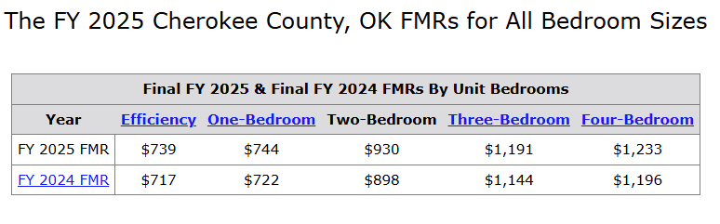
AWARD INFORMATION AND OVERVIEW
Fair Market value example for Cherokee County, Oklahoma
Link to Fair Market value rates can be found at: https://www.huduser.gov/portal/datasets/fmr/fmrs/FY2025_code/select_Geography.odn

Slide 17
AWARD INFORMATION AND OVERVIEW
Successful recipients will receive annual renewal grants in accordance with the latest Renewal Notice (for example, PIH 2025-10).
Current Tribal HUD-VASH grantees who are successful under this Notice should expect the additional allocation to be added to the existing allocation in a subsequent renewal cycle.
Note that renewals for Expansion awards with longer POPs because the applicant is proposing new housing development will begin after the recipient has begun leasing the new housing.

Slide 18
II. Eligibility Information

Slide 19
ELIGIBLE APPLICANTS
Indian tribes (as defined under section 4(13) of NAHASDA)
AND
Tribally Designated Housing Entities (TDHEs) authorized by one or more Indian tribes pursuant to section 4(22) of NAHASDA that have ever been allocated formula funding.
Applications submitted by a TDHE on behalf of an Indian tribe(s) must include a Tribal resolution(s) or Tribal certification(s) on official letterhead authorizing the TDHE to apply on behalf of the Indian tribe(s).
Please note consortiums and subrecipients are also permitted.

Slide 20
CONSORTIUMS
A consortium is a group of two or more tribes that jointly apply to the Tribal HUD-VASH program for one grant to serve eligible Veterans residing in multiple Tribal communities within geographic proximity.
A consortium must enter into an agreement that designates a single lead applicant, identifies other participating applicants, outlines their joint arrangement, and complies with the requirements in 2 CFR 200.331 through 200.333 (including each tribe’s assurance of compliance with program requirements).
The lead applicant signs the grant agreement with HUD.
The lead applicant ensures the Veterans in the Tribal communities in the consortium are served.

Slide 21
SUBRECIPIENTS
You may also propose sub-granting to eligible Indian tribes or TDHEs to serve multiple Indian tribes. If so, you must enter a subrecipient agreement or contract with the subrecipient(s). See 2 CFR 200.331-333.
HUD strongly encourages the lead applicant to ensure the proposed subrecipient(s) has sufficient capacity and is in good standing with HUD.
You and your proposed subrecipients can only apply for one grant award under this Notice.
The VA must be able to provide case management services to eligible Veterans within the service area(s) of the subrecipient(s).

Slide 22
ELIGIBLE COSTS
Tribal HUD-VASH funds can only be used for rental assistance and administrative costs
Rental Assistance can be Tenant-Based or Project-Based
Administrative Costs included but not limited to:
  Eligibility determinations;
  Intake and briefings;
  Owner outreach efforts;
  Unit inspections;
  Rent negotiations;
  Processing subsequent moves
  Annual and interim reexaminations;
  Tenant fraud investigations and hearings;
  The costs associated with making rental assistance payments to owners; and
  Complying with reporting requirements.

Slide 23

COST SHARING OR MATCHING
Cost sharing or matching is not required under this grant, but you are encouraged to leverage other Federal (including IHBG formula funds) and non-Federal sources.
Note that if you propose to build, buy, or rehab housing for this program you will need to identify the funding source.

Slide 24
New Housing Construction and Substantial Rehabilitation
HUD will consider applications that propose to use other federal or non-federal funding to construct, rehabilitate, or acquire units that will later use Tribal HUD-VASH rental assistance.
If you propose to build, buy or rehab, you must obtain funding to do so within three years of grant award. If you do not provide HUD with evidence of a firm funding commitment within three years, HUD may rescind the grant and recapture grant funds.
Tribal HUD-VASH grants can only be used for rental assistance and administrative costs. The costs to build, buy or rehab need to be borne by other funding sources (e.g., IHBG, IHBG Competitive, ICDBG, USDA, LIHTC, other state or tribal funds, etc.) If a loan is used to build, buy or rehab the units, Tribal HUD-VASH funds can be used to make payments to the loan (but please ensure you have enough funding to also operate and maintain the housing).

Slide 25
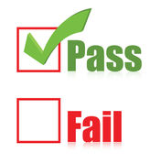
THRESHOLD REQUIREMENTS
Utilization Rate Criteria (existing Tribal HUD VASH grantees only)
Must have an average Tribal HUD-VASH utilization rate of at least 70 percent over the 12-month period immediately preceding the Notice publication date
Utilization rate is the average number of units leased each month divided by the total number of Tribal HUD-VASH units allocated for the 12-month period.
*If you are uncertain about whether you meet this threshold criteria, contact TribalHUDVASH@hud.gov.

Slide 26
THRESHOLD REQUIREMENTS
Resolution of Civil Rights Matters - If you have any outstanding civil rights matters, they must be resolved to HUD's satisfaction before you apply.

Slide 27
III. Program Requirements

Slide 28
USE OF FORMULA CURRENT ASSISTED STOCK
A recipient who wants to use FCAS units to house Tribal HUD-VASH program veterans can only do so if the FCAS units are not being counted in the recipients' IHBG FCAS formula count.
Tribal HUD-VASH recipients that want to use low-rent FCAS units must provide written notification to IHBG Formula Customer Service Center to remove the FCAS unit(s) from their IHBG FCAS formula count.
Vacant Mutual Help units may be converted to low-rent units in accordance with 24 CFR 1000.316, and used after the low-rent units are removed from the tribe/TDHE’s IHBG FCAS formula count.
When the former FCAS units are no longer being operated as Tribal HUD-VASH units, the units will no longer be considered Tribal HUD-VASH units and can be added back to the Tribe/TDHE’s FCAS formula count.
See ONAP Program Guidance, "IHBG in the Tribal HUD-VASH Program" (No. 2018-01, published February 21, 2018)

Slide 29
MINIMUM/MAXIMUM AWARD INFORMATION
  There is no minimum or maximum number limitation on the number of units that you can request. However, your proposal must be feasible.
  The proposed units must be supported by available housing stock or a viable plan to develop new housing.
  The VA must be able to support your program proposal with case management services, as indicated by a VA commitment of support included in your application.

Slide 30
IV. Expansion Application Contents And Submission

Slide 31
HOW TO SUBMIT YOUR APPLICATION
You must apply through GRANTS.GOV by the deadline
You must have an active GRANTS.GOV registration. This requires a Login.gov registration as well. See step-by-step instructions at the GRANTS.GOV Quick Start Guide for Applicants. Register now, don't wait!
You must be registered in the System for Award Management (SAM.gov). Register now, don't wait!

Slide 32
HOW TO SUBMIT YOUR APPLICATION
  If you cannot submit your application electronically, contact TribalHUDVASH@hud.gov to request a waiver of this requirement. Waiver requests must:
  Be received at least 7 days before the application deadline
  Be for good cause (lack of SAM registration or valid UEI is not good cause), and
  The paper application must be received before the deadline.
  If you do not apply by the deadline, your application will not be reviewed.

Slide 33
HOW TO SUBMIT YOUR APPLICATION
Your complete application must include several narratives and non-form attachments, which we will go over in detail.
Your application submissions may be in the format of your choosing but must include the required information.
Don't submit third party documents, such as audits, general letters of support, or policies, unless specifically asked to do so.

Slide 34

APPLICATION FORMATTING TIPS
HUD suggests the following formatting requirements. However, applications that do not follow the formatting recommendations will not be penalized:
Letter-sized paper, 8.5” x 11”, with 1” margins;
Double-Spaced text in the workplan narrative and single-spaced titles, headings, footnotes, quotations, references, and captions;
12-point font; and
Easily readable font such as Times New Roman, Courier, Courier New, or Arial.

Slide 35
APPLICATION CONTENTS
One- page proposal summary:
Name of applicant and unique entity identifier (UEI number)
Number of units requested and estimated bedroom size of these units;
Type of proposed assistance: describe if your program will provide Tenant-Based or Project-Based Rental Assistance, or a combination;
Housing supply: describe the availability of housing for the program;
Brief description of new construction, rehabilitation or acquisition project, if applicable; and
Brief description of proposed partnerships (e.g., subrecipients or consortiums), if applicable.

Slide 36
APPLICATION CONTENTS
Administrative capacity narrative
Your application must demonstrate sufficient administrative capacity to manage a Tribal HUD-VASH program. Describe your ability to administer the grant and support the program including:
  Knowledge and experience of key staff (including program manager) who will implement the THV program.
  Your familiarity with the program requirements found in the 2018 Consolidation Notice.
If proposing new housing construction or rehabilitation, describe your experience with similar recent projects.
  Please limit the narrative to five (5) pages or less.

Slide 37
APPLICATION CONTENTS
Need narrative
Documentation may include but not limited to:
Describe the need for housing among eligible Veterans in the area, including the estimated number of eligible homeless or at-risk Veterans
Point-in-Time counts
Waiting lists that include homeless Veterans or Veterans at risk of homelessness
A list of eligible Veterans from the Tribal Veteran’s Representative
Data from the local VA
U.S. Census Bureau’s American Community Survey (ACS) data
Provide information verifying the presence of eligible Veterans who are homeless or at risk of homelessness in the area

Slide 38
APPLICATION CONTENTS
Description of proposed Tribal HUD-VASH program
Provide a detailed description of your proposed program that demonstrates a well-developed plan to implement the program, including:
Number of Veterans you plan to serve under this grant;
Information about local housing;
Type of units and their location;
Unit sizes and HUD Fair Market Rent (FMR) rates for the units;
Timeline for implementing the program, including policy development, staff training, coordination with VA and local landlords (if applicable) and achieving full lease-up;
A project plan and timeline for completing new construction or rehabilitation, including planned funding sources (if applicable); and
A description of how the Veterans will qualify for such housing if proposing capital funding with income restrictions that differ from Tribal HUD-VASH, such as LIHTC.

Slide 39
APPLICATION CONTENTS
VA Commitment of Support
You must include a letter of support from your partnering VA medical facility’s Director with your application
The VA’s letter must:
  Affirm that the Indian tribe or TDHE has consulted with its local VA facility about its interest in expanding or creating a Tribal HUD-VASH program, and
  Commit to providing case management services for eligible Veterans, should the applicant succeed in receiving a Tribal HUD-VASH expansion award
Information regarding Local VA facility information and Local VA Homeless Program Coordinators is available online at: https://www.va.gov/find-locations and https://www.va.gov/homeless/.
If you need assistance getting in touch with your local VA, please reach out to tribalhudvash@hud.gov or VACOHUD-VASHTeam@va.gov.

Slide 40
APPLICATION CONTENTS
Tribal Resolution (if applicable)
TDHEs: If you are a TDHE applying on behalf of an Indian tribe(s), you must include a tribal resolution(s) or tribal certification on official letterhead authorizing the TDHE to apply on behalf of the tribe(s).
Consortiums and Sub-recipients: You must include a Tribal resolution(s) or Tribal certification(s) on official letterhead from each participating tribe supporting the proposed project.

Slide 41
V. Review and Corrections To Deficient Submissions

Slide 42
HUD REVIEW OF THRESHOLD REQUIREMENTS
  HUD will not review your application if:
  You do not submit your application by the deadline (Make sure you are registered in grants.gov and sam.gov!)
  You are not an eligible applicant
  You do not meet the threshold for 70% utilization rate (existing Tribal HUD-VASH grantees only)
  You do not meet the civil rights threshold

Slide 43
CORRECTIONS TO DEFICIENT SUBMISSIONS
If HUD finds a technical error, area of concern, or a need for more information about your application, HUD will contact you and request a cure or additional information.
This may include additional information about the items requested by this Notice or other information as determined by HUD.
You must provide a response in accordance with the instructions and the timeline contained in the deficiency notification. If you do not respond timely or you do not provide the information requested, you will not be awarded funds under this Notice.

Slide 44
HUD REVIEW OF OTHER NOTICE REQUIREMENTS
  For program requirements, HUD may reach out during review to ensure program requirements are met to HUD satisfaction. For example:
  Can the VA provide case management services?
  If FCAS units will be used, HUD may condition the award on you working with the IHBG Formula Center to temporarily remove the units from the IHBG Formula prior to drawing down THV funds

Slide 45
HUD REVIEW OF OTHER NOTICE REQUIREMENTS
  For application submission requirements, HUD may reach out during review to ensure requirements are met to our satisfaction. For example:
  If information is inconsistent across application submission, we will require you to update documents.
  If an application submission is missing, you will be required to submit it.
  If based on your submission we are unsure if you have the capacity to manage a Tribal HUD-VASH program, we may require additional information.
  If it isn't clear that your proposed project is feasible, we may acquire additional detail, such as additional items in your timeline

Slide 46
HUD REVIEW OF OTHER NOTICE REQUIREMENTS
If after review HUD determines that you do not have sufficient housing stock, or if the VA cannot support your application, HUD may award you a lower amount than requested, or you may not be awarded funds.

Slide 47
VI. Selection And Award Process

Slide 48
SELECTION AND AWARD PROCESS
HUD will select applicants based on need, administrative capacity, and the criteria in the Notice.
HUD will treat all applicants consistently
How will the Notice criteria factor into HUD's selection process?
  HUD may determine to only review complete applications, if many applications are submitted
  HUD may determine not to fund applications where concerns with the application were not addressed to HUD’s satisfaction

Slide 49
SELECTION AND AWARD PROCESS
    HUD will consider need by:
    Assessing factors such as the number of eligible Veterans who are homeless or at risk of homelessness, and
    Other need factors
      Providing awards across small, medium and large Tribes
      Providing awards across Indian country
      Considering the need for new housing in your area and/or for this population

Slide 50
SELECTION AND AWARD PROCESS
    HUD will evaluate administrative capacity by considering factors such as:
    Availability of housing, or
    The feasibility of the applicant’s proposal to buy, build or rehab units for the program

Slide 51
SELECTION AND AWARD PROCESS
All applicants will be notified about the outcome of their application via email.
Upon HUD’s approval of the award package, HUD will issue a grant agreement electronically to be signed by the recipient. HUD will disburse funds through the HUD Line of Credit Control System (LOCCS).

Slide 52
VII. Risk Evaluation

Slide 53
RISK EVALUATION
Even if you submit your threshold items and put forth a solid proposal, HUD may not fund your award based on a risk evaluation.
HUD will determine if you’ve handled past federal awards well and demonstrated sound business practices in accordance with 2 CFR § 200.206.
HUD will review its own data and records, SAM.gov, and Department of Treasury data.

Slide 54
RISK EVALUATION
  HUD will examine a range of capacity indicators, including:
  program performance, such as compliance with reporting requirements;
  outstanding financial audits and unresolved HUD monitoring findings;
  Voluntary Compliance Agreements, HUD Notices of Intent and/or Intent to Impose Remedies;
  Office of Inspector General findings or audit findings;
  high unexpended grant balances;
  compliance with mitigation plans; and
  overall administrative capacity to administer the Tribal HUD-VASH program.

Slide 55
VII. Reporting

Slide 56
REPORTING REQUIREMENTS
Please note that if you are awarded funds, you will need to comply with a variety of reporting requirements.
Review Section VI.O of the Consolidation Notice to familiarize yourself with Tribal HUD-VASH reporting requirements.
Once awarded, you must comply with reporting requirements to remain eligible for HUD funding.
Please note HUD is implementing new grants management and reporting tools, which will be rolled out for your use in the near term. As a grantee, you will be required to report on grant performance and financial activities (including vendor and cash disbursement supporting details for yourself and your sub-recipients) using these new tools when they are released.
HUD reserves the right to exercise all available rights and remedies for any noncompliance with grants management and financial reporting requirements, to include requiring 100% review or stopping future disbursements altogether if reporting is not timely submitted.

Slide 57
VIII. Reminders and FAQs

Slide 58
REMINDERS
HUD strongly recommends applications be submitted 48 hours before the deadline date
“Received by Grants.gov"- applicant received a confirmation of receipt and confirmation number
"Validated by Grants.gov"- application has been accepted and was not rejected with errors
Verify the contents of your submitted application to confirm grants.gov received everything you intended to submit.
Triple check that everything's been uploaded properly, that files are compatible w/ grants.gov (not corrupt), triple check the application submission requirements, etc.

Slide 59
REMINDERS
Number of Applications
Each eligible applicant may only submit one application under this Notice. If an applicant submits more than one application, HUD will only accept the last application submitted by the application deadline.
An Indian tribe that authorizes a TDHE or consortium to apply on its behalf may not also submit an application.
Timely Submission of Applications - Applications submitted after the deadline (August 15, 2025, at 11:59:59 PM Eastern time), will be marked late. Late applications are ineligible and will not be considered for funding.

Slide 60
FREQUENTLY ASKED QUESTIONS
Question: Typically, are the Tribal HUD VASH awards renewed annually at the same funding level as long as all program requirements are met and the TDHE remains in good standing?
Answer: Yes. Renewal grants are noncompetitive and in the 10 year history of the program, we haven’t had a THV grantee not get renewed. Of course, renewals are always subject to appropriations from Congress. You can review the most recent Renewal Notice to get an idea of the process.
Questions: Is the Tribal HUD-VASH Renewal application and the HUD VASH Tribal Expansion the same applications?
Answer: No.
Renewal Notice – this is for Tribes/TDHEs who are already THV grantees and want to continue being in the program.
  Expansion Notice – This is for new Tribes/TDHEs who want to join the THV program and for current THV grantees who want to serve more Veterans.

Slide 61
FREQUENTLY ASKED QUESTIONS
Questions: Is it a requirement to have the VA be the case manager? Who funds the case management?
Answer: VA provides the funding for case management. Per 80 FR 63822, “A tribe/TDHE should work with the local VAMC to determine how Case Management will be delivered to Native American veterans. VA may provide these services directly through the local VAMC, or through a Community-Based Outpatient Clinic (CBOC). Alternatively, the VA may engage in a contractual relationship with a tribal healthcare provider or the Indian Health Service (IHS) for service delivery.”
VA may require certain qualifications or licensing for performing clinical case management. Reach out to your local VA to discuss – use the contact links on page 9 of the notice. This could also be something a grantee could transition to in the future, should you be successful in applying for the program.

Slide 62
FREQUENTLY ASKED QUESTIONS
Question: Are Native Hawaiians eligible for Tribal HUD VASH?
Answer: No. Native Hawaiians are not eligible for Tribal HUD VASH, because participants must be members of an Indian tribe, as defined in section 4(13) NAHASDA.

Slide 63
RESOURCES FOR TRIBAL HUD-VASH
Grants.gov Listing
HUD Tribal HUD-VASH resource page
Expansion Notice
Fair Market Rents
2 CFR Part 200 Uniform Guidance
Native American Housing Assistance and Self Determination Act of 1996 (NAHASDA)
2018 Consolidation Notice
Office of Native American Programs Contacts
Notes:
There’s flexibility in how many units you may request, and rental assistance can be tenant- or project-based. HUD will also consider proposals that utilize newly constructed or rehabilitated units—provided funding commitments are in place within three years. The focus is on rental assistance and admin costs only; construction funds must come from other sources.

Slide 64
Application Deadline Date
August
15
Friday, August 15, 2025
11:59:59 pm EST
For any questions please contact TribalHUDVASH@hud.gov

