Slide 1

PHAS Housing Families Experiencing Homelessness through the Public Housing and Housing Choice Voucher Programs
July 20, 2023

Slide 2


Presenter Introductions
Mande Ellison
Lead Homelessness Services Specialist
Emily Warren
Senior Housing Program Specialist
Housing Voucher Management and Operations Division
April Mitchell-Gasque
Senior Program Specialist
Special Needs Assistance Programs (SNAPS)
Office of Community Planning and Development
Jerrianne Anthony
Senior Housing Program Specialist
Housing Voucher Management and Operations Division
Ashley Richards
Senior Homeless Services Specialist
Caroline Crouse
Senior Program Specialist
Special Needs Assistance Programs (SNAPS)
Office of Community Planning and Development
Notes:
ME

Slide 3
Agenda
  Introduction
  Overview of Notice
  Forming partnerships and collaboration between the PHA and CoC
  Characteristics of an effective Coordinated Entry process
  Pairing Data from IMS/PIC with HMIS Data
  Ensuring Racial Equity in the Preference System
  Waiting List Admin and Preferences
  Q&A
Notes:
ME

Slide 4

Learning Objectives
  Provide training on Notice PIH 2023-13: Guidance on housing individuals and families experiencing homelessness through the Public Housing and Housing Choice Voucher Programs
  Help PHAs and CoCs understand best practices for partnering and working collaboratively to house individuals and families experiencing homelessness
Notes:
ME

Slide 5
HUD Timeline and Background
In 2009, the Homeless Emergency Assistance and Rapid Transition to Housing (HEARTH) Act revised the definition of homeless for HUD’s homeless assistance programs
On December 5, 2011, HUD implemented this definition
Notice PIH 2023-13 has been updated to include Categories 2 & 3 of the definition
PIH previously adopted only a portion of the 2011 definition, but PHAs now must use the entire definition (all four categories) for line 4c of the 500058
Notes:
ME

Slide 6
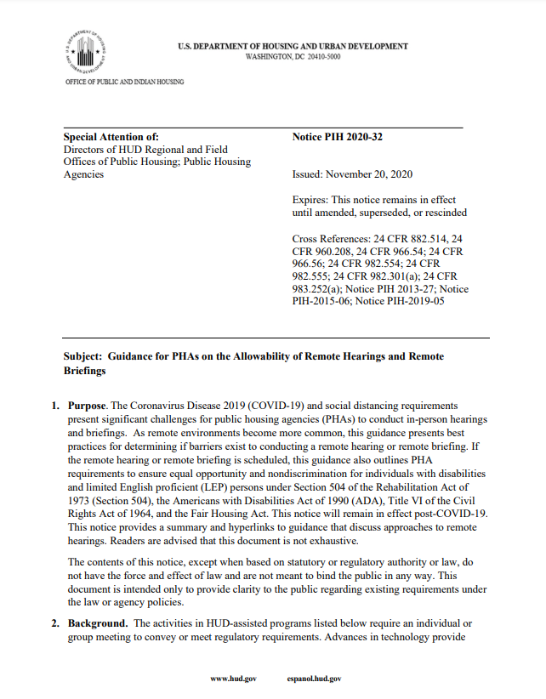
Notice PIH 2023-13
Guidance on housing individuals and families experiencing homelessness through the Public Housing and Housing Choice Voucher Programs
Issued June 8, 2023
Applicable to Public Housing Agencies (PHAs) that administer Public Housing and/or HCV and Continuums of Care (CoCs)
Notes:
ME

Slide 7
6/10/13
6/8/23
Notice PIH 2023-13
Notice PIH 2013-15
    Notice PIH 2023-13 supersedes previous guidance
The Proxy Inspection Assistant should be familiar with the orientation of the property such as boiler and utility rooms, roof access, closets, etc.
Anyone acting as a proxy must have the following physical ability to:
    HUD is updating Notice PIH 2013-15 to expand its guidance related to how PHAs can leverage their public housing and HCV resources to assist persons and families who are experiencing homelessness.
Notes:
ME

Slide 8
Changes from the 2013 Notice
Definition of Homeless
Updates definition of homeless for Form HUD-50058 reporting
Data Sharing
Outlines new guidance on how PHAs and CoCs can share data derived from IMS/PIC and HMIS
Waiting List Management
Provides updated guidance on waiting list management and preferences
Provides updated guidance on screening policies regarding criminal activity and substance use/abuse
Screening
Notes:
ME

Slide 9
Changes from the 2013 Notice- Continued
Termination and Evictions
Provides updated guidance on program termination and eviction policies
PBV
Provides information regarding project-based vouchers for Permanent Suppositive Housing (PSH)
Racial Equity
Updates guidance to address racial equity in the fight to end homelessness
Provides updated information and strategies for PHAs to build relationships with partnering organizations
Partnering Organization
Notes:
ME

Slide 10
Overview of HUD Homeless Definition
Category 1: Literally homeless individuals/families
Category 2: Individuals/families who will imminently lose their primary nighttime residence with no subsequent residence, resources or support networks
Category 3: Unaccompanied youth or families with children/youth who meet the homeless definition under another federal statutes
Category 4: Individuals/families fleeing or attempting to flee domestic violence
Notes:
ME
Categories 2 and 3 have been added to the eligibility criteria per this notice.

Slide 11

The Role of PHAs and CoCs
    Continuums of Care (CoCs) apply annually for and manage federal resources to assist individuals and families experiencing homelessness
    Public Housing Authorities (PHAs) provide stable, long-term housing and housing subsidies which can help end the cycle of homelessness
Notes:
ME

Slide 12
Forming Partnerships and Collaboration between the PHA and CoC
Notes:
Emily

Slide 13

    HUD strongly encourages PHAs and CoCs to proactively engage in partnerships, since the communities that have been most successful in working toward ending homelessness are those where PHAs form direct partnerships with the local CoC, homeless service providers, and other agencies
Notes:
Emily- A partnership between the CoC and the PHA is a critical part of a community-wide effort to end homelessness

Slide 14
Building Relationships
PHAs and CoCs are encouraged to establish strong partnerships, as this enables the PHA and CoC to access the large network of different homeless service providers throughout their community
Strong relationships ensure individuals and families admitted to the Public Housing or HCV program are provided the services necessary to remain stably housed and compliant with the family obligations and other requirements of the program
Notes:
Emily

Slide 15
Building Relationships
PHAs and CoCs can use both formal and informal approaches to build relationships, including:
  Participating in the Moving On Program
  Establishing MOUs to detail specific roles in the partnership and leverage combined resources to create PSH and RRH
  Becoming members of the CoC
  Participating in the CoC’s HMIS
  Participating in the CoC’s prioritization meetings
  Providing training to PHA staff on the local strategic plan to end homelessness and the various supportive programs that may be available to Public Housing residents and HCV participants
  Providing training to CoC staff to ensure they understand how to best support the clients/participants navigating the HCV and Public Housing application process
Notes:
Emily

Slide 16
Benefits to Both Organizations
Relationship between CoCs and PHAs can benefit both organizations by:
  Sharing best practices
  Identifying and prioritizing people experiencing homelessness for assistance
  Aiding in locating a unit, accessing additional services, etc.
  Providing documentation for verification purposes
  Sharing information on the physical location of people experiencing homelessness to ensure services can be provided
  Providing case management assistance to households when applying to PHA programs
  Providing housing search assistance
  The CoC serving as a liaison between the PHA, family, and owner
  Identifying and recruiting of landlords for HCV programs
Notes:
Emily

Slide 17
Leveraging Resources
Partnerships between PHAs and CoCs allow them to leverage resources to better serve individuals and families experiencing homelessness
Example: A PHA and CoC may partner to create a PSH project, with the PHA providing a voucher/project-based unit for rental assistance, while the CoC provides or coordinates the accompanying supportive services
Example: Creating a Rapid Rehousing (RRH) project where services are provided through CoC or Emergency Solution Grants (ESG) funds, while housing subsidies are supplied through a HCV
Notes:
Emily

Slide 18

Duplicative Subsidy
When services are provided by both the CoC and PHA, it is important that subsidies are not duplicated
Example: The organizations may not both pay the rental subsidy, but the CoC could pay for the rental deposit while the voucher pays for the rental subsidy
Notes:
Emily

Slide 19
Characteristics of an Effective Coordinated Entry (CE) Process and How it relates to this Notice
Notes:
Emily intro April

Slide 20
What is a CE system?
Q
A
A CE system (formerly called Centralized or coordinated assessment system) is a set of processes designed to coordinate streamlined and equitable participant access, assessment, prioritization and referral to housing and/or services. The system must cover the CoC geographic area and involve all CoC and ESG funded projects.
Notes:
April

Slide 21

Requirements: Coordinated Entry
CoCs must establish and operate “a centralized or coordinated entry system that provides an initial, comprehensive assessment of the needs of individuals and families for housing and services with the intention of matching the homeless individual or family with the most appropriate resources.”
Citation: CoC Program Interim Rule
more detailed requirements can be found at: Notice CPD-17-01: Notice Establishing Additional Requirements for a Continuum of Care Centralized or Coordinated Assessment System
Notes:
April

Slide 22
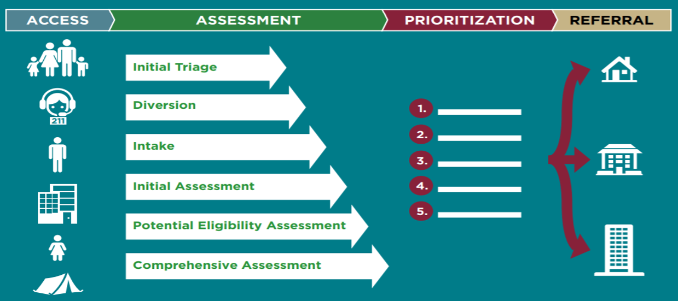
Coordinated Entry Process
Notes:
April

Slide 23
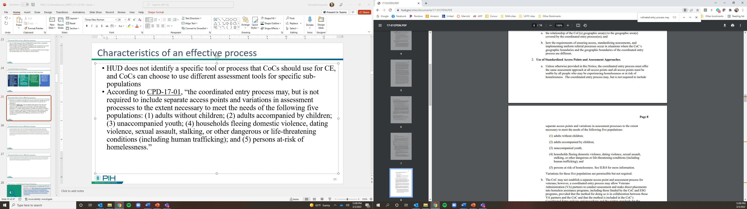
CoC Assessment Tools
HUD does not identify a specific tool or process that CoCs should use for CE
CoCs can choose to use different assessment tools for specific sub-populations
Citation: CPD-17-01
Notes:
April

Slide 24
PHA Role in CE Process
As one of the largest providers of affordable housing in their communities, PHAs can play a critical role in the CE process
​
PHAs should connect with their local CoCs to understand their local CE design and operation (processes, tools, policies, and procedures)​ so they can best participate in the CE System to effect the most changes in our communities' Homeless Response Systems.
Notes:
April

Slide 25

PHA Participation in the Coordinated Entry System
HUD strongly encourages PHAs to participate in the coordinated entry system in their area by establishing a mechanism for referrals once an assessment has been made by the CoC
Notes:
April

Slide 26
PHA Participation in the Coordinated Entry System
To participate in the coordinated entry system, PHAs may:
Accept CE system referrals of people experiencing homelessness who are eligible for and in need of housing programs
Provide housing support through EHVs
Use the CE system to identify households that may be eligible for any limited preference for people experiencing homelessness
Notes:
April

Slide 27

Resources: Additional CE Best Practices
For more information on additional CE best practices, see PHA Strategies to Assist People Experiencing Homelessness Guidebook: Using Coordinated Entry to Identify People Experiencing Homelessness for Housing Assistance
Notes:
April

Slide 28
Pairing Data from IMS/PIC with HMIS Data
Notes:
Jerrianne

Slide 29
What is IMS/PIC?
Q
A
Inventory Management System/Public Housing Information Center
The Form 50058 module allows PHAs to electronically submit information to HUD about their housing inventory and families who participate in the Public Housing and HCV Programs
Enables PHAs and HUD personnel to access a common database of PHA information
Notes:
Jerrianne

Slide 30

Purpose of IMS/PIC
PHAs are required to submit a Form 50058 at least annually for each assisted family
HUD requires complete, accurate, and timely submission of Form 50058 data to the IMS PIC System for effective program monitoring
Notes:
Jerrianne

Slide 31
What is HMIS?
Q
Homeless Management Information System
Locally administered information technology system used by CoCs to comply with the data collection and reporting requirements of the COC program interim rule
Records and analyzes client-level data and data on the provision of housing and services for individuals and families who are homeless or at-risk of homelessness
HUD and other federal partners use aggregate data from HMIS to better inform homeless policy and decision making
A
Notes:
Jerrianne

Slide 32
Purpose of HMIS
HMIS can be used to generate reports, assess programs, and process intake and referral information in some CE systems
The system is a valuable tool and can be used by CoCs to make data-driven decisions and increase access to housing resources for families experiencing homelessness
Notes:
Jerrianne

Slide 33
Data Sharing
CoCs, PHAs, and their partners can establish data sharing agreements to link the PHA’s IMS/PIC data with the CoC’s HMIS systems
Notes:
Jerrianne

Slide 34
Data sharing agreements allow PHAs and CoCs to:
Further enhance their analytical capabilities
More effectively collaborate
Understand and analyze individual paths taken by homeless families through the system of homelessness
Better understand actual family outcomes
Create and coordinate strategies that support better outcomes
Notes:
Jerrianne

Slide 35
Examples
Example 1: If many families are receiving vouchers, but only a small number of those families successfully lease up, it may indicate a need for support in finding units, completing landlord applications, or getting paperwork returned to the PHA
Example 2: If families successfully lease up but are frequently terminated within 1-2 years, it may indicate a need for increased support through their time within the program
        Both examples highlight instances where access to data can lead to a greater understanding of the path through homelessness, enabling PHAs and CoCs to coordinate the application of additional resources most needed by the people experiencing homelessness in their communities
Notes:
Jerrianne

Slide 36

Policies
CoCs and PHAs should implement informed policies and procedures to understand how data is collected, used, stored, and disclosed across the homeless services system
Policies:
  Must comply with the requirement to protect clients’ PII
  Should follow the guiding principle that only the least amount of data necessary to achieve the purpose should be shared
Notes:
Jerrianne

Slide 37

Protecting Client Data
CoCs and PHAs must be transparent in the data collection process and articulate polices to clients in a way that they understand
Clients must be protected from denial of services they would otherwise qualify for if they do not consent to data collection/sharing
  Where information collection is required by law, CoCs and PHAs are not required to seek consent
Notes:
Jerrianne

Slide 38
Ensuring Racial Equity in the Preference System
Notes:
Jerrianne

Slide 39
Ensuring Racial Equity
The Proxy Inspection Assistant should be familiar with the orientation of the property such as boiler and utility rooms, roof access, closets, etc.
Anyone acting as a proxy must have the following physical ability to:
    It is important that PHAs utilize their resources to identify, understand, and take the necessary action to address racial disparities in their communities, particularly when establishing and applying homeless admissions preferences
Notes:
Ashley

Slide 40
Disproportionate Representation
    Black, Hispanic/LatinX, and American Indian and Alaskan Natives are overrepresented among the U.S. homeless population
60%
40%
Notes:
Ashley

Slide 41
Homelessness and People of Color
    Homelessness disproportionately effects people of color.
89%
40%
Citation: SPARC Phase-1 Findings March 2018
Notes:
Ashley

Slide 42
Homelessness and African Americans
    African Americans are significantly overrepresented among the homeless population in the U.S.
40%
40%
Citation: 2019 Annual Homeless Assessment Report (AHAR)

Slide 43
Analyzing Racial Disparities Among People Experiencing Homelessness
PHAs may utilize the CoC Analysis Tool examine racial disparities in the numbers of individuals or families experiencing homelessness in the local community or those who obtain and maintain permanent housing

Slide 44

Fair Housing Considerations
Agencies, organizations, or consortia that make referrals to PHAs must not deny their services to members of any Federally protected class under fair housing laws, i.e., race, color, religion, national origin, sex, disability, or familial status
Notes:
Ashley

Slide 45
Preferences and Waiting List Administration
Notes:
Ashley

Slide 46
Establishing Local Preferences
    PHAs may, but are not required to, establish waiting list preferences
    A PHA’s greatest tool for increasing program access for individuals and families experiencing homelessness is establishing a preference in their admissions policies
    HUD regulation allow PHAs to establish certain local preferences in PHA policies in accordance with HUD regulations
    PHAs may establish other preferences in PHA policies not addressed in regulations if they are based on local housing needs and priorities
    Citation: 24 CFR 960.206 for PH; 24 CFR 982.207 for HCV; 24 CFR 983.251(c)(3) for PBV
Notes:
Emily

Slide 47
Preferences and Partnering with Service Providers
A PHA that wishes to partner with a homeless service provider to project-base vouchers may consider:
  Creating a separate waiting list for the project
  Adopting a preference for people who are homeless
  Adopting a preference for families who qualify for voluntary services, including disability-related services, offered in conjunction with assisted units at the project
  Adopting a preference for individuals or families referred by the coordinated entry system
Notes:
Emily

Slide 48
Opening the Waiting list
If a PHA does not have enough applicants on its waiting list who qualify for a specific preference, the PHA may open its waiting list strictly to people to whom the preference applies
The notification process, as well as the preferences themselves, must comply with HUD fair housing requirements
The notification process, as well as the preferences themselves, must comply with HUD fair housing requirements
Notes:
Emily

Slide 49
Opening/Closing the Waiting List
Once an adequate number of persons meeting the preference have been placed on the waiting list, the PHA may keep the waiting list open only for the population qualified for the preference while keeping it closed for all other applicants
This can be particularly helpful if the PHA preference is for referrals from partner agencies since it will allow the agencies to continue sending referrals when more resources are available through the PHA
Notes:
Emily

Slide 50
Resources: Best Practices for Waiting List Operation
PHA Strategies to Assist People Experiencing Homelessness Guidebook
Notes:
Emily

Slide 51
More Related Resources
CoC Homeless Populations and Subpopulations Reports
Coordinated Entry as a Tool for Equity: Training on Fair Housing and Coordinated Entry
Racial Equity- HUD Exchange
Notes:
Emily

Slide 52
Question and Answer Time-
Please use the chat to ask questions!
Notes:
HUD staff

Slide 53

Contact Us
Inquiries about this Notice should be directed to:
publichousingpolicyquestions@hud.gov
for Public Housing,
vouchernotice@hud.gov
for Housing Choice Vouchers,
And
SNAPSinfo@hud.gov
for CPD.

