Slide 1


Slide 2
HUD Strong Families Initiative
May - June
Empowering Fathers,
Mothers and Children

Slide 3
Our Mission
To strengthen, empower, and improve the quality of life for HUD-assisted families.
HUD Strong Families provides fathers, mothers and children access to local resources for:
  Health
  Education
  Economic Empowerment

Slide 4
HUD Strong Families Initiative
Builds upon longstanding Father’s Day efforts to involve fathers in the lives of their children.
Our focus includes mothers, children and parents of all kinds.
Provides an ideal opportunity for communities to deliver a wide variety of resources to families.

Slide 5
Strong Families Matter
Children reared in safe and nurturing families and neighborhoods, free from maltreatment and other adverse childhood experiences, are more likely to have better outcomes as adults.
Source: Maternal, Infant, and Child Health, Healthy People 2020 (healthypeople.gov)

Slide 6
And Fathers Matter!
Fathers in the community can provide boys with role models and mentors.
Their presence may indicate other neighborhood factors that benefit families, like lower incarceration rates and better job opportunities.
Source: The Upshot, The New York Times (March 19, 2018)

Slide 7
Areas of Focus
Health
  Nutrition & Fitness
  Mental Health
  Disease Prevention
Education
  High School & GED
  FAFSA & Post-Secondary
  Job Training
  STEM
Economic Empowerment
  Stable employment
  Financial literacy
  Economic self-sufficiency

Slide 8
Marketing Your Event
Resources on the HUD Strong Families website:
Event Ideas
  Tips for a Successful Event
  Photos and flyers from previous events
Marketing Materials
  Flyers
  Posters
FAQs
And more!

Slide 9
Ideas for Partnering
Businesses
  Grocery stores
  Barbershops
Institutions
  Libraries
  Schools
  Community Colleges
Radio stations
Other PHAs & Multifamily owners
Faith-based groups
Community groups
  Boys & Girls Clubs
  YMCA / YWCA
Service organizations
  Lions
  Kiwanis
Local government
  Depts. of Parks & Rec.
Service providers
  And their Federal partners
Area festivals

Slide 10
HUD’s Role
Support Public Housing Authorities and Multifamily owners to host resource fairs in May and June by connecting participating communities with:
  Key Federal Agencies
  National Nonprofits
  Service Organizations

Slide 11
How You Can Join
Host a resource event in your community this May and June.
Your event can include anything from:
  Job Fairs
  STEM Educational Workshops
  Digital Literacy Trainings
  Health Clinics

Slide 12

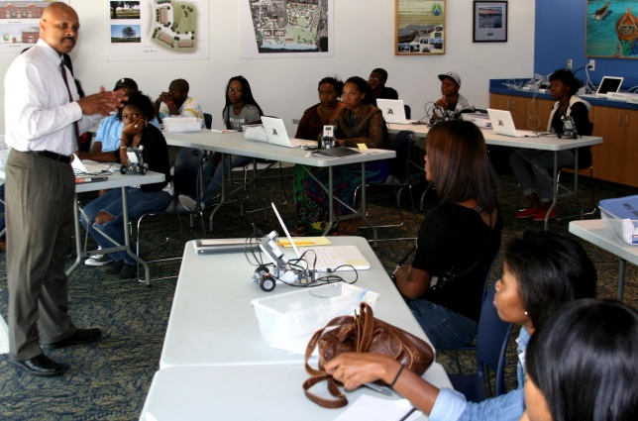
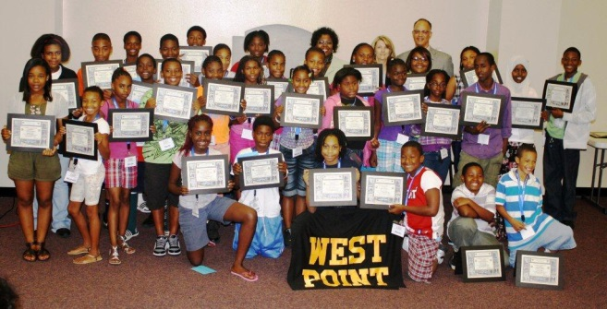
Your Impact
Terre Haute Housing Authority
Partners: Fatherhood Coalition
Children’s Bureau
Catholic Charities
HIV Coordination Services
Indian Legal Services
Attendance: 125
Rockford Housing Authority
Barbeque Family Fun Day
Partners: Rockford Park District
Boys and Girls Club
Community Organizations Attendance: 500

Slide 13
Register Today!
More than 1,000 communities have taken part in past events
Receive HUD Strong Families updates
Register soon!

Slide 14
Contact Us
Questions?
Ideas?
Share your story!
StrongFamilies@HUD.gov

