Slide 1
FHA Multifamily Production
Fiscal Year 2024 Summary
Source: DAP
Date of data run: 10/09/2024

Slide 2
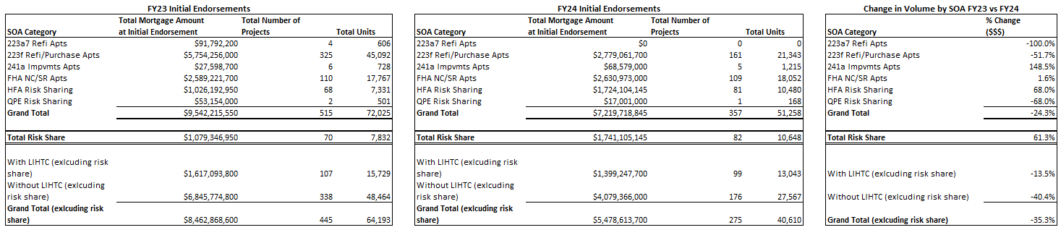
FHA Multifamily Production
Fiscal Year 2023 vs Fiscal Year 2024

Slide 3
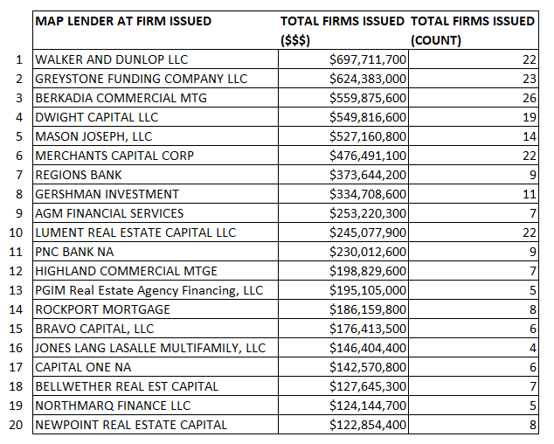
FY24 Firm Commitments by Lender (MAP Applications)

Slide 4
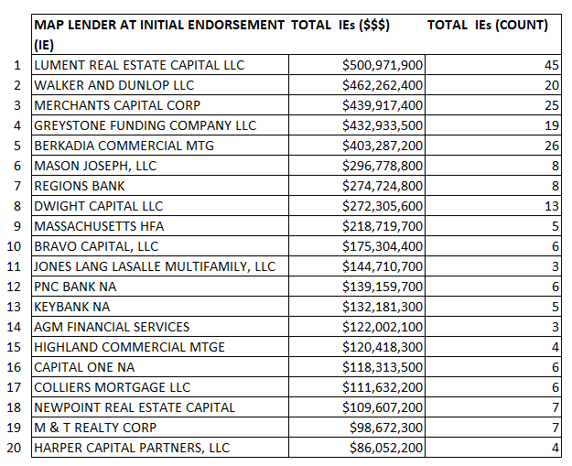
FY24 Initial Endorsements by Lender (MAP Applications)

Slide 5
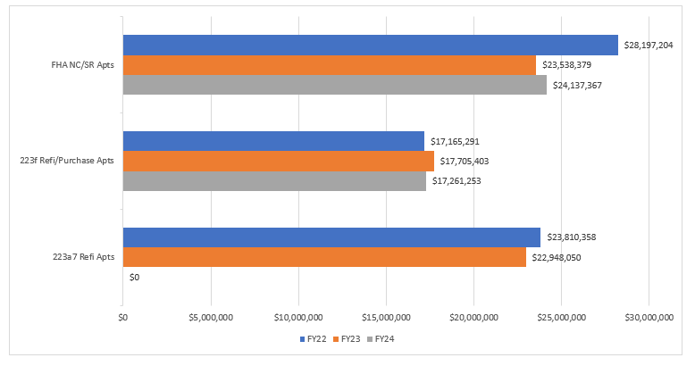
Average Loan Size at Initial Endorsement
FY22 – FY24

Slide 6
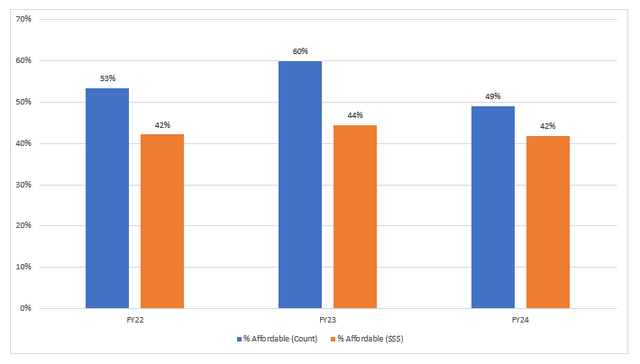
Percentage Affordable Firms Issued by Count and Volume FY22-FY24
(all MF Production SOAs including Risk Share)
*All projects that qualify for an Affordable or Broadly Affordable MIP rate based on the March 2016 Federal Register notice announcing changes to MIP rates are considered affordable for the purpose of this analysis.

