Slide 1
FHA Multifamily Production
Fiscal Year 2022 Summary
Source: DAP
Date of data run: 10/11/2022

Slide 2
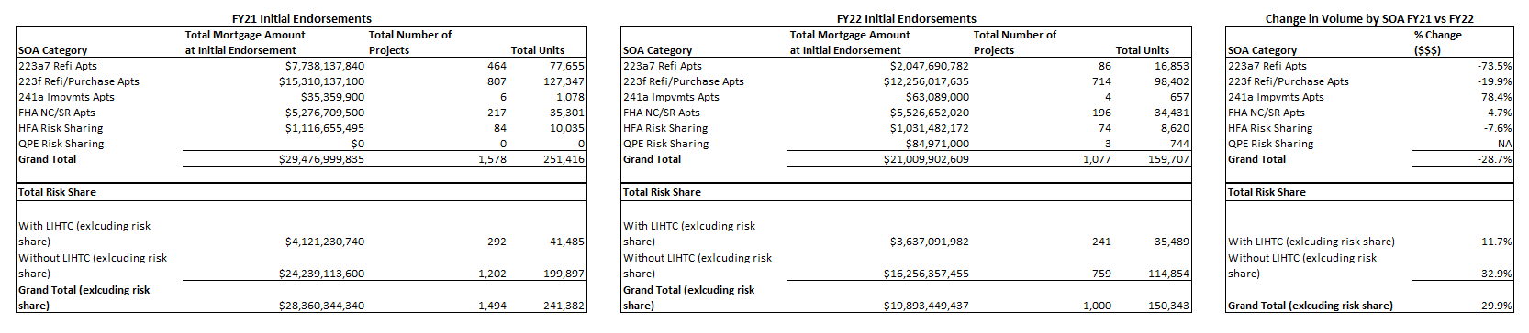
FHA Multifamily Production
Fiscal Year 2021 vs Fiscal Year 2022

Slide 3
FY22 Firm Commitments by Lender (MAP Applications)

Slide 4
FY22 Initial Endorsements by Lender (MAP Applications)

Slide 5
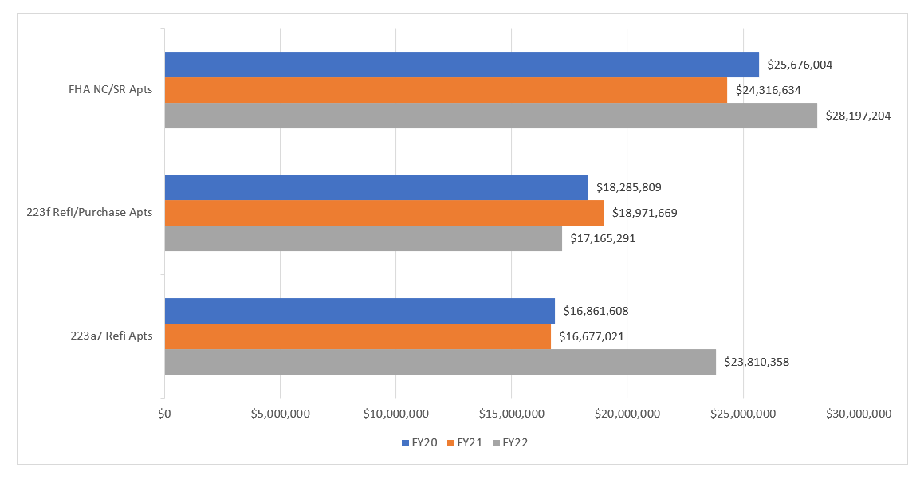
Average Loan Size at Initial Endorsement
FY20 – FY22

Slide 6
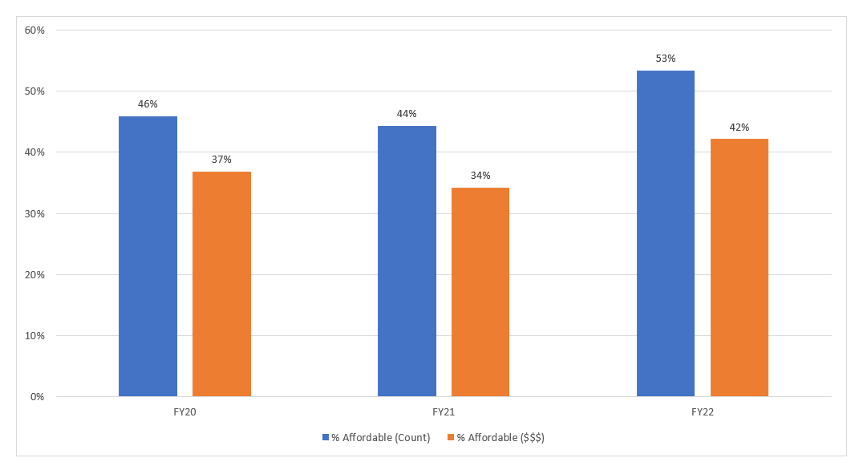
Percentage Affordable Firms Issued by Count and Volume FY20-FY22
(all MF Production SOAs including risk share)
*All projects that qualify for an Affordable or Broadly Affordable MIP rate based on the March 2016 Federal Register notice announcing changes to MIP rates are considered affordable for the purpose of this analysis.

