Slide 1

ONAP National Best Practice Webinar Featuring the Tlingit-Haida Regional Housing Authority
August 19, 2026

Slide 2
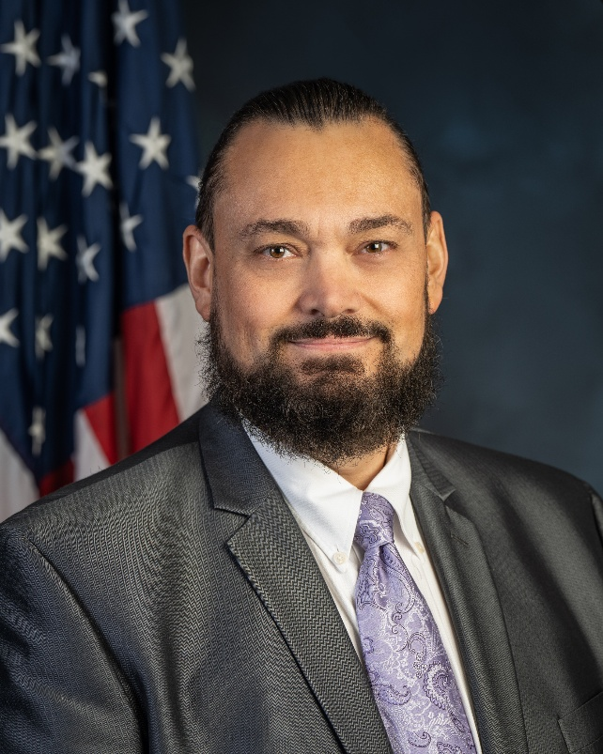
OFFICE OF NATIVE AMERICAN PROGRAMS (ONAP)
Brian Cook
Acting Associate Deputy Assistant Secretary
Office of Native American Programs
Department of Housing and Urban Development
www.hud.gov/codetalk | Email: Codetalk@hud.gov

Slide 3
Indian Community Development Block Grant - Imminent Threat (ICDBG-IT)
  Grants available to Tribes and Tribally Designated Housing Entities (TDHEs) to eliminate or lessen imminent threats to the public health or safety of tribal residents that exist due to natural disaster or other hazard.
    Applies to issues that if unresolved or not addressed will have an immediate negative impact on public health or safety.
    Applies to non-recurring, unique and unusual circumstance that impacts an entire service area.
    Applicants provide evidence that there are no alternate sources of funding to alleviate this threat.
    Wide range of eligible activities such as rehabilitation and reconstruction of homes damaged by a natural disaster or clearance of hazardous structures or debris. See 24 CFR Par 1003 Subpart C for a list of all eligible activities.
  For more information:
    https://www.hud.gov/helping-americans/public-indian-housing-grants-icdbg

Slide 4
ICDBG-IT Technical Assistance
Two Hours FREE ICDBG-IT technical assistance available (TA) to any interested eligible applicant
The available TA can help Tribes/TDHEs determine if proposed activities are eligible for funding and plan next steps.
To request TA, email ONAPICDBG-ITOn-Call@hud.gov and include the following information:
    Tribe/TDHE name
    Primary contact (name, phone number, email)
    Prior experience with the ICDBG-IT grant
    Brief description of activity type
    Specific questions to address

Slide 5
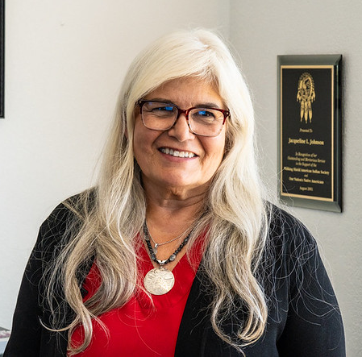
INTRODUCTION
TODAY’S FEATURED GUEST
Jacqueline Pata
Executive Director/CEO
Tlingit-Haida Regional Housing Authority
jpata@trnha.org

Slide 6
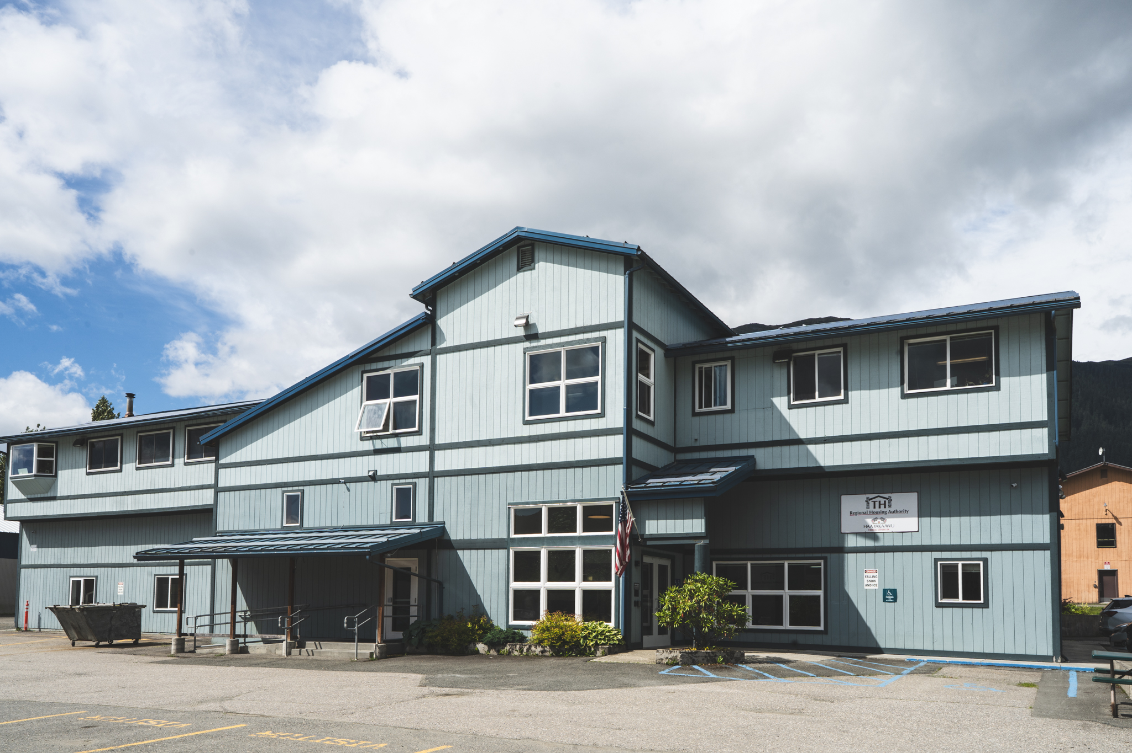
Tlingit-Haida Regional Housing Authority
In partnership with federal, state, Tribal and local governments, THRHA used ICDBG-IT funding to respond to the Mendenhall Glacial Outburst flood in Juneau, AK.

Slide 7

Mendenhall Glacier

Slide 8

Mendenhall River Valley

Slide 9

FIRST STEPS
  How did you hear about the ICDBG-IT program?
  Who did you reach out to at HUD?
  What was the process like?
  What are the first steps that you would recommend for a Tribe or TDHE responding to a similar crisis?

Slide 10
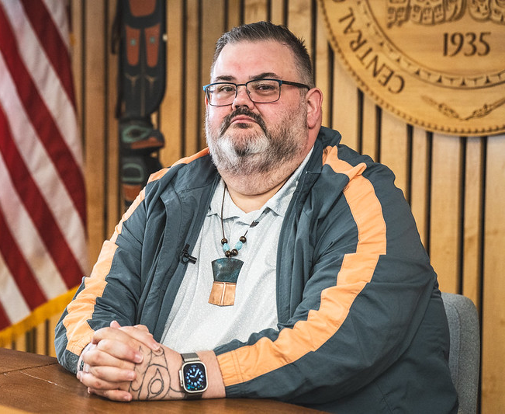


PARTNERSHIPS
Who are your partners in this project and how are they important to the success of the project?

Slide 11

FUNDING
How are ICDBG-IT funds being used in this project?
How are you combining funds related to THRHA on this project?
Are there other related activities that you are funding and how did you fund those?

Slide 12

What are Hesco barriers?

Slide 13

RESULTS
How has this project impacted your community?

Slide 14
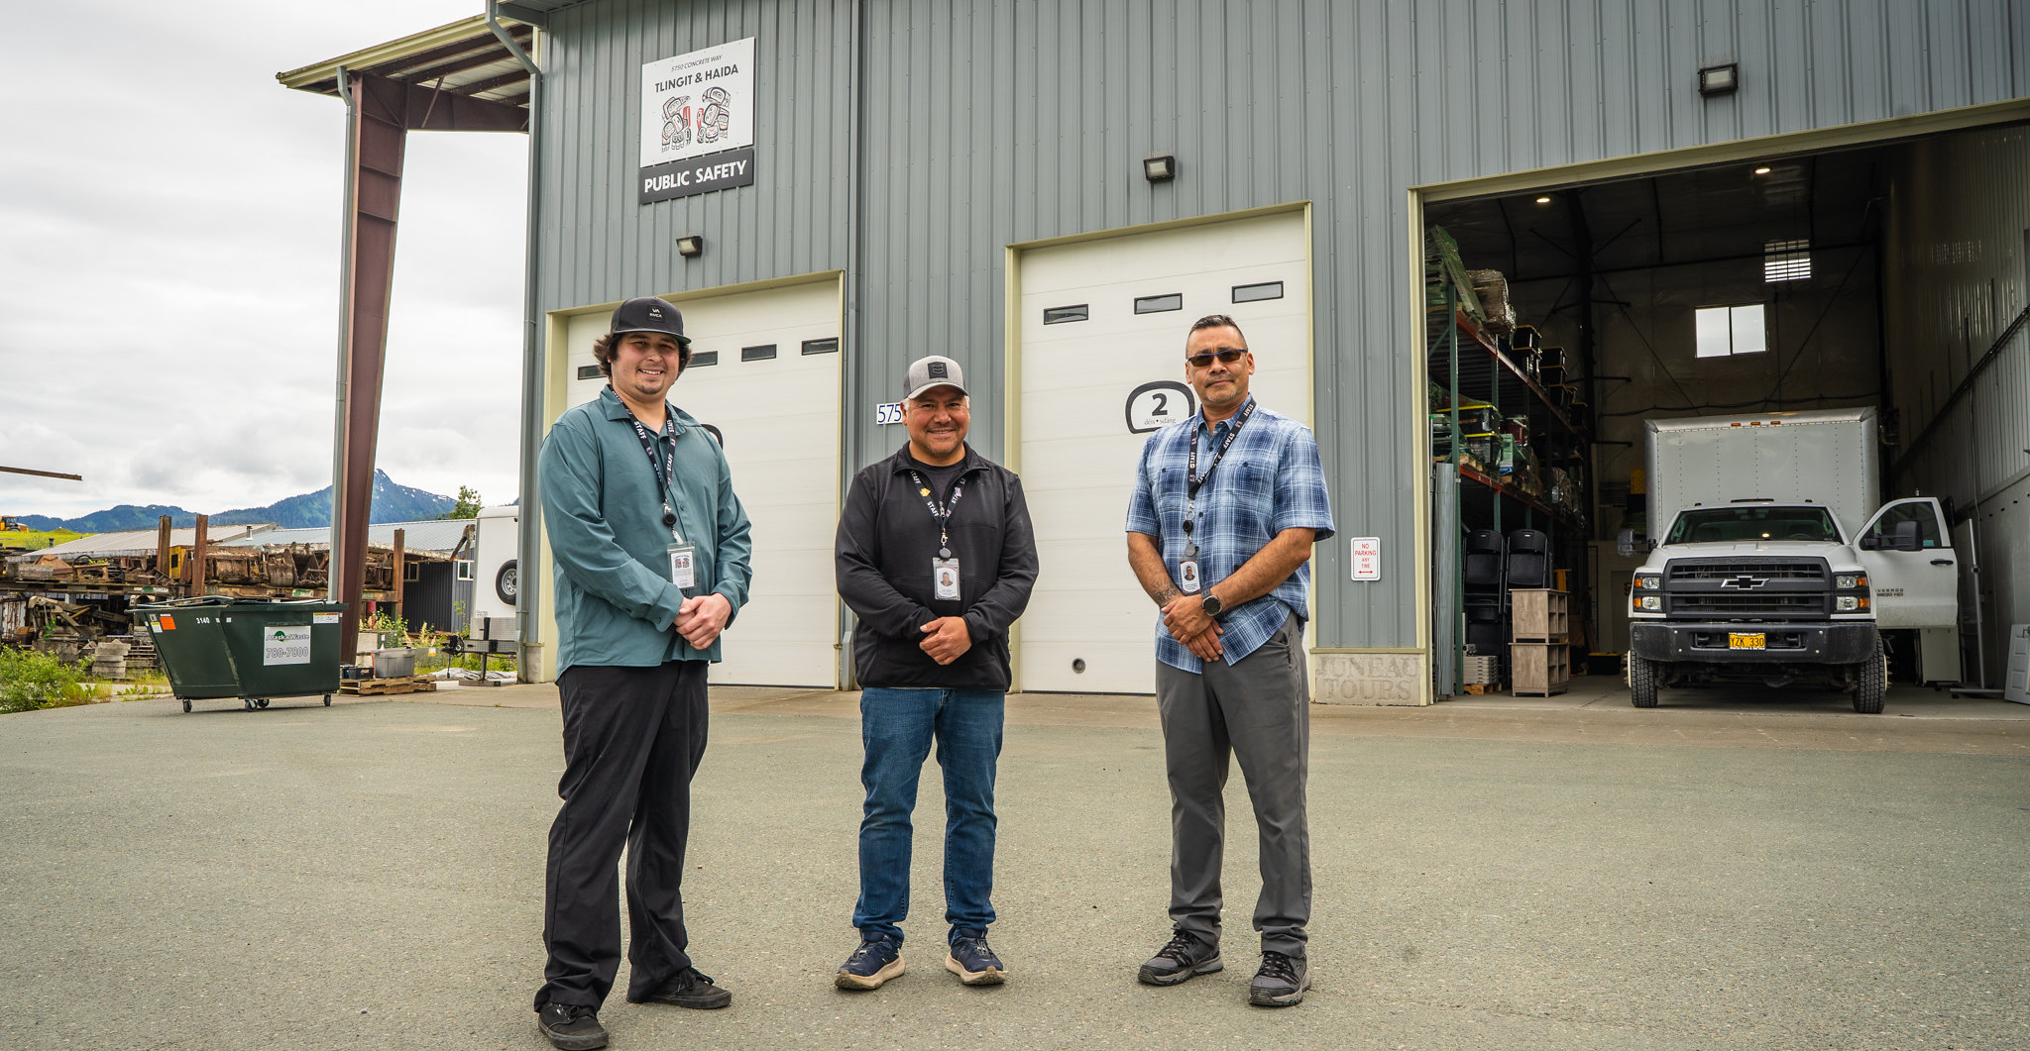
Lessons Learned

Slide 15

QUESTIONS?

Slide 16
Resources
https://www.hud.gov/helping-americans/public-indian-housing-grants-icdbg
On-call TA is available at no cost to Tribes/TDHEs. To request TA, email ONAPICDBG-ITOn-Call@hud.gov and include the following information:
  Tribe/TDHE name
  Primary contact (name, phone number, email)
  Prior experience with the ICDBG-IT grant
  Brief description of activity type
  Specific questions to address
ICDBG-IT Application Instructions: PIH_2025-09

Slide 17
Webinar transcript, presentation slides, and videos will be posted on the Office of Native American Programs homepage: www.hud.gov/codetalk
Email comments to: Codetalk@hud.gov
This material is based upon work supported by funding under an award with the U.S. Department of Housing and Urban Development. The substance and findings of the work are dedicated to the public. Neither the United States Government, nor any of its employees, makes any warranty, express or implied, or assumes any legal liability or responsibility for the accuracy, completeness or usefulness of any information, apparatus, product or process disclosed or represents that it use would not infringe privately-owned rights. Reference herein to any specific commercial product, process, or service by trade name, trademark, manufacturer, or otherwise does not necessarily constitute or imply its endorsement, recommendation, or favoring by the U.S. Government or any agency thereof. Opinions expressed in this document are those of the authors and do not necessarily reflect the official position of, or a position that is endorsed by, HUD or by any HUD program.
Notes:
Thank you & Wrap up.

