Slide 1
FHA Multifamily Production
Fiscal Year 2026 Summary
Source: PLUS
Date of data run: 10/16/2026

Slide 2
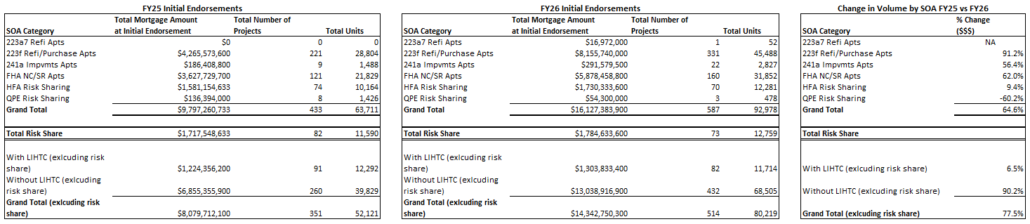
FHA Multifamily Production
Fiscal Year 2025 vs Fiscal Year 2026

Slide 3
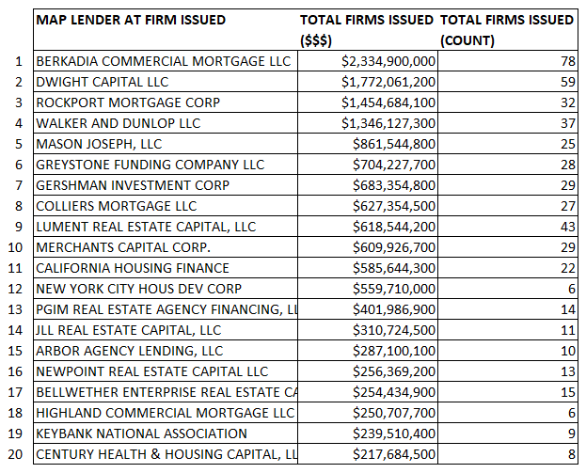
FY26 Firm Commitments by Lender (MAP Applications)

Slide 4
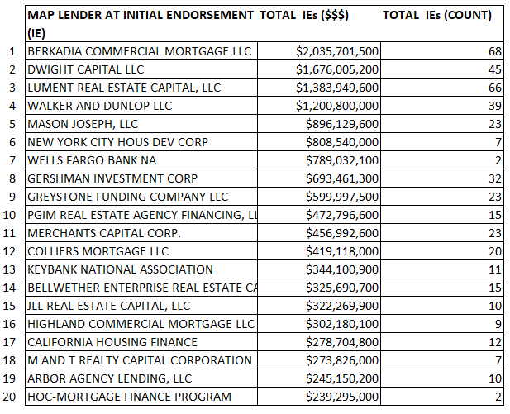
FY26 Initial Endorsements by Lender (MAP Applications)

Slide 5
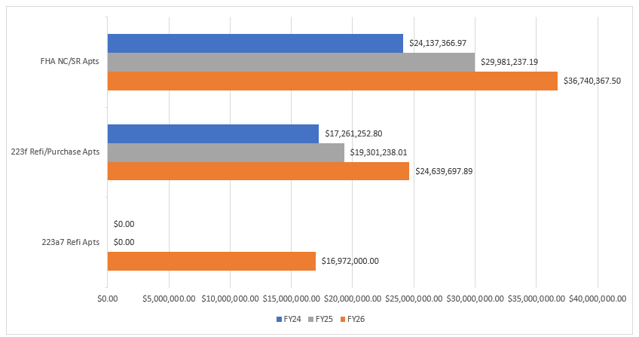
Average Loan Size at Initial Endorsement
FY24 – FY26

