Slide 1
ONAP Electronic Document Delivery (EDD) Lender Webinar June 29, 2020

Slide 2
Agenda
Introduction
Demo
Requesting access to ONAP EDD
Setting up your password
Important Notes
Q&A

Slide 3
Introduction
ONAP EDD is a web-based portal to connect DG Lenders/Servicers and ONAP with loan application documents.

Slide 4
Demo
Logging into the application
Opening the ONAP EDD Module
Viewing my dashboard of documents submitted
Uploading a new document
Viewing the document details
Withdrawing a document

Slide 5
Requesting Access
Complete the ‘Catalyst User Form’ found here:
https://www.hud.gov/program_offices/public_indian_housing/ih/homeownership/184/lenders
Email the completed form to
ONAP-OLGSystemsAccess@hud.gov

Slide 6
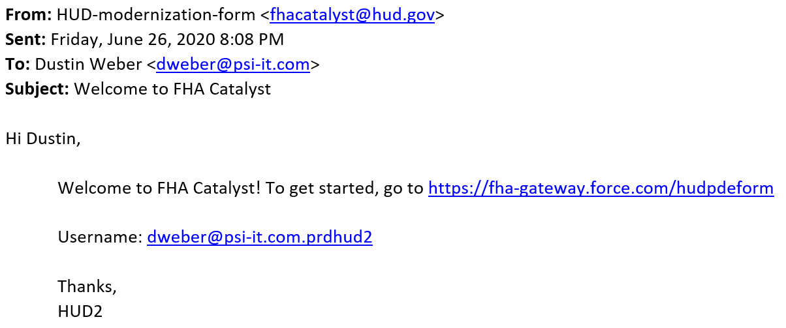
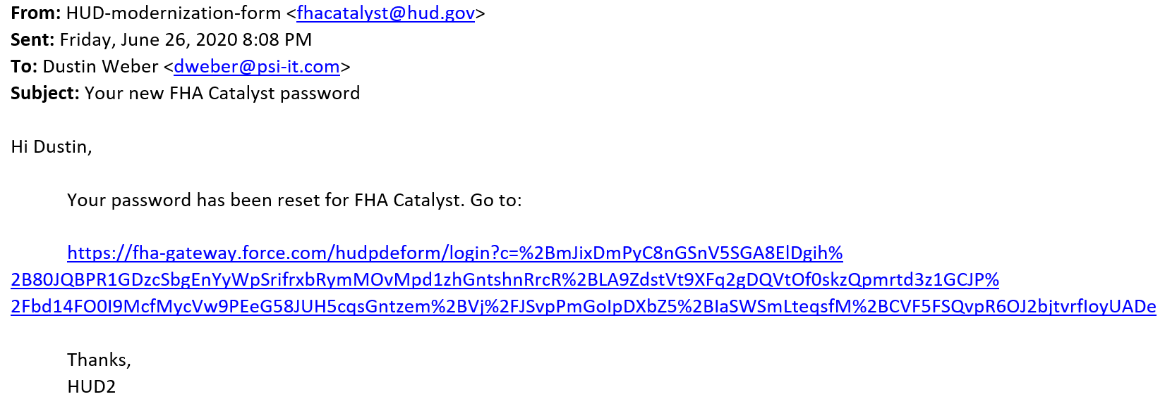
Setting up your Password
1
You will receive an automated email with your username and the URL to reset your password to access the application. Clicking the URL for the first time will prompt you to set up your password.
Once your password is successfully reset, you will receive an application to begin using the app.
2

Slide 7
Important Notes
Ensure your organization has whitelisted the application URL, so you are not blocked from using the site.
The Salesforce platform highly recommends using Google Chrome browser.
File upload/download times vary depending on individual network connection, computer, VPN connection, etc.
Expected document upload and download times are highlighted in the table below:
Session Timeout is set to 30 minutes.

Slide 8
Q&A

